Slide 1
Pain & Addiction: Common Threads Course XXIV
2023 ASAM Annual Conference | April 13, 2023

Slide 2
2023 Theme
Navigating Pain & Addiction Challenges Across Transitions of Care

Slide 3
Reminders
Please put cell phones and other mobile devices in silent mode.
Lunch will be an hour from 12:00 pm – 1:00pm. Lunches are available to attendees at no additional cost.
Instructions for claiming CME will be provided at the end of the course
Need assistance? Ask ASAM Staff at the Information Desk

Slide 4
Learning Objectives
Upon completion of this educational activity, participants should be able to:
Identify and describe the new developments affecting the science, policy, and clinical practice of addiction medicine.
Compare presented clinical guidelines/best practices with the participant's current practice and identify strengths or gaps.
Analyze new research and science to develop practical applications for treatment or further research.
Explain recent or upcoming policy changes and identify implications or areas for provider involvement.
Create a network of professionals or a set of resources that can be used to support the participant's practice

Slide 5
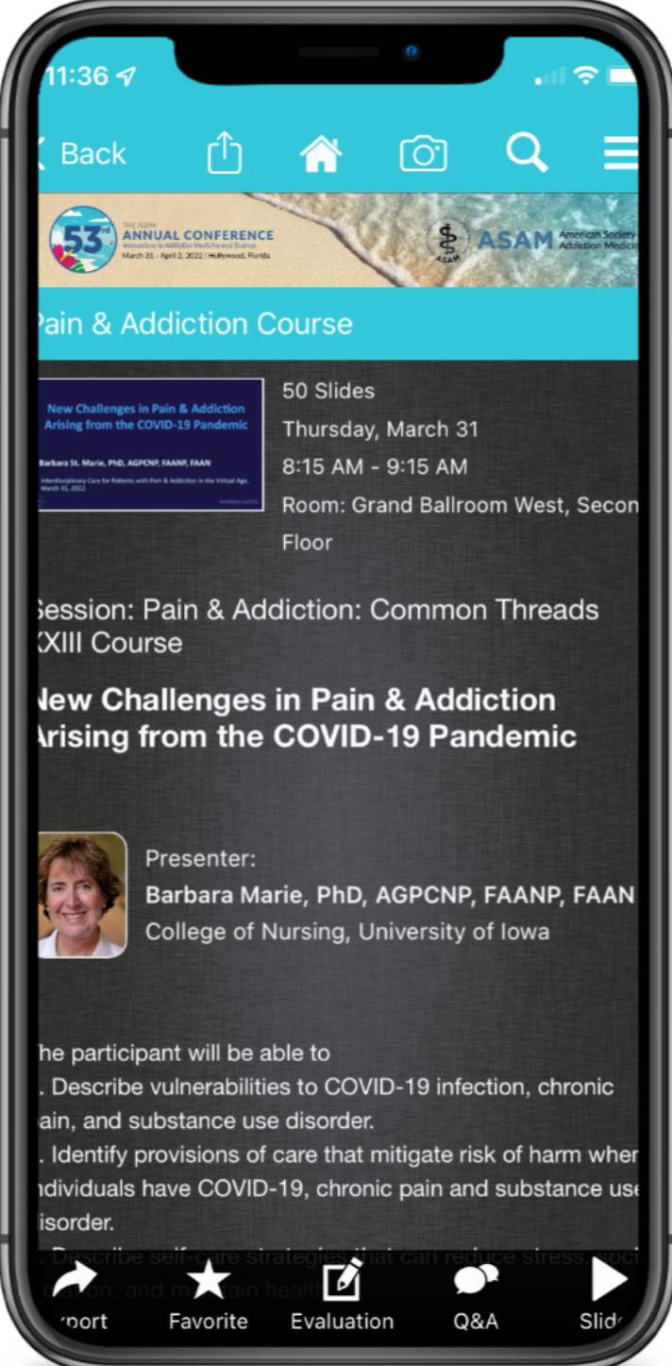
Audience Q&A
There will be time for audience Q&A during lunch and at the end of the day
Submit your questions using the Q&A feature in the ASAM Annual 2022 conference app
This is also where you can download slides, read bios, and complete session evaluations
Instructions to download the app can be found on pg 4 of the program and on the back of your badge

Slide 6
Thursday, April 13, 2023
8:00 am – 5:30 pm ET

Slide 7
Disclosure Information
Joseph Green
No Disclosures
Joseph Green is a professional storyteller, award-winning spoken word artist, educator, narrative disruptor, and person in sustained recovery. He advocates for and inspires those overcoming the disease of substance-use disorder through his keynote speeches and workshops. As Chief Executive Officer of LMSvoice, an educational consulting and production company, Joseph and his team create curriculum, innovative storytelling practices, and emotionally charged visual content to disrupt harmful narratives and restore humanity in all the spaces we occupy. A person in long-term recovery, Joseph will share his lived experience through a short story and spoken word poem. He hopes that you will be inspired and seek to find the motivation from your own story and the stories of those you serve.
Notes:
Disclosure slide option #1 for individual presenters. Select either option 1 or option 2, you don’t need to have both.

