Slide 1
Low Dose Buprenorphine Initiation Strategies
Melissa B. Weimer, DO, MCR, DFASAM
ASAM Annual Pre-Conference 2023
April 13, 2023, 2:40-3:10pm

Slide 2
Disclosure Information
Presenter 1: Melissa Weimer, DO, MCR, DFASAM
Presenter 3 Commercial Interests: Path CCM, Stock Options; CVS Health, Advisor
Notes:
Add disclosure information

Slide 3
Learning Objectives
Describe low dose buprenorphine initiation with opioid continuation and clinical indications for its use
Discuss the rationale and potential risks and benefits of novel buprenorphine initiation strategies.

Slide 4
Resources/Pre-reading
JAM Narrative Review and Practical Guide
1 Page Outpatient Guide
Shared Decision Making tool

Slide 5
A minute on terminology: “LOW-DOSE” vs “MICRO-DOSE”
Accuracy & connotation of terms are important, especially as we grow as a field
In pharmacology and translational science, “micro-dose” refers to non-medical use
Connotation with LSD use
We prefer “Low dose,” “ultra low dose,” or “Bernese method”
If you can’t shake “micro,” we recommend “micro-induction”
Weimer, Fiellin. Addiction, January 2022.

Slide 6
Background
In the United States Buprenorphine initiation guidance was codified in SAMHSA TIP #40 (c. 2004)
Since then, the scope of OUD has increased dramatically
Buprenorphine initiation much more widespread
Though still devastatingly limited
There is now renewed interest in variations on the traditional buprenorphine initiation plan

Slide 7
2023 vs 2000
Fentanyl and its analogues now ubiquitous
Stimulant co-use increasing common and as high as 90% in some populations
Additional synthetics such as xylazine are common in some regions.
Diverse population with OUD—rural, urban, race/ethnicity
Homeless and other social determinants substantially more common

Slide 8
Difficult situations
Transitioning from Methadone to Buprenorphine
Patients with severe acute pain and OUD
Non Rx fentanyl use
Previous unsuccessful attempts at buprenorphine initiation
Mannelli, Curr Drug Abuse Rev, 2012 Silverstein, Int J Drug Policy, 2019
Bissaga, Addiction, 2019 Antoine, Am J Addict, 2020
Varshneya, J Addict Med, 2021
Notes:
?deposition in fat of fentanyl due to lipophilicity with prolonged use
Silverstein, Int J Drug Policy, 2019
Qualitative study with experience of precipitated withdrawal long after withdrawal started from buprenorphine
Also report more prolonged withdrawal
Dayton OH
Bissaga, Addiction, 2019
Commentary stating that nonRx fentanyl users experience more precipitated withdrawal and more prolonged w/d
Mannelli, Curr Drug Abuse Rev, 2013
Review of Methadone to bupe and bupe to naltrexone transition
Found more withdrawal and recommended inpatient treatment for high dose transition
Varied how it was done
ASAM-rec low dose methadone 30-40mg and waiting 24-48hrs, COWS 11-12
SAMHSA-taper to 30-40 and remain on dose x 1 week. 24-36 hrs then start buprenorphine slowly
Antoine, Am J Addict, 2020
4 cases
2 of precipitated withdrawal with standard induction, 2 with new induction after higher COWS score and smaller doses

Slide 9
Buprenorphine: KEY characteristics
High Affinity
Partial Agonist
Volpe, Regul Toxicol Pharmacol 2011
SAMHSA, TIP 63, 2020
Notes:
K values
Oxycodone 25, methadone 3.3, fentanyl 1.346, HM .3654, bupe .2157
Why do these two properties cause withdrawal?

Slide 10
Precipitated opioid withdrawal
Partial opioid agonists can cause opioid withdrawal symptoms when introduced to full opioid agonists
Ghosh, CJA, 2019

Slide 11
“Classic” Buprenorphine Initiation
Stop full agonists
Wait for withdrawal
Give 1st dose and repeat in 1-2 hours
Uptitrate to effective dose over 1-3d
COWS > 8-12
2-4 mg buprenorphine each dose depending on tolerance
ASAM National Practice Guideline, 2020
SAMHSA, TIP 63, 2020
Notes:
Figure out better way to show this
SAMHSA and ASAM say COWS>12
Something about methadone transition and difficulty to bridge to next topic
Mention that there are advocates and support for faster transitions
California bridge starts with dose of 8mg and max dose day 1 16mg
Is there good data to support this?
Jacobs Am J Addict. 2015 with study of trajectories saying less likely to drop out
Application
Buprenorphine Home Induction in apple
Starting buprenorphine by Amston studios in google

Slide 12
Low dose buprenorphine with opioid continuation (LDB-OC)
Continue agonist & titrate up buprenorphine
with low doses
Administering small and gradually increasing doses of buprenorphine while continuing/overlapping a full agonist opioid over 2-7 days
Initial doses: typically <2mg buprenorphine
Many cases & case series (n ~ 250)
Various buprenorphine formulations used
Intravenous
Buccal film
Transdermal patches
SL film or tabs
Cohen, et al. Low Dose Initiation of Buprenorphine: A narrative Review and Practical Approach. Journal of Addiction Medicine, 2021.
Notes:
Add number of cases
Weimer JAM accepted
Button case series
Ghosh SR
Cohen review
Ahmed SR
Moe SR

Slide 13
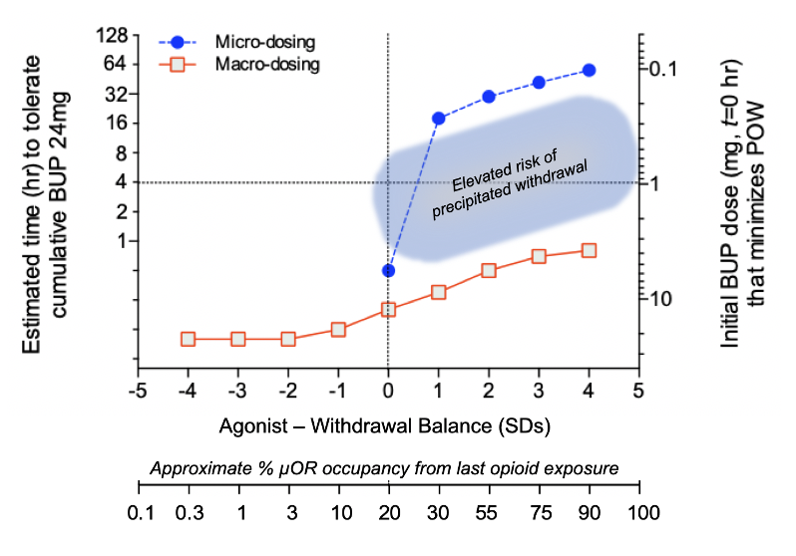
Dose predicted to have only small blockade effects with minimal displacement of agonist. The agonism is also minimal. If opioids are not continued, there will be withdrawal
Dose that is sufficient to to produce blockade but only generates a weak agonist signal
Dose that maximizes the agonist effects of buprenorphine. (no ceiling identified)
Low dose
Middle dose
High dose
Greenwald and Herring , et al. Annals of Emergency Medicine, 2022.
Notes:
Andrew
Clinical implications of the neuropharmacological model for buprenorphine (BUP) initiation dosing, based on macro- and micro-dosing literature (see Tables 1 and 2). The dual X-axes are identical to Figure 1. The right Y-axis estimates the initial BUP dose that is not likely to precipitate opioid withdrawal [POW]), relative to the pre-initiation opioid balance or µOR occupancy (dual X-axes). The left Y-axis estimates the time required for the patient to tolerate a cumulative 24 mg dose of sublingual BUP. The horizontal dashed line at 4 hr time to cumulative 24 mg (which is an arbitrary cutoff) reflects that BUP macro-dosing can be accomplished acutely in the ED setting.
Our model suggests that when there is residual agonist effect from the last opioid use (and absence of withdrawal), intermediate BUP starting doses will increase the risk of POW (shaded area). Whereas macro-dosing (>8 mg SL) or micro-dosing (<1mg SL) will be better tolerated with a reduced chance of POW. In contrast, with significant clinic withdrawal present (low µOR occupancy), macro-dosing can be routinely used with POW, and micro-dosing is both unnecessary and counter-productive.

Slide 14
Low Dose Initiation Theory
Buprenorphine causes
“re-sensitization” of the
opioid receptors
Low dose approach allows
Up-regulation of opioid
Receptors to prevent
opioid withdrawal
De Aquino. Clin Drug Investig, 2021
Notes:
Melissa
Whereas full opioid agonists consistently desensitize the MOR [58,59,60], BUP does not induce desensitization—likely due to its G-protein pathway bias, with less recruitment of beta-arrestin pathway [61, 62]. Further, in contrast to MOR agonists, BUP up-regulates the number of surface MOR—an effect similar to that induced by the opioid antagonist naloxone [62]. Following long-term treatment with full opioid agonists, MOR-coupled G proteins shift from the inhibitory Gi to stimulatory Gs type, contributing to development of hyperalgesia, tolerance, and dependence [63]. Interestingly, this shift can be prevented by co-administration of with BUP along with MOR agonists [62]. Furthermore, pre-treatment with BUP has been found to block the desensitization and internalization induced by full opioid agonists [61, 64]. Collectively, these data suggest that BUP may reverse some of the neuroadaptations induced by full opioid agonists—thereby leading to resensitization. Taken together, these hypothesized mechanisms may allow maintaining an adequate opioid tone with small doses of BUP, hence preventing precipitated withdrawal—even with the co-administration of therapeutic doses of full opioid agonists (Fig. 2).

Slide 15
Rationale for Low-Dose Initiation
A patient-centered approach that:
enables clinicians to start buprenorphine without waiting for withdrawal
allows patients to continue full-opioid agonists for pain
facilitates faster transitions from methadone
May reduce the risk of precipitated withdrawal from synthetic opioids with unpredictable clearance
De Aquino et al, Clin Drug Invest 2021
Huhn et al, Drug and Alc Depend 2020
Notes:
References 6-7

Slide 16
Principles of low dose buprenorphine initiation
Appropriate clinical
situation
Start low
Gradual uptitration
Continue the full
agonist
Clear and frequent
communication
Pause or slow if
withdrawal sx
Care coordination
is critical
Cohen, J Addict Med, 2021

Slide 17
Example Low Dose Initiation regimen
Day | Buprenorphine/naloxone Dose | Strip/tab Strength | Full Agonist Dose
1 | 0.5mg ($1/4$ strip) | 2mg | Continue
2 | 0.5mg BID$(1/4$ strip) | 2mg | Continue
3 | 1mg BID$(1/2$ strip) | 2mg | Continue
4 | 2mg BID | 2mg | Continue
5 | 4mg BID | 2mg | Continue
6 | 4mg TID | 2mg | Continue
7 | 8mg BID | 8mg | STOP

Slide 18
Case 1 – In hospital acute pain
24 year old woman with severe OUD admitted to the hospital with endocarditis now s/p tricuspid valve replacement. Interested in starting buprenorphine.
Currently on hydromorphone 8mg PO q3hr as needed for pain hydromorphone 2mg IV q6hrs for breakthrough as well as other adjunctive pain medication
Cannot stop opioids in post-op setting for traditional initiation

Slide 19
Questions to consider
Is her pain controlled?
Are there non-opioid treatments you can add to her pain regimen?
Does she have further surgeries?
What full agonist opioid dose will keep her comfortable during the transition?
When will she be discharging?

Slide 20
Buprenorphine Dosing Plan - SL
Day | Buprenorphine-naloxone Dose | Tab | Full Opioid Agonist Dose
1 | 0.5 mg daily | Quarter of 2 mg tab/film | Hydromorphone 8mg Q3H scheduled
2 | 0.5 mg BID | Half of 2 mg tab/film | Hydromorphone 8mg Q3H scheduled
3 | 1 mg BID | Full 2 mg tab/film | Hydromorphone 8mg Q3H scheduled
4 | 2 mg BID | Two 2 mg tabs/film | Hydromorphone 8mg Q3H scheduled
5 | 4 mg BID* | Half of 8 mg tab/film | Hydromorphone 8mg Q3H scheduled
7 | 8 mg BID | Full 8 mg film | Stop
8 | 8mg TID | Full 8mg film | *can restart/continue some opioid if needed
Supportive Medications (ondansetron, loperamide, hydroxyzine, tizanidine, clonidine, dicyclomine)
*Can repeat days if patient develops withdrawal, achiness

Slide 21
Question
Your hospital pharmacy says you can’t split films/tab in the hospital?
What other buprenorphine formulations can you use?

Slide 22
Buprenorphine Dosing Plan – Buccal
Day | Buprenorphine Dose | Buccal Buprenorphine | Full Opioid Agonist Dose
1 |  | 225mcg once daily | Same
2 |  | 225mcg BID | Same
3 |  | 450mcg BID | Same
4 | 2 mg BID |  | Same
5 | 4 mg BID |  | Same
6 | 4 mg TID |  | Same
7 | 8 mg BID |  | Off

Slide 23
Question
Can this be done as an outpatient?

Slide 24
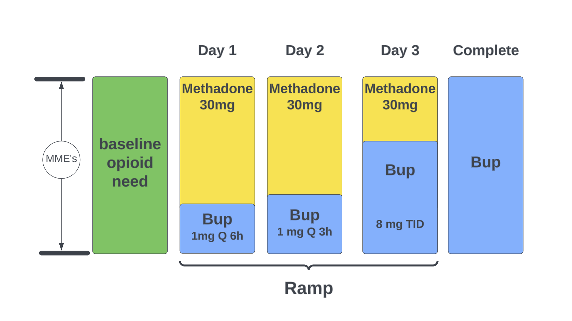
Option – LDB-OC using DEA exemption
Slide courtesy Andrew Herring, MD

Slide 25
Outpatient LDB initiation pearls for practice
Shared decision making with patient, clear information
Do not taper down, or withdrawal will ensue, irrespective of buprenorphine
This includes any full agonist opioid
*Clear and frequent communication with patient
Provide them with handout for reference, daily call
Reminder: do not taper down the full agonist
Help with cutting buprenorphine strips/bubble packs if possible
Problem solve with them
Provide comfort meds prn
Harm reduction
Cheerlead!
*Pause or slow if withdrawal symptoms, or challenges
Provide a bubble pack if possible
Ensure ongoing access to full agonist opioid and continue as long as needed
If they do not have ongoing opioid, do not employ LDP

Slide 26
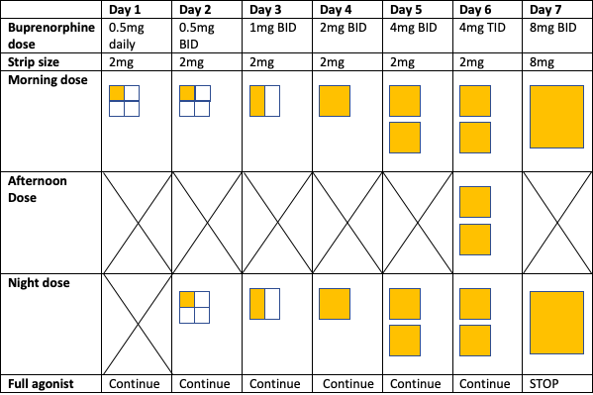
Dosing Guide
1 page
guide

Slide 27
Case 2 - methadone
45 year old man with severe OUD in sustained remission on methadone 100mg presents to your clinic to discuss transition to buprenorphine
Had success with buprenorphine >10 years ago but transitioned to methadone after a period of returning to opioid use
Worried about developing cravings and withdrawal if he has to taper methadone
Interested in low dose initiation
Question 1: What would you do with the methadone dose throughout the low dose initiation process?
Question 2: What would you do if he develops withdrawal symptoms during the transition?
Question 3: How would you coordinate with the OTP? What might cause the OTP to stop methadone during the low dose transition?

Slide 28
Traditional Methadone-> buprenorphine transition
High risk for precipitated withdrawal unless down-titrated to 30-50mg
Down-titration → risk of return to opioid use
SAMHSA TIP 63
Lintzeris, J Addict Med, 2018

Slide 29
Buprenorphine Dosing Plan - SL
Day | Buprenorphine-naloxone Dose | Tab | Full Opioid Agonist Dose
1 | 0.5 mg daily | Quarter of 2 mg tab/film | Methadone 100mg daily
2 | 0.5 mg BID | Half of 2 mg tab/film | Methadone 100mg daily
3 | 1 mg BID | Full 2 mg tab/film | Methadone 100mg daily
4 | 2 mg BID | Two 2 mg tabs/film | Methadone 100mg daily
5 | 4 mg BID* | Half of 8 mg tab/film | Methadone 100mg daily
7 | 8 mg BID | Full 8 mg film | Stop
8 | 8mg TID | Full 8mg film
Supportive Medications (ondansetron, loperamide, hydroxyzine, tizanidine, clonidine, dicyclomine)
*Can repeat days if patient develops withdrawal, achiness

Slide 30
Final Takeaways/Summary
Terminology and language is important in our field
Low dose buprenorphine initiation with opioid continuation is an important new strategy in certain clinical situations
Low dose buprenorphine initiation with opioid continuation should utilize several guiding principles and may be different in different clinical settings
Shared decision making with patients is an important component of a successful initiation
Notes:
Take this time at the end of your presentation to review key takeaways and information that audiences should remember in the future. If practical, apply this to clinical practice.

Slide 31
References
Cohen SM, Weimer MB, Levander XA, Peckham AM, Tetrault JM, Morford KL. Low Dose Initiation of Buprenorphine: A Narrative Review and Practical Approach [published online ahead of print, 2021 Dec 23]. J Addict Med. 2021;10.1097/ADM.0000000000000945. doi:10.1097/ADM.0000000000000945
Volpe DA, McMahon Tobin GA, Mellon RD, et al. Uniform assessment and ranking of opioid μ receptor binding constants for selected opioid drugs. Regul Toxicol Pharmacol. 2011;59(3):385-390. doi:10.1016/j.yrtph.2010.12.007
Substance Abuse and Mental Health Services Administration. Medications for Opioid Use Disorder. Treatment Improvement Protocol (TIP) Series 63 Publication No. PEP21-02-01-002. Rockville, MD: Substance Abuse and Mental Health Services Administration, 2021. Ghosh SM, Klaire S, Tanguay R, Manek M, Azar P. A Review of Novel Methods To Support The Transition From Methadone and Other Full Agonist Opioids To Buprenorphine/Naloxone Sublingual In Both Community and Acute Care Settings. Canadian Journal of Addiction. 2019;10(4):41-50.
Crotty K, Freedman KI, Kampman KM. Executive Summary of the Focused Update of the ASAM National Practice Guideline for the Treatment of Opioid Use Disorder [published correction appears in J Addict Med. 2020 May/Jun;14(3):267]. J Addict Med. 2020;14(2):99-112. doi:10.1097/ADM.0000000000000635
Mannelli P, Peindl KS, Lee T, Bhatia KS, Wu LT. Buprenorphine-mediated transition from opioid agonist to antagonist treatment: state of the art and new perspectives. Curr Drug Abuse Rev. 2012;5(1):52-63. doi:10.2174/1874473711205010052
Silverstein SM, Daniulaityte R, Martins SS, Miller SC, Carlson RG. "Everything is not right anymore": Buprenorphine experiences in an era of illicit fentanyl. Int J Drug Policy. 2019;74:76-83.
Bisaga A. What should clinicians do as fentanyl replaces heroin? Addiction. 2019;114(5):782-783.
Antoine D, Huhn AS, Strain EC, et al. Method for Successfully Inducting Individuals Who Use Illicit Fentanyl Onto Buprenorphine/Naloxone. Am J Addict. 2020.
De Aquino JP, Parida S, Sofuoglu M. The Pharmacology of Buprenorphine Microinduction for Opioid Use Disorder. Clin Drug Investig. 2021;41(5):425-436. doi:10.1007/s40261-021-01032-7
Huhn AS, Hobelmann JG, Oyler GA, Strain EC. Protracted renal clearance of fentanyl in persons with opioid use disorder. Drug Alcohol Depend. 2020;214:108147. doi:10.1016/j.drugalcdep.2020.108147
Notes:
Type each reference as a bullet using the information provided on this slide. ASAM uses the AMA Manual Format. Examples are provided below in this slide.
AMA Format Basics
Cited works are numbered in order of initial appearance in the presentation at the bottom of each slide, and appear in the Reference List on this slide in numerical order.
Use arabic superscript numerals outside periods and commas, and inside colons and semicolons.
Authors’ names are inverted, and use only initials for first and middle names. No periods between initials.
In article titles only the first word and proper nouns and abbreviations that are ordinarily capitalized are capitalized.
Use accepted Index Medicus abbreviations of journal names (see the List of Journals Indexed in Index Medicus).
For journals use issue numbers in parentheses after the volume number. If there is no issue number specify month before the year.
In-Text Examples: Diabetes mellitus is associated with a high risk of foot ulcers.¹⁻³ Several interventions have been successful at increasing compliance.^{11,14-16} The data of Smith et al¹⁸ is further evidence of this effect. As reported previously,^{1,3-6} The results were as follows⁴:
Journal article (1-6 authors):
1. Hu P, Reuben DB. Effects of managed care on the length of time that elderly patients spend with physicians during ambulatory visits. Med Care. 2002;40(7):606-613.
Journal article with more than six authors:
2. Geller AC, Venna S, Prout M, et al. Should the skin cancer examination be taught in medical school? Arch Dermatol. 2002;138(9):1201-1203.
Journal article with no named author or group name:
3.Centers for Disease Control and Prevention (CDC). Licensure of a meningococcal conjugate vaccine (Menveo) and guidance for use--Advisory Committee on Immunization Practices (ACIP), 2010. MMWR Morb Mortal Wkly Rep. 2010;59(9):273.
Electronic Journal article: (DOI and non-DOI)
4. Gage BF, Fihn SD, White RH. Management and dosing of warfarin therapy. The American Journal of Medicine. 2000;109(6):481-488. doi:10.1016/S0002-9343(00)00545-3.
Entire Book:
6. McKenzie BC. Medicine and the Internet: Introducing Online Resources and Terminology. 2nd ed. New York, NY: Oxford University Press; 1997.
Book Chapter:
7. Guyton JL, Crockarell JR. Fractures of acetabulum and pelvis. In: Canale ST, ed.Campbell's Operative Orthopaedics. 10th ed. Philadelphia, PA: Mosby, Inc; 2003:2939-2984.
Electronic Book:
8. Rudolph CD, Rudolph AM. Rudolph's Pediatrics. 21st ed. New York, NY: McGraw-Hill Companies; 2002. http://online.statref.com/Document/Document.aspx?DocID=1&StartDoc=1&EndDoc=1882&FxID=13&offset=7&SessionId=A3F279FQVVFXFSXQ . Accessed August 22, 2007.
Internet Document:
9. American Cancer Society. Cancer Facts & Figures 2003. http://www.cancer.org/downloads/STT/CAFF2003PWSecured.pdf. Accessed March 3, 2003.

Slide 32
References
Varshneya NB, Thakrar AP, Hobelmann JG, Dunn KE, Huhn AS. Evidence of Buprenorphine-precipitated Withdrawal in Persons Who Use Fentanyl [published online ahead of print, 2021 Nov 23]. J Addict Med. 2021;10.1097/ADM.0000000000000922. doi:10.1097/ADM.0000000000000922
Chan CA, Canver B, McNeil R, Sue KL. Harm Reduction in Health Care Settings. Med Clin North Am. 2022;106(1):201-217. doi:10.1016/j.mcna.2021.09.002
Accurso AJ. Blister-Packing of 2 mg Buprenorphine Monoproduct as a Patient-Centered Method of Microdosing for Buprenorphine Induction. Clin Drug Investig. 2021.
Lintzeris N, Monds LA, Rivas C, et al. Transferring Patients From Methadone to Buprenorphine: The Feasibility and Evaluation of Practice Guidelines. J Addict Med. 2018;12(3):234-240. doi:10.1097/ADM.0000000000000396
Thakrar AP, Jablonski L, Ratner J, Rastegar DA. Micro-dosing Intravenous Buprenorphine to Rapidly Transition From Full Opioid Agonists [published online ahead of print, 2021 Mar 19]. J Addict Med. 2021;10.1097/
Terasaki D, Smith C, Calcaterra SL. Transitioning Hospitalized Patients with Opioid Use Disorder from Methadone to Buprenorphine without a Period of Opioid Abstinence Using a Microdosing Protocol. Pharmacotherapy. 2019;39(10):1023-1029.
Weimer MB, Guerra M, Morrow G, Adams K. Hospital-based Buprenorphine Micro-dose Initiation. J Addict Med. 2021;15(3):255-257. doi:10.1097/ADM.0000000000000745
Ghosh SM, Klaire S, Tanguay R, Manek M, Azar P. A Review of Novel Methods To Support The Transition From Methadone and Other Full Agonist Opioids To Buprenorphine/Naloxone Sublingual In Both Community and Acute Care Settings. Canadian Journal of Addiction. 2019;10(4):41-50.
Hickey T, Abelleira A, Acampora G, et al. Perioperative Buprenorphine Management: A Multidisciplinary Approach. Med Clin North Am. 2022;106(1):169-185. doi:10.1016/j.mcna.2021.09.001
Klaire S, Zivanovic R, Barbic SP, Sandhu R, Mathew N, Azar P. Rapid micro-induction of buprenorphine/naloxone for opioid use disorder in an inpatient setting: A case series. Am J Addict. 2019;28(4):262-265.

Slide 33
Buprenorphine Dosing Plan - Patch
Day | Buprenorphine Dose | Full Opioid Agonist Dose
1 | 20 mcg patch | Same
2 | 1 mg SL BID | Same
3 | 2 mg SL BID | Same
4 | 4 mg SL BID | Same
5 | 6 mg SL BID | Same
6 | 8 mg SL BID | OFF
Supportive Medications (ondansetron, loperamide, hydroxyzine, tizanidine, clonidine, dicyclomine)
Button D, Hartley J, Robbins J, Levander XA, Smith NJ, Englander H. Low-dose Buprenorphine Initiation in Hospitalized Adults With Opioid Use Disorder: A Retrospective Cohort Analysis. J Addict Med. 2021.

Slide 34
Buprenorphine Dosing Plan - IV
Day | Buprenorphine | Full Opioid Agonist Dose
1 | 0.15 mg IV q6h x2 doses | Same
1 | 0.3 mg IV q6h x2 doses
2 | 0.6 mg IV q6h x2 doses | Same
2 | 4 mg SL q6h x2 doses
3 | 8 mg SL q6h x2 doses | OFF
Supportive Medications (ondansetron, loperamide, hydroxyzine, tizanidine, clonidine, dicyclomine)

