Slide 1
Inpatient & Perioperative Pain Management for Patients with Opioid Use Disorder
Melissa B. Weimer, DO, MCR, DFASAM
Pain & Addiction: Common Threads Course XXIV
April 13, 2023, 8:55-9:25am

Slide 2
Disclosure Information
Presenter 1: Melissa Weimer, DO, MCR, DFASAM
Commercial Interests: Path CCM, Stock Options; CVS Health, Advisor
Notes:
Add disclosure information

Slide 3
Learning Objectives
Understand principles that complicate acute pain treatment in individuals with opioid use disorder
List multimodal pain treatment options for patients with opioid use disorder and acute pain
Understand how to approach pain treatment in individuals who are prescribed medication treatment for opioid use disorder

Slide 4
Patient Perspective
Patients describe avoiding medical care due to:
Fear of mistreatment
Fear of being judged or labeled
Fear of withdrawal
Fear of untreated pain
Velez, C, Nicolaidis C, Korthuis PT, et al.

Slide 5
Case 1
35 year old man is hospitalized for pneumonia and also has acute low back pain
He has a history of OUD and is engaged in durable methadone treatment at a dose of 80mg
He would like to avoid opioids and requests the most effective non-opioid treatment

Slide 7
Non-medication approaches to acute pain treatment
Heat/ice
Acupuncture, Acupressure*
Mindfulness
Binding or bracing
Balneotherapy (aka bath)
Transcutaneous electrical nerve stimulation
Chiropractic treatment
Osteopathic manipulation
Massage therapy
Physical therapy
Yoga
*associated with moderate to large decrease in pain intensity vs sham,
low strength of evidence
Chou, et al. AHRQ publication, December 2020
Notes:
Chou R, Wagner J, Ahmed AY, Blazina I, Brodt E, Buckley DI, Cheney TP, Choo E, Dana T, Gordon D, Khandelwal S, Kantner S, McDonagh MS, Sedgley C, Skelly AC. Treatments for Acute Pain: A Systematic Review. Comparative Effectiveness Review No. 240. (Prepared by the Pacific Northwest Evidence-based Practice Center under Contract No. 290-2015-00009-I.) AHRQ Publication No. 20(21)-EHC006. Rockville, MD: Agency for Healthcare Research and Quality; December 2020. DOI: 10.23970/AHRQEPCCER240 . Posted final reports are located on the Effective Health Care Program search page

Slide 8
Acute pain treatment options – ambulatory setting
NSAIDs
Steroids
Acetaminophen
Muscle relaxer
Anticonvulsants
Immediate release opioids
For musculoskeletal pain (excluding back pain),
NSAIDs and acetaminophen have similar efficacy
Insufficient evidence comparing opioids to NSAIDs
Chou, et al. AHRQ Publication, 2020
Notes:
Chou R, Wagner J, Ahmed AY, Blazina I, Brodt E, Buckley DI, Cheney TP, Choo E, Dana T, Gordon D, Khandelwal S, Kantner S, McDonagh MS, Sedgley C, Skelly AC. Treatments for Acute Pain: A Systematic Review. Comparative Effectiveness Review No. 240. (Prepared by the Pacific Northwest Evidence-based Practice Center under Contract No. 290-2015-00009-I.) AHRQ Publication No. 20(21)-EHC006. Rockville, MD: Agency for Healthcare Research and Quality; December 2020. DOI: 10.23970/AHRQEPCCER240 . Posted final reports are located on the Effective Health Care Program search page

Slide 10
Case 2
34 year old female with severe opioid use disorder (uses approx. 1g of IV opioids per day) admitted 24 hours ago for a large abscess on her forearm who is complaining of severe pain and anxiety.
Exam shows tachycardia, hypertension, diaphoresis, and anxiety. She is rubbing her joints and rocking back and forth.
Pt is requesting IV opioids.
Expected discharge in 48 hours.

Slide 11
General Principles
Opioid withdrawal worsens other painful conditions
Treating opioid withdrawal symptoms can improve pain management
Giving opioids will not worsen a patient’s substance use disorder
Patients who use heroin/fentanyl are highly tolerant to opioids
Important to determine if the patient is currently receiving medication treatment (methadone, buprenorphine or ER naltrexone)

Slide 12
General Approach
Urine Drug Test (including fentanyl)
Treat the opioid “debt”
Adjuvant treatments
Offer Buprenorphine or Methadone
Use known effective pain treatments
NSAIDs, acetaminophen, full agonist opioids
Recognize that you may need to prescribe higher doses of opioids

Slide 13
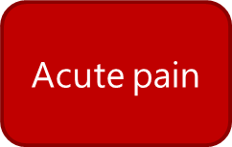
Opioid Debt + Pain
Acute pain
Baseline Opioid Tolerance
Opioid Debt
Methadone
or Buprenorphine
&
Full Agonist Opioids
Insufficient opioids

Slide 14
Options for Treatment
Option 1
#1 – Address opioid withdrawal – methadone
#2 – Treat pain - Ketorolac, acetaminophen, oxycodone 10-15mg every 4 hrs PRN pain, Ice, Heat
Option 2
#1 – Address opioid withdrawal – buprenorphine
#2 – Treat pain – Ketorolac, acetaminophen, hydromorphone 4-6mg every 4 hrs PRN pain, ice, heat
Option 3
#1 – Address opioid withdrawal – scheduled short acting opioids
(relatively high dose, ex. Oxycodone IR 20-30mg every 3 hrs scheduled)
#2 – Treat pain – Ketorolac, acetaminophen, ice, heat

Slide 15
Case 2: Continued
Patient chooses to start methadone and stabilizes on multimodal treatment with NSAID, acetaminophen, and PRN hydromorphone
Patient goes on to develop severe sepsis from aortic valve endocarditis
Ends up needing an emergent aortic valve replacement
Complains of severe post op-pain

Slide 16
Pre-op and Post-op Pain Options
Discuss the case with anesthesia pre-op
Ask for a nerve block, if possible
Continue methadone – consider BID or TID dosing
Consider post-operative treatments like
Increased full agonist opioids, use oral & Intravenous (IV)
Patient Controlled Analgesia
Ketamine IV
Gabapentin
Scheduled acetaminophen and/or NSAID

Slide 17
Medications to avoid for acute pain
Benzodiazepines
Carisoprodol
Tramadol (aka “Tramadon’t”)
Extended release opioids

Slide 18
Acute pain treatment options – inpatient setting
NSAIDs
Steroids
Acetaminophen
Muscle Relaxer
Anticonvulsants
Opioids, intermittent IV vs PCA vs oral
Ketamine
Nerve block
Notes:
Chou R, Wagner J, Ahmed AY, Blazina I, Brodt E, Buckley DI, Cheney TP, Choo E, Dana T, Gordon D, Khandelwal S, Kantner S, McDonagh MS, Sedgley C, Skelly AC. Treatments for Acute Pain: A Systematic Review. Comparative Effectiveness Review No. 240. (Prepared by the Pacific Northwest Evidence-based Practice Center under Contract No. 290-2015-00009-I.) AHRQ Publication No. 20(21)-EHC006. Rockville, MD: Agency for Healthcare Research and Quality; December 2020. DOI: 10.23970/AHRQEPCCER240 . Posted final reports are located on the Effective Health Care Program search page

Slide 19
Opioid Reward Considerations
Routes of Administration
IV administration
IM/SC administration
Oral administration
CNS side effects
(Reward, sedation, etc)
Plasma Concentration
Analgesia
Pain
0
Time

Slide 20
Opioid Reward Considerations
Schedules of Administration
Intermittent Bolus Administration
Long-acting, CR meds
Patient controlled analgesia (PCA)
CNS side effects (Reward, sedation, etc)
Plasma Concentration
Analgesia
-Pain
-Withdrawal if opioid dependent
Time

Slide 22
Case Resolution
The patient does well on a combination of
Methadone 40mg BID
Scheduled acetaminophen
Scheduled NSAID
Ketamine infusion in the immediate post operative period
Hydromorphone IV 2-4mg every 3-4 hours x 48-72 hours
Hydromorphone PO 8mg every 3 hours scheduled, then transitioned to PRN, eventually fully tapered off
Gabapentin 600mg TID
Hydroxyzine PRN

Slide 23
Case 3
27 yo man with opioid use disorder and sarcoma of the left thigh. He will be undergoing resection of the tumor in the next week.
He has been taking buprenorphine/naloxone 8/2mg BID for 6 months and is afraid to go off of it.
Should his buprenorphine be continued?

Slide 24
Buprenorphine Continuation
Evidence supports
Buprenorphine alone can provide adequate analgesia for some procedures
Buprenorphine can be used simultaneously with full agonist opioids for adequate analgesia
Reduces total full agonist use and shortens hospital length of stay
Hickey, et al. MCNA, 2022
Quaye AN, Zhang Y. Pain Med 2019.

Slide 25
Pain Regimen
Pre-op gabapentin 600mg TID
Acetaminophen 650mg QID
Change buprenorphine to 4mg QID or continue 8mg BID
Epidural for surgery
Hydromorphone and fentanyl in the immediate post-operative period

Slide 26
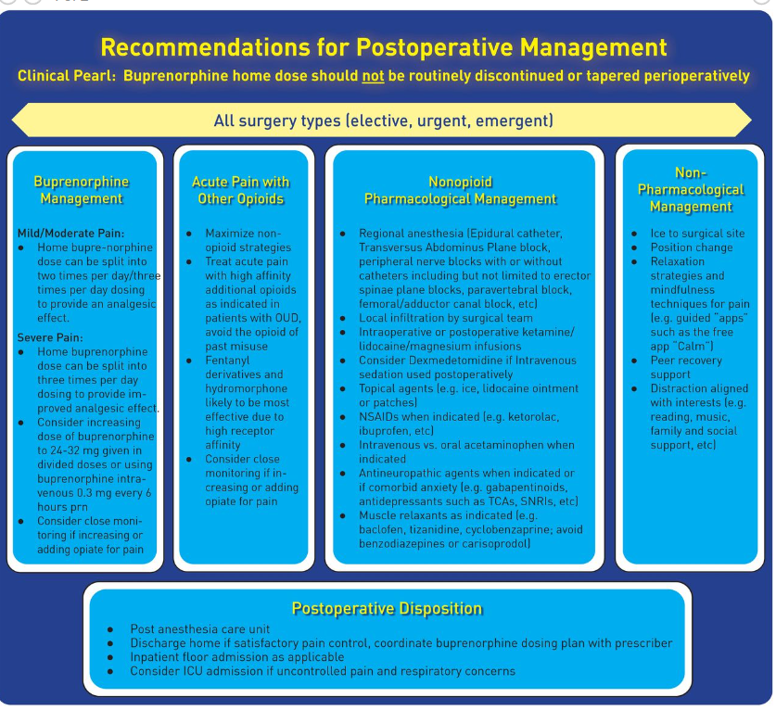
Lynn Kohan et al. Reg Anesth
Pain Med 2021;46:840-859

Slide 27
Perioperative Buprenorphine Management
Modified from Mass General Brigham Substance Use Steering Committee
Hickey, et al. Medical Clinics of North America, 2022.

Slide 28
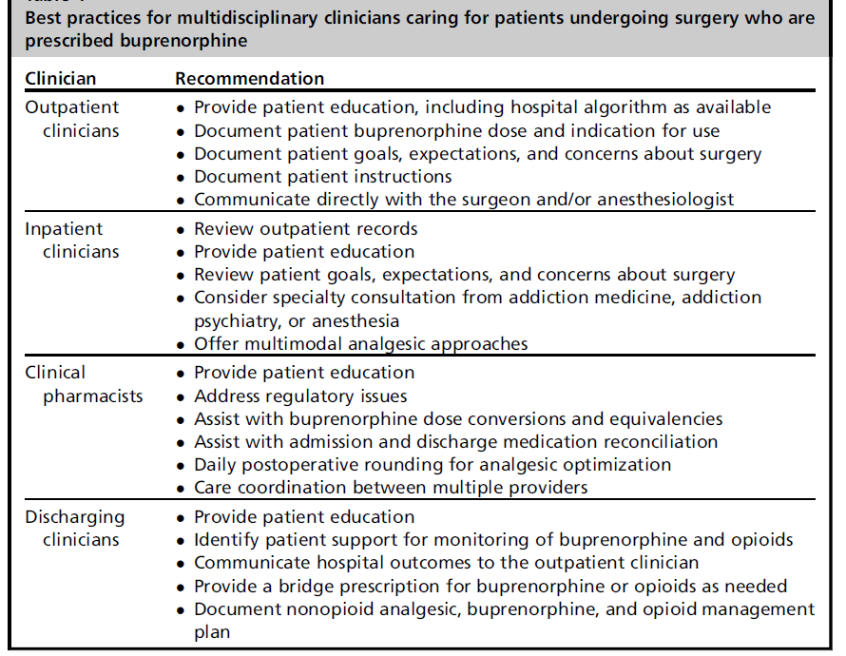
Hickey, et al. MCNA, 2022

Slide 29
Final Takeaways/Summary
Multiple non-opioid medications and adjuvant therapies are effective for the treatment of acute pain
Poorly treated acute pain can lead to ongoing persistent pain
Patients with OUD and acute pain should have their opioid withdrawal and pain treated at the same time
Offer all patients with OUD highly effective treatments such as methadone or buprenorphine
Continue methadone and buprenorphine in the perioperative setting and use multimodal treatments
Notes:
Take this time at the end of your presentation to review key takeaways and information that audiences should remember in the future. If practical, apply this to clinical practice.

Slide 30
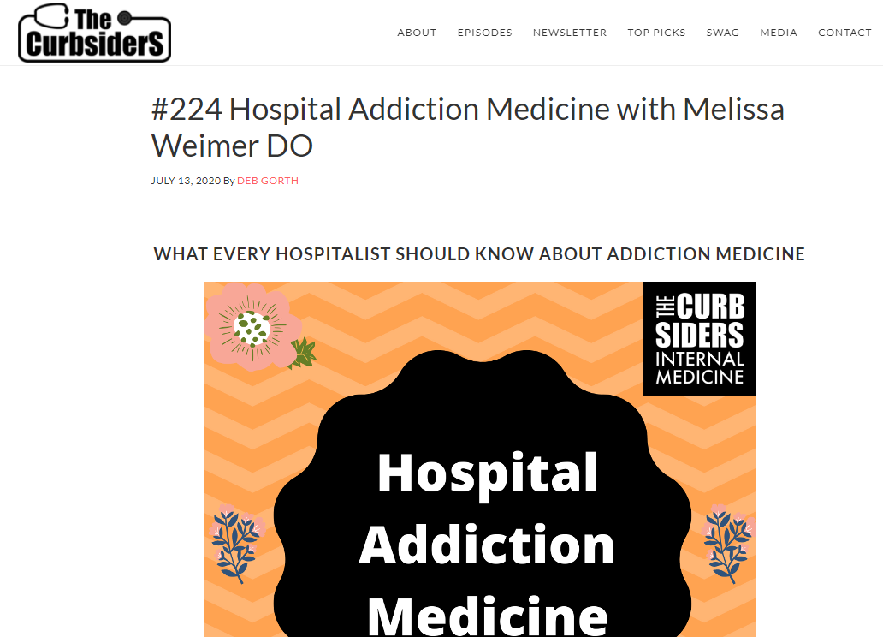
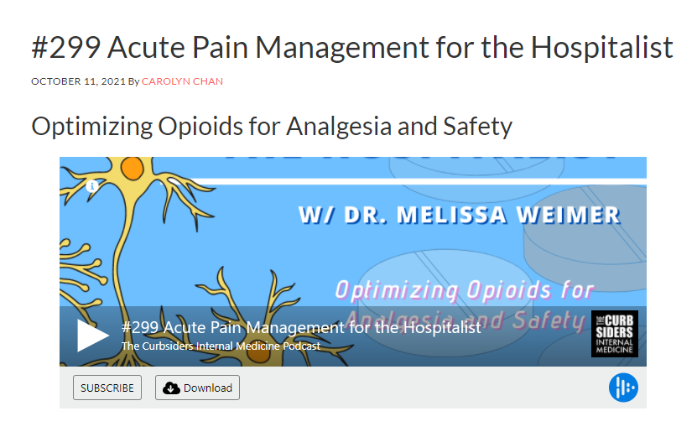
https://thecurbsiders.com/podcast/224
https://thecurbsiders.com/podcast/299

Slide 31
References
Alford, D, et al. (2006) Acute Pain Management for patients receiving maintenance methadone or buprenorphine therapy. Ann Intern Med. 144(2):127-134.
Hathaway DB, Bhat J, Twark C, Rodriquez C, Suzuki J. Patients’ experiences with continuation or discontinuation of buprenorphine before painful procedures: A brief report. American Journal of Addictions, 2023.
Kohan L, Potru S, Barreveld AM, Sprintz M, Lane O, Aryal A, Emerick T, Dopp A, Chhay S, Viscusi E. Buprenorphine management in the perioperative period: educational review and recommendations from a multisociety expert panel. Reg Anesth Pain Med. 2021 Oct;46(10):840-859.
Hickey T, Abelleira A, Acampora G, Becker WC, Falker CG, Nazario M, Weimer MB. Perioperative Buprenorphine Management: A Multidisciplinary Approach. Med Clin North Am. 2022 Jan;106(1):169-185.
Quaye AN, Zhang Y. Perioperative management of buprenorphine: solving the conundrum. Pain Med 2019;20(7):1395–408.

