Slide 1
Oh the Places You’ll Go: Coordinating Transitions of Care for Addiction and Pain
Tiffany Lu, MD MS
The Pain and Addiction Common Threads Course, April 2023
Notes:
15 min on inpatient services communicating among themselves, and coordinating “warm handoff” to outpatient providers
15 min on receiving the pt as an outpatient provider (addiction medicine, pain)
Patients who are hospitalized with pain and addiction often have active medical and psychosocial needs that require coordinated discharge planning. We will identify common barriers that impact transitions of care and examine practical strategies to facilitate discharge planning for patients with pain and addiction. We will also discuss the need for a low-threshold approach when engaging in patients with pain and addiction in post-hospital care.
Identify common barriers that impact transitions in care from hospital to community for patients with OUD and pain
Examine evidence-based strategies to optimize linkage to post-hospital care for patients with OUD and pain
Discuss a low-threshold approach when engaging patients with OUD and pain in post-hospital care

Slide 2
Disclosure Information
Oh the place you’ll go
April 12, 2023
Tiffany Lu, MD MS
Associate Professor
Albert Einstein College of Medicine
Montefiore Medical Center
No disclosures
Notes:
Hi My name is Tiffany Lu and I am a general internist and addiction medicine specialist in Bronx, New York. I direct Montefiore’s Buprenorphine Treatment Network, which consists of 7 community clinics providing OUD treatment in the primary care setting. Over the last two years, I have also had the rich experience of attending on a new inpatient Addiction Consult Service at Montefiore and established a new outpatient Addiction Medicine Bridge Clinic to facilitate post-discharge care for patients are initiated on medications for addiction treatment. I have no conflict of interest disclosures, though I want to take the opportunity to acknowledge the work of my colleagues at Montefiore-Einstein that inform my presentation today.

Slide 3
Learning Objectives
Identify common barriers that impact transitions of care from hospital to community for patients with OUD and pain
Examine evidence-based strategies to optimize linkage to post-discharge care for patients with OUD and pain
Discuss a low-threshold approach when engaging patients with OUD and pain in post-discharge care
Notes:
During this half-hour presentation, we will identify common barriers that impact transitions of care from hospital to community and examine evidence based strategies to optimize linkage to post-discharge care for patients with OUD, and discuss a low-threshold approach when engaging patients with OUD and pain in post-discharge care

Slide 4
Transitions of Care: Where to Start?
Wrist fracture s/p surgical repair with acute pain
Opioid use disorder initiated on buprenorphine treatment
Multiple substance use with increased overdose risk after period of abstinence
Unsheltered homelessness and intimate partner violence
Notes:
Let’s review the transitions of care needs for patient X that Dr Rudolf just presented to you. Taking an inventory of transitions of care needs is a critical step before we can target our interventions.
Where do we start?
Traumatic injury resulting in acute pain from wrist fracture that required surgical repair
Opioid use disorder diagnosis with buprenorphine treatment initiation and titration
Multiple substance use (methamphetamine) with period of abstinence and reduced tolerance while in hospital, which poses an increased risk for overdose post hospital discharge
Psychosocial Unsheltered homeless and intimate partner violence

Slide 5
Transitions of care can be a vulnerable period for patients with OUD and pain
Linkage to post-hospitalization OUD treatment among out-of-treatment persons are widely variable (as low as 17%)¹
Patient Barriers | Clinician Barriers | System Barriers
-Severe medical and psychiatric conditions -Unstable housing -Lack of transportation -Poor social supports | -Discomfort with opioid rx for pain and OUD -Lack of experience with buprenorphine -Unfamiliarity with community-based treatment options | -Lack of protocols for coordinating post-discharge OUD care -Access to buprenorphine vary by pharmacy -Insurance gaps or restrictions
¹Naegar et al. JSAT 2016
Notes:
Transitions of care can be a vulnerable period for patients with OUD and pain
For persons with OUD who are out of treatment at the time of hospitalization, linkage to post-hospitalization OUD treatment are widely variable
A study from 2016 reported that ﻿only 17% of privately insured patients who had an opioid-related hospitalization engaged in post-discharge OUD treatment services within 30 days of their discharge.
There are many barriers that impact transitions of care between hospital and community for patients with OUD and pain
On the patient level, having active severe medical and psychiatric conditions, including infective endocarditis, schizophrenia and other psychotic disorders, can pose challenges for a successful transitions of care; other barriers that can make it difficult for the patient to engage in care include unstable housing, lack of transportation, and poor social supports
On the clinician level, discomfort with managing opioid agonist for pain and OUD, lack of experience with buprenorphine, and unfamiliarity with community-based treatment options can all negatively impact the patient’s hospital discharge
On the system level, lack of hospital-wide protocols for coordinating post-discharge OUD care make it hard for both hospital and community clinicians to optimize transitions of care. At the pharmacy level, the stocking/availability of buprenorphine can vary and not be readily accessible to the patient even if they have an active prescription. Insurance limitations
Full agonist opioid rx for acute pain typically limited to <7 days

Slide 6
Unplanned discharges as a common barrier
Patients with SUDs nearly 3x more likely to have unplanned discharges (“against medical advice”) than those without SUD
2-12x higher risk of hospital readmission within 30 days
Unplanned discharges often due to patients’ experiences of inadequately treated pain, withdrawal, and stigma
“Anytime that they hear you’re a drug addict, they immediately shut down, they don’t want to work with you and pain management. They think you’re only there to f--- have the painkillers.”
“I left, because I didn’t want to sit there and continue suffering…I ended up going to use because I was in so much pain. And doctors don’t do nothing for the pain.”
Simon et al. Substance Abuse 2020
Notes:
ANIMATE TO READ QUOTES WHEN READY

Slide 7
Attrition between referral and linkage to outpatient treatment
Among 226 pts referred for BUP treatment in Bronx community clinics 2018-19:
25% patients were referred from hospital settings
Referring clinician called/emailed to schedule appts and gave warm handoff
Number of Patients
Steps in Cascade of Care
Khalid et al. JSAT 2022.
Notes:
Appointments typically coordinated via treatment coordinators via centralized phone number or email
WARM HAND OFF
Pts were referred from a variety of settings, including hospitals, substance use disorder treatment programs (e.g. inpatient rehab, outpatient programs without MOUD capacity), community-based orgs (SEPs, re-entry programs), self-referrals
25% referred from hospitals

Slide 8
Optimizing transitions in care from hospital to community for patients with OUD
Evidence-based interventions:¹
In-hospital initiation of opioid agonist medications for OUD²
Linkage to outpatient treatment via addiction consult services³⁻⁴
Discharge coordination via patient navigation services or peer recovery coaching^{5,6}
Same- or next-day post-discharge appointment⁷
¹James et al. Drug Alc Dep 2023; ²Liebschutz et al. JAMA 2014; ³Wakeman et al. JGIM 2017; ⁴Englander et al. JGIM 2019; ⁵Nordeck et al. Drug Alc Dep Rep 2022; ⁶Byrne et al. Drug Alc Dep 2020; ⁷Roy et al. Drug Alc Depend 2021

Slide 9
Initiating OUD treatment during trauma-related hospitalizations may help with linkage to care
Among 197 pts initiated on BUP at Level 1 Trauma Center 2018-19:
31% hospitalized for trauma-related injuries
63% trauma pts linked to post-discharge care vs 48% non-trauma pts (no significant difference)
Trauma hospitalizations = reachable moment to (re-)initiate BUP
Bhatraju et al. Drug Alc Dep 2020 (Table 2: OR of 30-Day Follow-Up Adjusted for Sex, Race/Ethnicity, and Housing Status)
Notes:
Trauma related injuries to MVA, falls, other traumas
Trauma pts were younger in age, more likely to be employed, less likely to inject drugs, less likely to have experience with methadone treatment, more likely to have longer hospitalizations
Initiating BUP in pt with trauma/acute pain not associated with linkage to outpatient BUP treatment
History of buprenorphine treatment associated with nearly 3x increased odds of linkage to outpatient BUP treatment
History of injection drug use associated with decreased odds of linkage to linkage to outpatient BUP treatment (which is typically a risk factor for worse treatment outcomes)
Partial opioid agonist use in acute pain among pts with OUD was not associated with worse linkage to care outcomes
“Reachable moment” to help initiate BUP for OUD after traumatic injury especially among pts who have prior history of BUP treatment

Slide 10
Addiction consult services help with linkage to outpatient treatment
Interprofessional, hospital-based addiction consult services implemented at academic hospitals associated with:
2x higher odds of post-discharge treatment engagement¹
60% lower risk for hospital re-admission within 90 days²
Initiate medication treatment for SUDs
Formalize referral pathways to post-hospital SUD care
Offer appt at low-threshold post-discharge bridge clinic
¹Englander et al. JGIM 2019; ²Wakeman et al. JGIM 2017;
Notes:
Interprofessional – addiction specialists, social worker, peer recovery coach

Slide 11
Same- or next-day post-discharge appointments associated with improved linkage
Among 142 pts initiated or recommended for BUP on discharge 2015-17:
Addiction consult service linked pts to appts at low barrier addiction clinic
Roy et al. Drug Alc Depend 2021
Notes:
Short wait-time to post-discharge appointment (0-1 days)
DON”T GET INTO OTHER PARTS LIKE DISTACE
JUST TALK ABOUT OBSERVATION OF OFFERED APPTS AND THE POINT THEY LINKED SO DIFFERENTLY

Slide 12
Transitions of Care: Taking Inventory of Discharge Needs
Wrist fracture s/p surgical repair with acute pain
Opioid use disorder initiated on buprenorphine treatment
Multiple substance use with increased overdose risk after period of abstinence
Unsheltered homelessness and intimate partner violence
Pain control and post-op follow-up
OUD treatment continuation
Harm reduction education & tools
Housing, social supports and case management
Involve different stakeholders in the hospital system – start with practical strategies and refine into protocols and workflows!
Notes:
Interprofessional team to work on all of this is great
If you don’t, then this is how you can break it down
Involve different stakeholders in the system to do this
Use the existing structure/system, don’t have to radicalize it to start somewhere!
Hospital pharmacy and nurses vs social workers
Much of these can be achieved in the hospital without an interprofessional addition consult service team

Slide 13
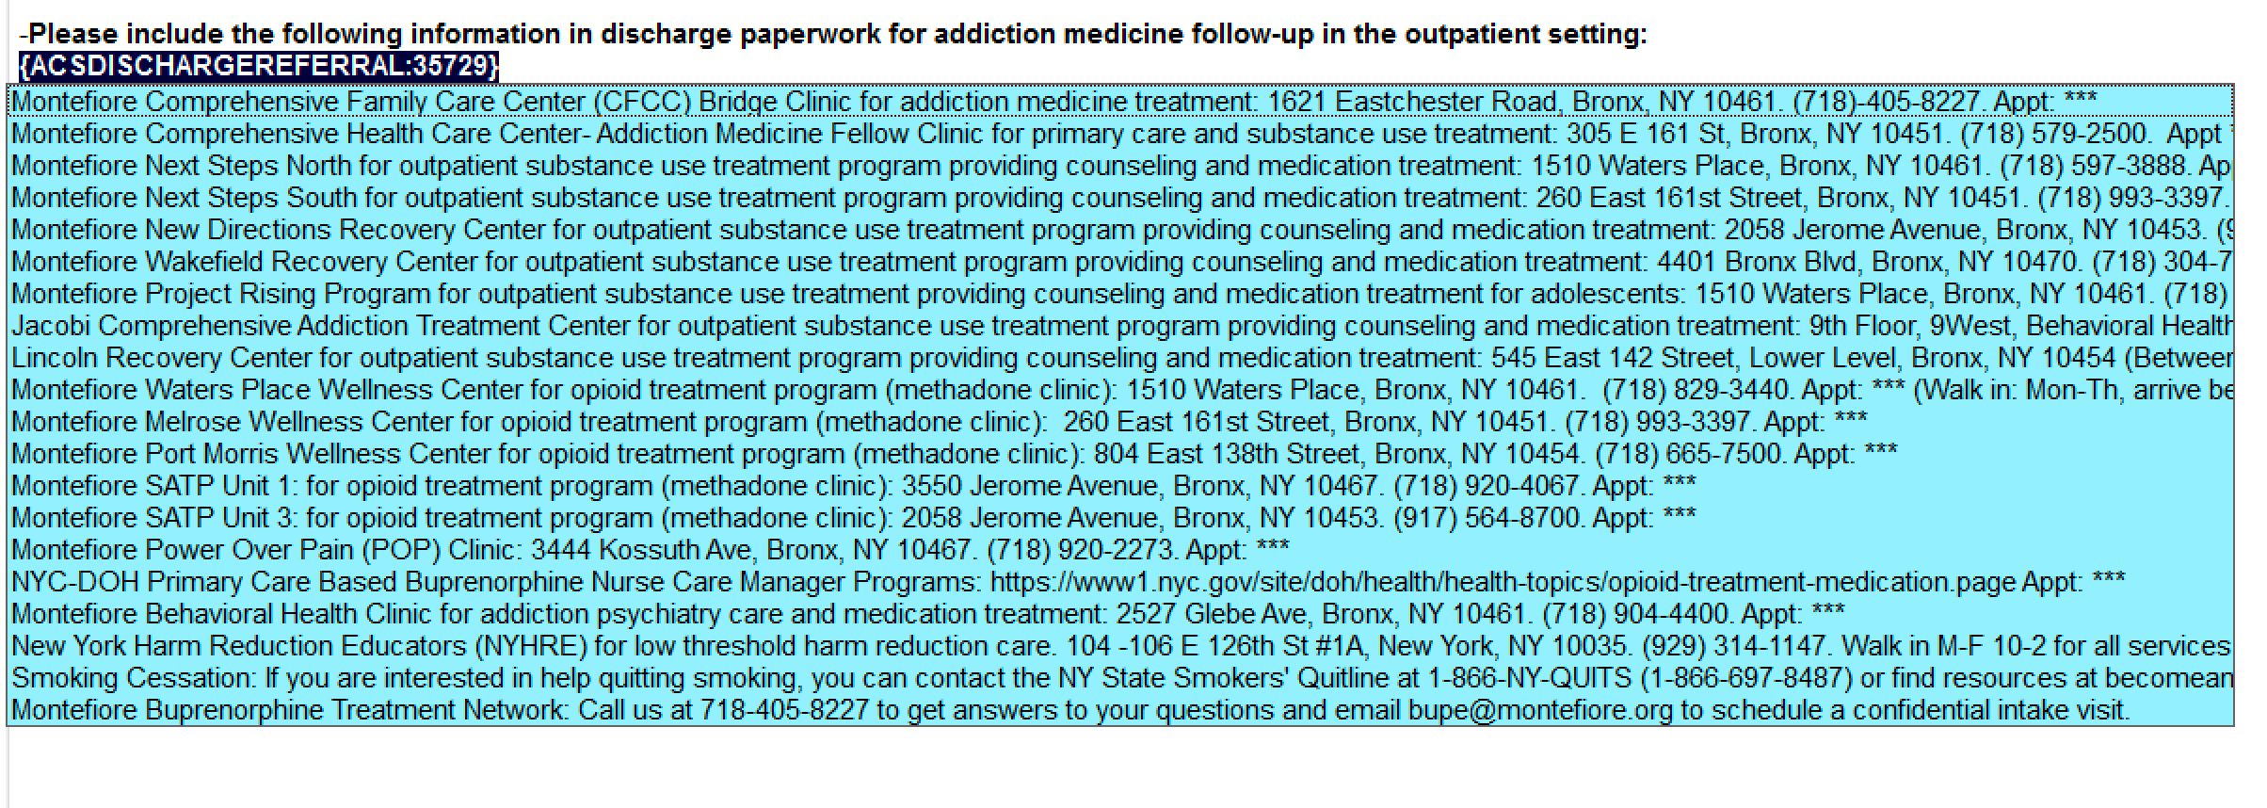
Practical strategies to optimize transitions of care: Facilitate linkage to care
Identify post-discharge providers and referral pathways
Support primary team to obtain post-discharge appointments with short wait times
Notes:
ANIMATION –
WARM OFF SMARTPHRASE, referral pathway, put it in the note, copy and paste in AVS

Slide 14
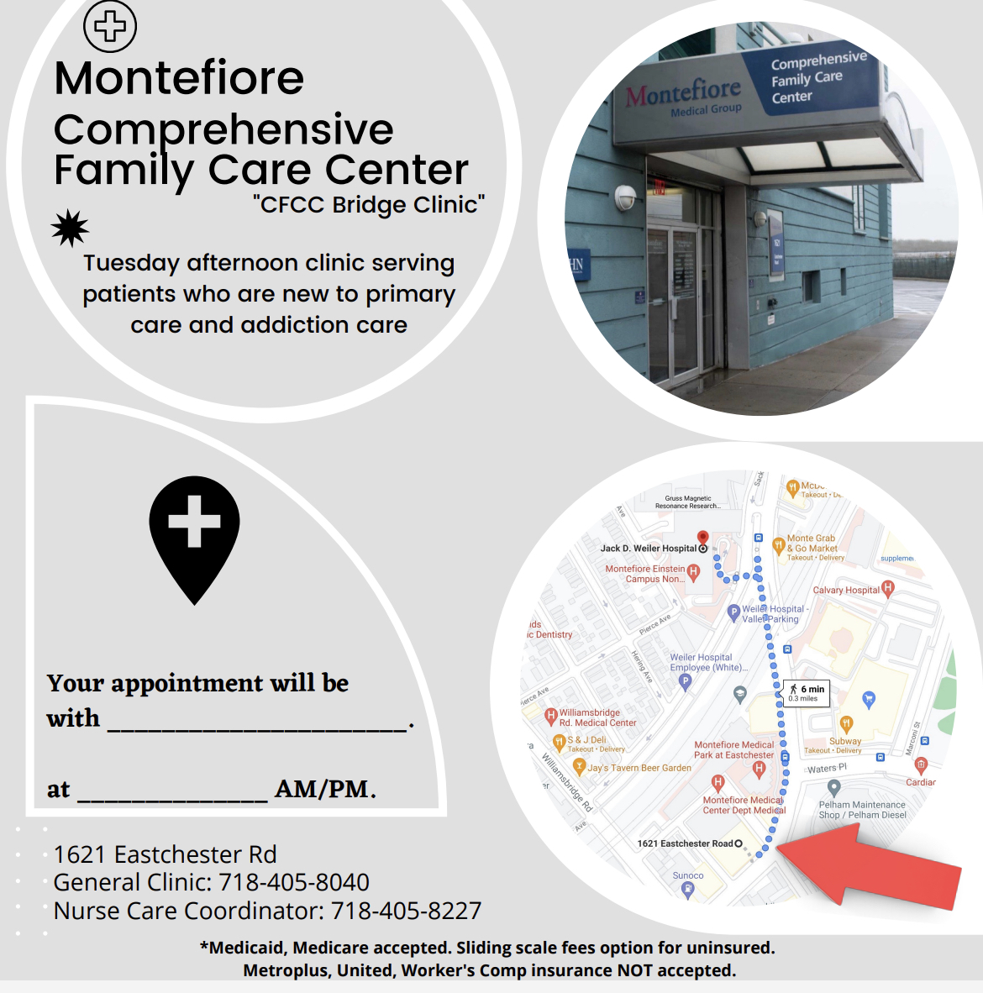
Practical strategies to optimize transitions of care: Facilitate linkage to care
Ensure closed loop communication with patients about post-discharge plans
Confirm patients’ contact information for outreach as needed
Example: Follow-up appt patient flyer
Notes:
ANIMATION –
WARM OFF SMARTPHRASE, referral pathway, put it in the note, copy and paste in AVS

Slide 15
Practical strategies to optimize transitions of care: Facilitate opioid agonist prescribing
Optimize buprenorphine dose for OUD/pain
Support primary team to prescribe bridge buprenorphine
Consider prescription duration of at least 7-14 days
Identify pharmacy partners for same-day med dispensing
Utilize hospital’s meds to beds program if available

Slide 16
Practical strategies to optimize transitions of care: Provide harm reduction education and tools
WHY?
Pain and reduced tolerance during hospitalization = vulnerable time!
“Meeting people where they are”
BARRIERS?
Hospital clinicians not typically trained to deliver harm reduction education
Harm reduction equipment distribution not routinely integrated in hospitals
Image from NC Harm Reduction Coalition
Notes:
We are about to discharge at a vulnerable time – pain, hospitalized and lost tolerance, need harm reduction

Slide 17
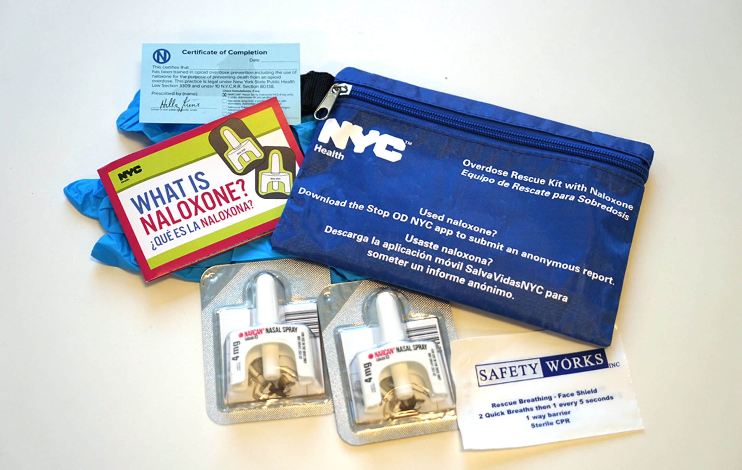
Practical strategies to optimize transitions of care: Integrating naloxone distribution in hospitals
Partner with local health department to dispense free naloxone take home kits, if available
Prescribe naloxone to hospital pharmacy for dispensing at bedside
Train hospital nurses and pharmacists to provide opioid overdose prevention education
Jakubowski et al. Substance Abuse. 2018
Notes:
If you live in an area where you have access to free naloxone kits perhaps through local health department, you can give them directly to patients

Slide 18
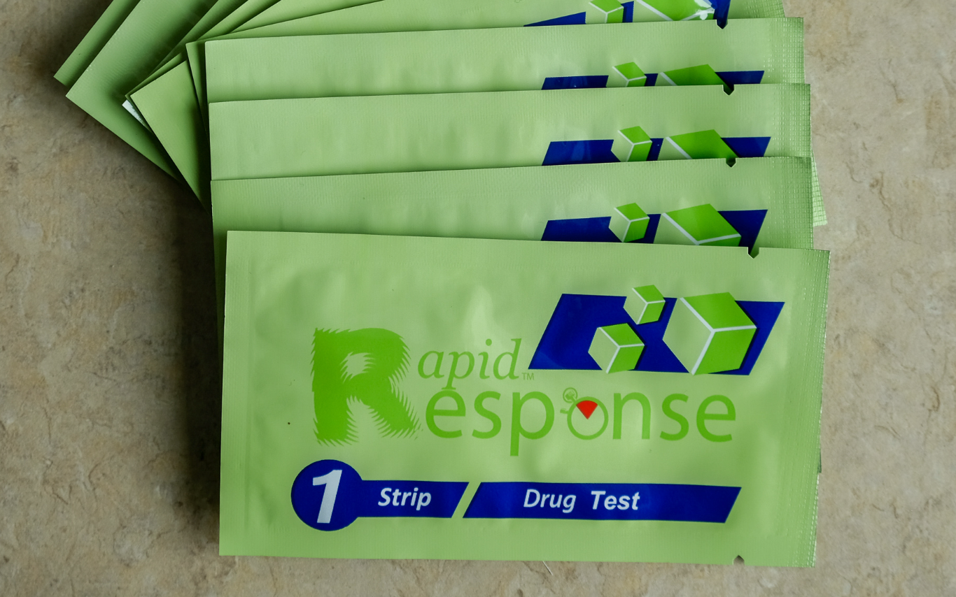
Providing harm reduction education and tools via inpatient Addiction Consult Service
Harm Reduction “Kits”:
Overdose prevention education
Naloxone access
Fentanyl test strips and education
Never use alone flyer and education
Local resources
Additional information on safer use of specific substances and routes of use
Perera et al. Harm Reduction Journal 2022
Notes:
ADD PHOTO OF BAG!!! Builds good will, helps therapeutic relationship

Slide 19
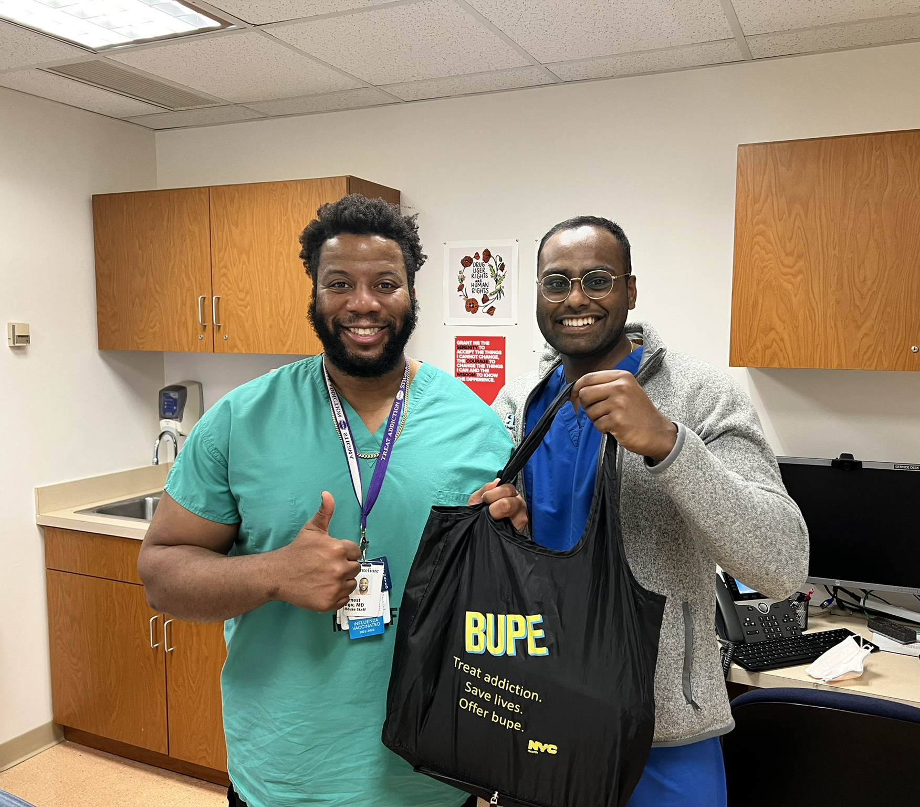
Providing harm reduction education and tools via inpatient Addiction Consult Service
Notes:
Builds good will, helps therapeutic relationship, helps staff experience

Slide 20
Transitions of Care: Engaging Patients in the Post-Discharge Visit
You are now seeing the patient in clinic for post-discharge visit….
TAKE A MINUTE TO AFFIRM THIS STEP WITH THE PATIENT!
How do you begin to address OUD, pain, and other needs?
Notes:
Emphasize low-threshold approach – what to do if someone is late?
Patient provider relationship

Slide 21
The Need for a Low-Threshold Approach
Low-threshold buprenorphine treatment defined by:
Same-day treatment access
Does not require additional visits before buprenorphine prescribing
Unobserved initiation available
Harm reduction approach
Reduction in illicit opioid use is acceptable goal
Use of other substances does not result in treatment cessation
Flexibility in treatment structure
Visit frequency reduced based on clinical stability
Intensive counseling offered but not required
Jakubowski and Fox. J Addict Med. 2019
Notes:
WHY DO IT: PRESENT STUDY ON SHORT WAIT TIME (quant) and PATIENT EXPERIENCES (qual data)

Slide 22
Applying a low-threshold approach to transitions of care
Goal
“Bridge Clinic” - Facilitate rapid access to and engagement in care for patients with OUD and co-occurring conditions
Evaluate
OUD treatment goals and stabilization
Other substance use patterns and risks
Acute medical and mental health concerns
Acute psychosocial needs
Offer
Medications for OUD and co-occurring conditions
Harm reduction education and tools
Referral to counseling, case management, and community services
Follow-up until transition to long-term treatment providers

Slide 23
Developing visit templates for post-discharge care
Notes:
Prioritize needs and address acute issue
SCREENSHOT OF TEMPLATE

Slide 24
Low-threshold post-discharge care improves patient experiences
Among N=29 pts interviewed at a large ‘Bridge Clinic’, positive experiences reported with: (1) accessible/flexible services, (2) harm reduction emphasis, and (3) patient-provider relationships
﻿“﻿I found out about the clinic six months ago. I overdosed and after that, I was referred to the clinic…I came the very next day….”
﻿“I get a feeling of safety with [my provider] that she's not going to…withhold treatment or make you go somewhere else or force you to do something that you know that you're not going to do and end up not coming back.”
﻿“﻿I walk out of here and I feel good about myself…instead of getting chastised for relapsing and feeling bad about it, we actually talked about it…”
Snow et al. JSAT 2019

Slide 25
Final Takeaways
Transitions of care between hospital and community is a vulnerable time for patients with OUD and pain
Initiating opioid agonist treatment and facilitating post-discharge care with short wait times are key interventions
Low-threshold approach to transitions of care, including providing harm reduction education and tools, is essential
Interprofessional addiction consult services and post-discharge bridge clinics may not be available – start somewhere!!
Notes:
MODIFY THIS TO SHORTEN WORDS
NOT WAITING TO START
MAKING POINT TO SCHEDULE SOON APPT
DON”T LET THE PERFECT BE ENEMY OF GOOD

Slide 26
Questions/Comments
Email: tlu@montefiore.org
@TiffanyLuMD

Slide 27
References Part 1
Naeger S, Mutter R, Ali MM, Mark T, Hughey L. Post-discharge treatment engagement among patients with an opioid-use disorder. J Subst Abuse Treat. 2016;69:64-71. doi:10.1016/j.jsat.2016.07.004
Simon R, Snow R, Wakeman SE. Understanding why patients with substance use disorders leave the hospital aginst medical advice: A qualitative study. Substance Abuse. 2020; 41:4, 519-525. doi: 10.1080/08897077.2019.1671942
Khalid L, Cunningham CO, Deng Y, et al. Cascade of care for office-based buprenorphine treatment in Bronx community clinics. J Subst Abuse Treat. 2022;139(March):108778. doi:10.1016/j.jsat.2022.108778
James H, Morgan J, Ti L, Nolan S. Transitions in care between hospital and community settings for individuals with a substance use disorder: A systematic review. Drug Alcohol Depend. 2023;243(May 2022):109763. doi:10.1016/j.drugalcdep.2023.109763
Liebschutz JM, Crooks D, Herman D, et al. Buprenorphine Treatment for Hospitalized, Opioid-Dependent Patients. JAMA Intern Med. 2014;174(8):1369. doi:10.1001/jamainternmed.2014.2556
Bhatraju EP, Ludwig-Barron N, Takagi-Stewart J, Sandhu HK, Klein JW, Tsui JI. Successful engagement in buprenorphine treatment among hospitalized patients with opioid use disorder and trauma. Drug Alcohol Depend. 2020;215:1-11. doi:10.1016/j.drugalcdep.2020.108253
Wakeman SE, Metlay JP, Chang Y, Herman GE, Rigotti NA. Inpatient Addiction Consultation for Hospitalized Patients Increases Post-Discharge Abstinence and Reduces Addiction Severity. J Gen Intern Med. 2017;32(8):909-916. doi:10.1007/s11606-017-4077-z
Englander H, Dobbertin K, Lind BK, et al. Inpatient Addiction Medicine Consultation and Post-Hospital Substance Use Disorder Treatment Engagement: a Propensity-Matched Analysis. J Gen Intern Med. 2019;34(12):2796-2803. doi:10.1007/s11606-019-05251-9
Notes:
ASAM requests the APA citation format
Link: https://owl.purdue.edu/owl/research_and_citation/apa_style/apa_formatting_and_style_guide/general_format.html

Slide 28
References Part 2
Byrne KA, Roth PJ, Merchant K, et al. Inpatient link to peer recovery coaching: Results from a pilot randomized control trial. Drug Alcohol Depend. 2020;215:108234. doi:10.1016/J.DRUGALCDEP.2020.108234
Nordeck CD, Welsh C, Schwartz RP, Mitchell SG, O’Grady KE, Gryczynski J. Opioid agonist treatment initiation and linkage for hospitalized patients seen by a substance use disorder consultation service. Drug Alcohol Depend Reports. 2022;2(February):100031. Roy PJ, Price R, Choi S, et al. Shorter outpatient wait-timedoi:10.1016/j.dadr.2022.100031
Roy PJ, Price R, Choi S, et al. Shorter outpatient wait-times for buprenorphine are associated with linkage to care post-hospital discharge. Drug Alcohol Depend. 2021;224(October 2020):108703. doi:10.1016/j.drugalcdep.2021.108703
Perera R, Stephan L, Appa A, et al. Meeting people where they are: implementing hospital-based substance use harm reduction. Harm Reduct J. 2022;19(1):1-7. doi:10.1186/s12954-022-00594-9
Jakubowski A, Fox A. Defining Low-threshold Buprenorphine Treatment. J Addict Med. 2019;14(2):95-98. doi:10.1097/ADM.0000000000000555
Snow RL, Simon RE, Jack HE, Oller D, Kehoe L, Wakeman SE. Patient experiences with a transitional, low-threshold clinic for the treatment of substance use disorder: A qualitative study of a bridge clinic. J Subst Abuse Treat. 2019;107(April):1-7. doi:10.1016/j.jsat.2019.09.003
Notes:
ASAM requests the APA citation format
Link: https://owl.purdue.edu/owl/research_and_citation/apa_style/apa_formatting_and_style_guide/general_format.html

