Slide 1
Ketamine & Other Non-Pharmacological Interventions in the Perioperative Period
Steven P. Cohen, MD
Pain & Addiction Common Threads Course | April 13, 2023

Slide 2

Disclosure Information (Required)
Ketamine & Other Non-Pharmacological Interventions in the Perioperative Period
April 13, 2023
Steven Cohen, MD
Consultant for Avanos, Scilex, Persica, Releviate, Clearing & SPR (none relevant to lecture)
This presentation does discuss off-label usage
Notes:
Disclosure slide option #1 for individual presenters. Select either option 1 or option 2, you don’t need to have both.

Slide 3
Learning Objectives
Understand the evidence supporting the preemptive use of ketamine in the perioperative setting and its ability to reduce opioid consumption
Be familiar with the evidence supporting PNS & RFA for postsurgical pain
Be cognizant of the limitations in clinical trials evaluating regional anesthesia for prevention of postamputation pain
Understand the rationale and outcomes for preoperative psych interventions in high-risk patients

Slide 4
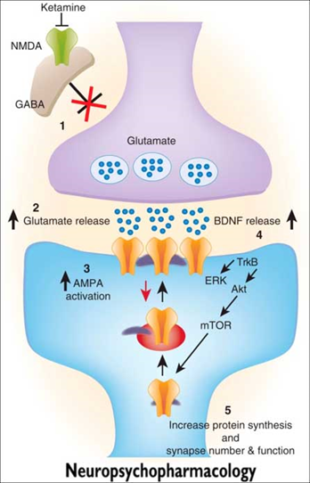
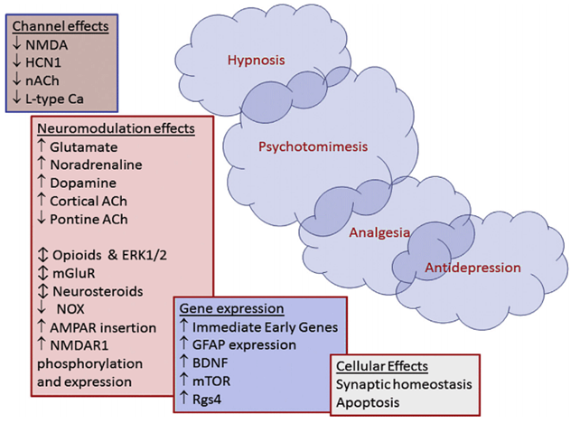

Mechanisms of Action for Ketamine
NMDA receptor antagonism
Antagonism of nicotinic and muscarinic cholinergic receptors
Blockade of Na+ and K+ channels
Activation of D2 dopamine receptors
Activation of L-type voltage-gated Ca++ channels
Facilitation of GABA signaling
Enhancement of descending modulatory pathways
Notes:
Its primary mechanism is as a non-competitive antagonist at the phencyclidine binding site of N-Methyl-D-Aspartate (NMDA) receptors residing in the central nervous system, particularly in the prefrontal cortex and hippocampus (Cohen SP, Liao W, Gupta A, Plunkett A. Ketamine in pain management. Adv Psychosom Med 2011; 30: 139-61.), where it decreases the frequency of channel opening and time duration of time spent in the active, open state (Orser BA, Pennefather PS, MacDonald JF. Multiple mechanisms of ketamine blockade of N-methyl-D-aspartate receptors. Anesthesiology 1997; 86: 903-17.) The NMDA receptor is a ligand-gated channel whose major endogenous agonist is glutamate, the predominant excitatory neurotransmitter in the CNS. When this receptor is inhibited, decreased neuronal activity ensues. Activation of the NMDA channel plays a major cognition, chronic pain, opioid tolerance, and mood regulation, and is considered the principal receptor involved in phenomena of central sensitization and windup

Slide 5
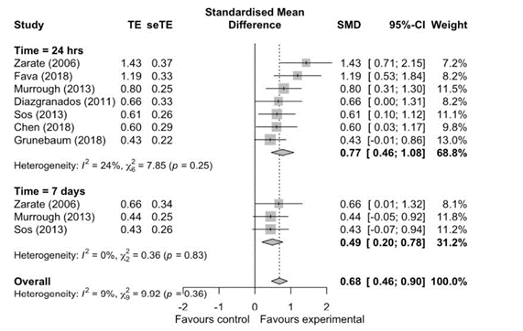
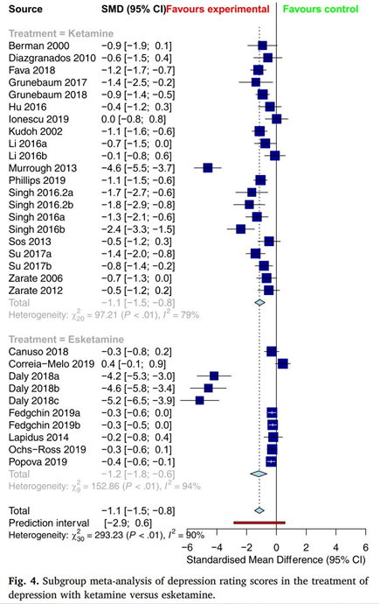
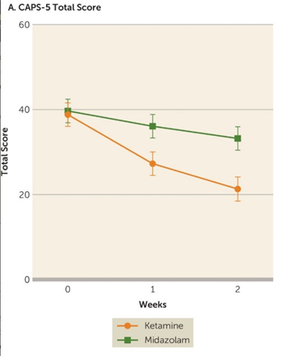

Ketamine and Psychiatric Morbidity
Co-prevalence rate of depression 30%-60%
Ketamine makes people ‘feel good’
Low-dose ketamine alleviates depression
  IV ketamine, higher doses > Esketamine
  Psychomimetic effects correlated with antidepressant effects in 37.5% of studies
Evidence growing for PTSD & other psychiatric illnesses
Growing rate of abuse
  2.3 million people in U.S. over 12 years old reported using ketamine
  3% of high school students
  Increasingly implicated in MVCs
    One study in Hong Kong found ketamine in 45% of subjects involved in non-fatal MVCs
Marcantoni et al. 2020: 0.5 mg/kg IVfor Depression Ketamine vs. Placebo for Depression
Bahji et al. 2021: IV Ketamine vs. s-Ketamine for Depression
Feder et al. 2021: Repeat Ketamine vs. Versed for PTSD
2013 National Survey on Drug Use and Health in U.S.; Mathai et al. 2021; Wong et al. Hong Kong Med JBahjiet al. 2021: IV Ketamine vs.s-Ketamine for DepressionFeder et al. 2021: Repeat Ketamine vs. Versed for PTSD
Notes:
9 studies, 368 patients relieves pain for up to 3 weeks: 6-hydroxynorketamine responsible?
S-ketamine compared to racemic ketamine: 4-fold greater affinity for NMDA receptor, 3-4 x greater anesthetic/ analgesic potency and more side effects (less side effects at equianalgesic doses)- but evidence of less side effects is mixed. But data suggests that racemic ketamine is better for
National survey data and the published literature indicate that ketamine abuse is relatively uncommon in the general population, with a reported lifetime prevalence of 1.3% among persons age 12 years and older, which is lower than that for other hallucinogens such as ecstasy and LSD. Among 12th graders, the annual prevalence of ketamine use has declined from 2.5% in 2000 to 1.2% in 2017. Exposure calls to U.S. poison centers involving ketamine abuse or misuse also declined slightly from 2013 to 2017 (176 calls in 2013 to 116 calls in 2017), despite the growth in non-veterinary ketamine sales

Slide 6
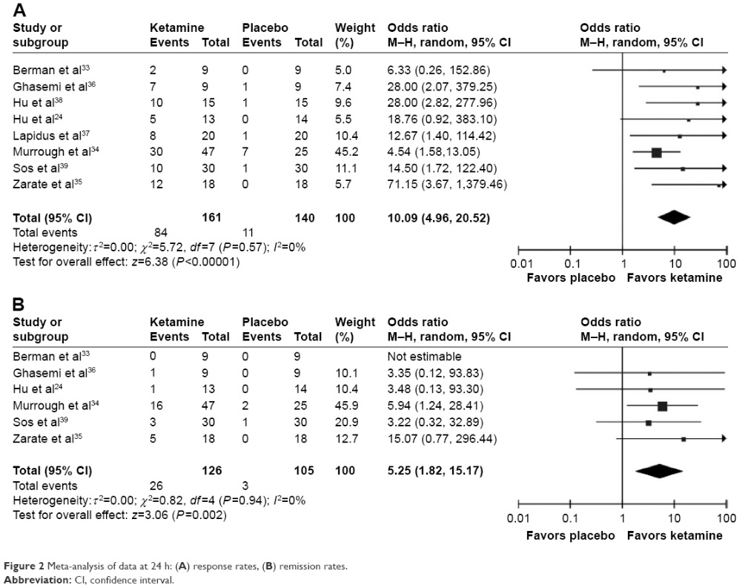
Depression & Pain Treatment
Ketamine similar to other drugs effective for depression & pain
  TCAs, SNRI, SSRI, MAOI, ECT, tDCS/rTMS
  May involve AMPA receptor up-regulation, activation of BDNF & mammalian target of rapamycin (mTOR) signaling pathways
    All potential pain targets
    > 4200 PubMed citations for depression, >4400 for pain (< 800 for chronic pain), > 1000 for anxiety, > 300 for depression
Han et al. Neuropsychiatr Dis Treat 2016
Notes:
9 studies, 368 patients relieves pain for up to 3 weeks: 6-hydroxynorketamine responsible?

Slide 7
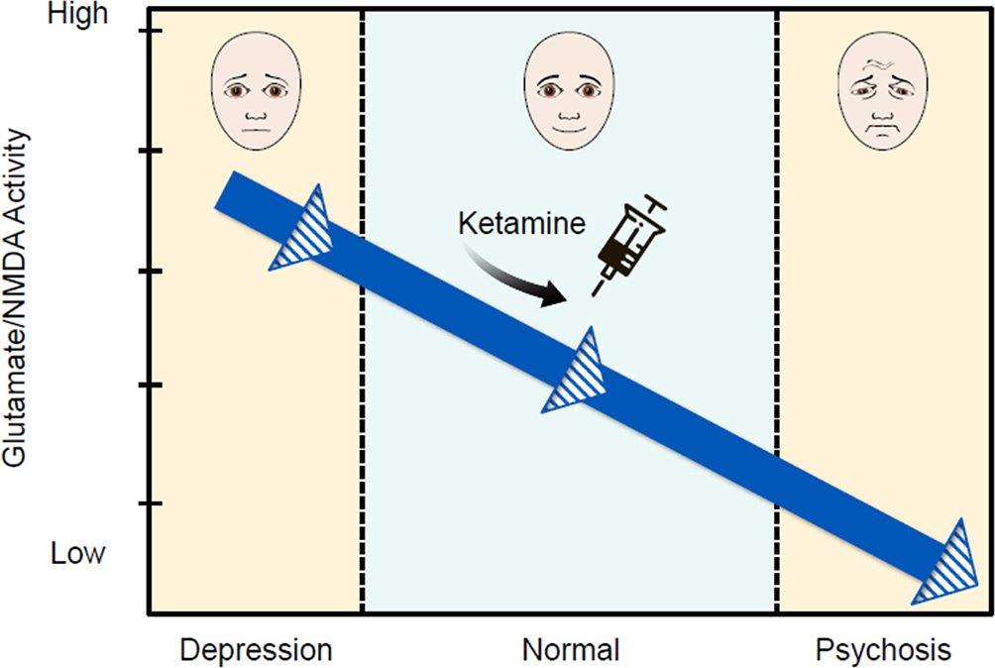
Pain Dimensions: More Effective for Affective Component?
Described in 1968 by Melzack & Casey
Sensory-Discriminative- Based on nociceptive input, includes magnitude & location
  Can be measured by QST
Affective-Motivational- Evolutionary arousal & negative emotions (unpleasantness), from limbic & reticular structures
Cognitive-Evaluative- Provides contextual info based on past experiences and likely outcomes (attitudes and beliefs), processed via higher CNS structures
Most studies have reported negative effects of ketamine on QST after 48h
Schwartzman et al. RCT in 19 pts with CRPS: 31% reduction in S-D component vs. 46% in A-M component
Eichenberger et al. A & A 2008, Schwartzman et al. Pain 2009; Noppers et al. EJP 2011

Slide 8
Can Central Sensitization Actually Be Reversed?
Chronic pain-induced changes occur on a chemical, functional and anatomical level
Seminowicz et al. J Neurosci 2011
  C-LBP associated with decreases in gray matter & cognitive changes
  18 pts with c-LBP > 1 yr and 16 controls underwent structural and f-MRIs, and cognitive and functional assessments
  Relative to controls, patients before treatment had significantly thinner cortex in left dorsolateral prefrontal cortex (DLPC), bilateral anterior insula/frontal operculum, left mid/posterior insula, left S1, left medial temporal lobe, and right anterior cingulate cortex (ACC), and greater cognitive deficits and physical disability
  6 mo post-treatment with surgery or facet blocks, the 14 pts who rec’d f/u had increased left DLPC, which was assoc. with improved pain and function.
  Increased thickness in 1º motor cortex & right anterior insula assoc. with reduced disability and pain, respectively
Rows A & B: Yellow and Red (A) and Blue (B) areas represent decreases in gray matter in cLBP pts. D represents areas of increased thickness in treatment responders. E shows increased cortical thickness at 6 wks (minimal) and at 6 mos in all cLPB patients (thatched red bar) and responders (solid red bar) following spine surgery (n=8) or facet blocks (n=6)
Notes:
Increased DLPFC thickness correlated with the reduction of both
pain and physical disability. Additionally, increased thickness in primary motor cortex was associated specifically with reduced physical
disability, and right anterior insula was associated specifically with reduced pain. Left DLPFC activity during an attention-demanding
cognitive task was abnormal before treatment, but normalized following treatment. These data indicate that functional and structural
brain abnormalities—specifically in the left DLPFC—are reversible, suggesting that treating chronic pain can restore normal brain
function in humans. Thickness, though increased, was still less than in “controls”.

Slide 9
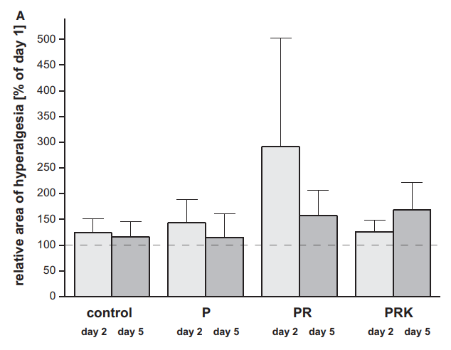
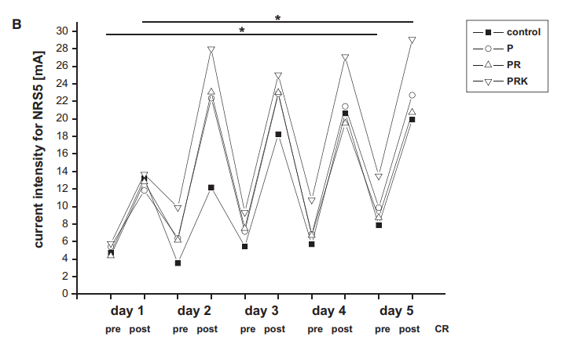
Can Ketamine Reverse Central Sensitization
Conditioned Pain Modulation is a surrogate marker for descending pain inhibition and abnormal pain processing/ central sensitization.
Niesters et al. Br J Anaesth 2013: Crossover study in 10 pts with neuropathy comparing ketamine (.57 mg/kg/h x 1 h) to MS04 to placebo
  Ketamine caused larger decreases in pain than morphine & placebo, but no significant differences in CPM augmentation was noted between groups (ketamine 10.9%; MS04 7.0%; and placebo 12%)
Nickel et al. Pain Pract 2016: 48 volunteers underwent conditioning noxious electrical stimulation x 5 days and day 22 with general anesthesia x 2 h after baseline QST: control, propofol, prop/remifentanil, prop/remi/ketamine in double-blind study
  Prop/remi showed trend toward greater 2º hyperalgesia @ 2 d than other groups (NS with Bonferroni correction). Differences in groups for other variables were non-significant showing pro- and anti-nociceptive effects
Notes:
Ketamine rate: 5 mcg/kg/min

Slide 10
RCTs Evaluating Ketamine on Quantitative Sensory Testing
Kvarnstrom et al. 2003: Crossover study in 12 pts with post-traumatic NeuP
  Ketamine dose 0.4 mg/kg over 40 min
  VAS reduction of 55%, 34% and 22% for ket, lidocaine and placebo over 2.5 hrs
  No significant difference in QST between responders and non-responders, or dose-response
  High incidence of AE’s with ketamine limits its usefulness
Kvarnstrom et al. 2004: Crossover DB study in 10 pts with SCI
  Same dose regimen & methodology as first study
  50% of ket vs. 10% of lido vs. 0% of placebo pts responded over 2.5 hrs, but no treatment was associated with QST changes
Baad-Hansen 2007: Compared ket, fentanyl and NS in 10 pts with intraoral pain and 10 healthy controls
  No effect of either drug on spontaneous intraoral pain
  For QST, fentanyl > ketamine on some measures
Eichenberger et al. 2008: Crossover study 20 pts with PLP who rec’d calcitonin, ketamine and placebo
    Ketamine > calcitonin & placebo up to 48h (no benefit for calcitonin-ketamine combo)
    Ketamine/calcitonin > calcitonin & placebo for electrical pain threshold & tolerance but not for pressure or heat
Kiefer et al. 2008: No effect on pain scores or QST in 4 pts with refractory CRPS in pilot study
Nickel et al. 4-arm RCT comparing no treatment, propofol, propofol/remi and propofol/remi/ketamine after noxious stimulus in 48 volunteers
  No effect of regimen on pain modulation or hyperalgesia
Notes:
CPM- ‘pain inhibits pain’, and is a way to evaluate endogenous pain modulation

Slide 11
Evidence for Ketamine Reversing Central Sensitization
Neuroinflammation implicated in chronic pain, neurodegeneration (e.g. MS, PD, stroke) and cognitive impairment
  Activates NMDA receptors & can be prevented by NMDA-R antagonism (e.g. inhibits microglial activation and pro-inflammatory cytokines)
Prominent in nociplastic conditions
Stubhaug et al. 2008: 20 living kidney donors randomized to 0.5 mg/kg ketamine bolus pre-incision followed by 48 h infusion or saline control
  Ketamine group had decreased area of punctate hyperalgesia and temporal summation (wind-up) compared to control
Stubhaug et al. Acta Anaesthesiol Scand 1997

Slide 12
Surgery and New Opioid Use & Abuse
Opioids are “gold standard” for treating acute pain
  Approximately 6% of people given opioids after surgery will continue long-term
  Baseline RF (chronic pain condition, h/o substance abuse, baseline psychopathology) > type of surgery
  Rate of PPSP is high (about 12% for moderate pain, < 5% for severe, > 50% for certain operations)
Poorly treated acute pain increases risk for PPSP
Poorly treated substance abuse contraindication for chronic pain rx, not acute
Namiranium et al. J Subst Abuse Treat 2020
  Compared relapse rates in 87 veterans in opioid agonist program > 1 yr. undergoing surgery vs. 249 control vets not receiving surgery
  Within 1 yr, 58% of surgical pts had misuse vs. 31% of control groupe (OR 1.91, 95% CI 1.05–3.48, p=0.034)
  Overdose rate 2.3% vs. 0.5%
  Increased rates of (+) opioids and BZD on 1st urine tox screen
Brummett et al. JAMA Surg 2017; Karlow et al. Ann Emerg Med 2018

Slide 13
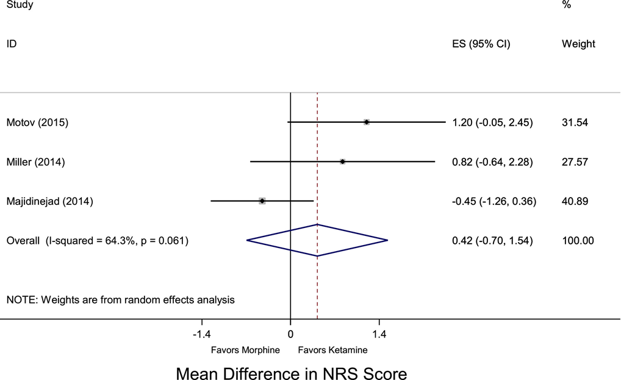
Ketamine vs. Opioids for Acute Pain
Karlow et al. Ann Emerg Med 2018: Meta-analysis comparing low-dose (< 0.5 mg/kg) IV ketamine to opioids for acute pain in ED
  1º outcome- Reported pain closest to 10” after administration
  3 studies, 251 patients
Mean difference in pain scores 0.42 (95% CI = –0.70 to 1.54)
Ketamine had more AEs (18 vs. 8) and requests for repeat dosing (4 vs. 0)
  None serious
Concluded ketamine non-inferior to opioids

Slide 14
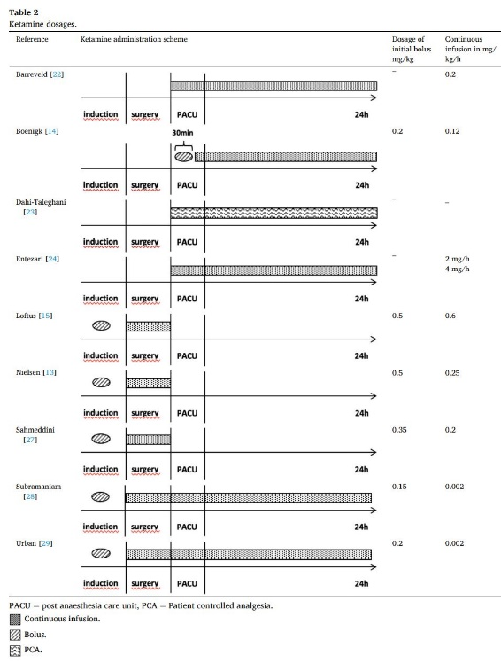
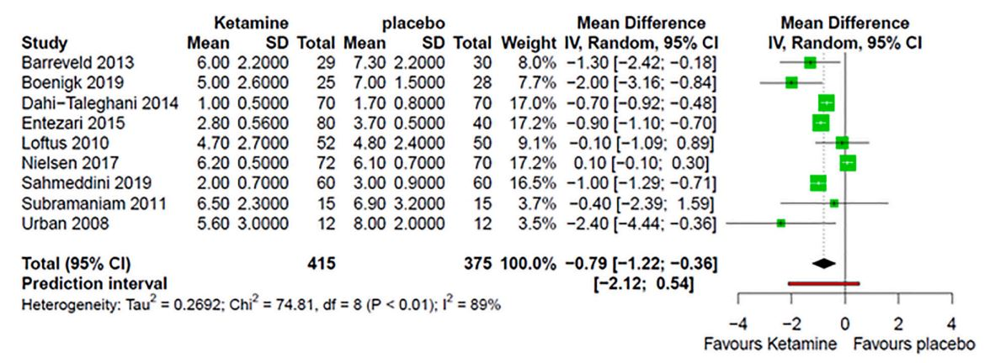
Placebo-Controlled Trials for Postoperative Pain in Opioid-Tolerant Patients
Meyer-Frießem et al. J Clin Anesth 2022: Meta-analysis comparing ketamine to placebo for postoperative pain in patients on opioids (N=9 studies, 802 patients)
Infusions started pre-induction (N=3), in OR after induction (N=2), or in PACU (N=4) and continued for 24 hr (6 of 9)
  Small reduction in pain with movement (MD − 0.79 points; 95% CI: − 1.22 to − 0.36) & pain at rest (N=3; MD − 0.6 points; 95% CI:-2.01 to 0.8)
  Patients treated with ketamine had mean reduction in OME consumption of 97.3 mg (95% CI: − 164.8 to − 29.7) after 24 h and 186.4 mg (95% CI: − 347.6 to − 25.2) after 48 h
  8 of 9 studies had high risk of bias

Slide 15
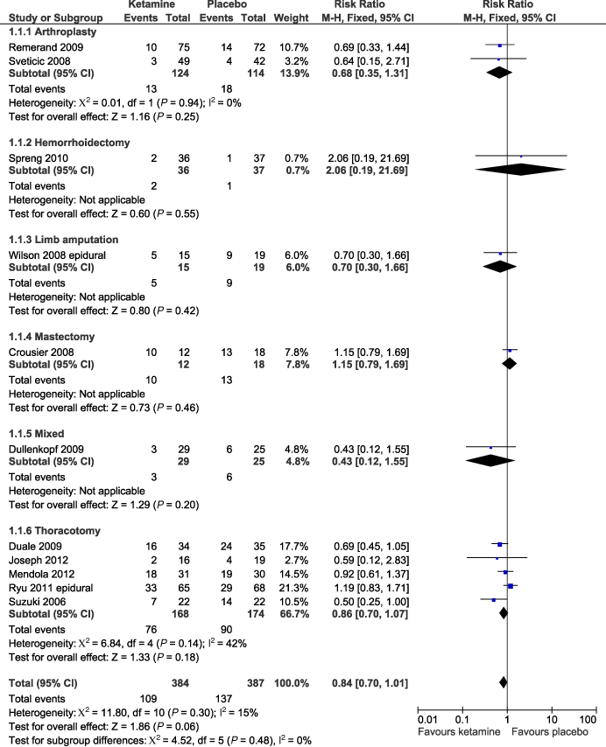
Meta-Analyses of Ability of Ketamine to Reduce Persistent Postsurgical Pain
Systematic review of epidural and IV ketamine: Failed to demonstrate significant reduction in risk of PPSP with ketamine (17 studies, 771 pts)
  28% incidence in ketamine vs. 35% in placebo group; 16% risk reduction (p=0.06) @ 3 months
  Epidural ketamine may be associated with neurotoxicity
IV Only: RR 0.75, NNT 12 @ 3 mo; RR 0.70, NNT 14 @ 6 mo.
Systematic review (10 studies, 784 pts) found a small preemptive effect @ 1 mo but not afterwards (3 of 10 studies positive)
Tena et al. CJP 2014: RCT (n=104) found neither preemptive epidural nor IV ketamine reduced PPSP after thoracotomy
Kang et al. Pain Physician 2020, RCT (n=184): Ketamine reduced PPSP after mastectomy (87% vs. 69%), but not avg pain scores
Anwar et al. Anesthesiology 2019, RCT (n=150): Pregabalin with (0%) or without ketamine (6%) reduced PPSP after cardiac surgery compared to placebo (34%) at 3 months
Khashan et al. Arch Orthop Trauma Surg 2016, RCT (n=45): Intra-articular MS04 = IA MS04 + ketamine > IA placebo for PPSP up to 2 weeks after rotator cuff repair
Forest plot showing incidence of PPSP @ 3 months in RCT comparing ketamine to placebo
McNicol et al. Acta Anaesthesiol Scand 2014; Klatt et al. Scand J Pain 2015
Notes:
RR 0.75 = 25% reduced incidence
Mixed evidence for toxicity in animals after IT administration, and anecdotal evidence in a cancer patient.

Slide 16
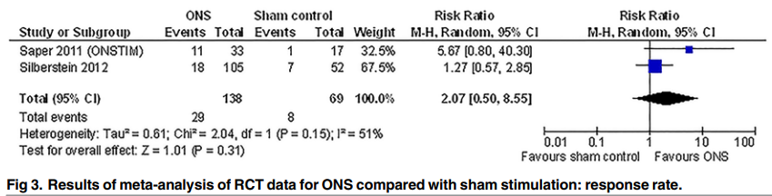
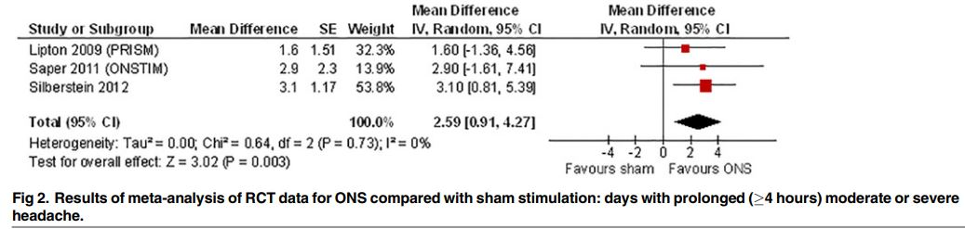
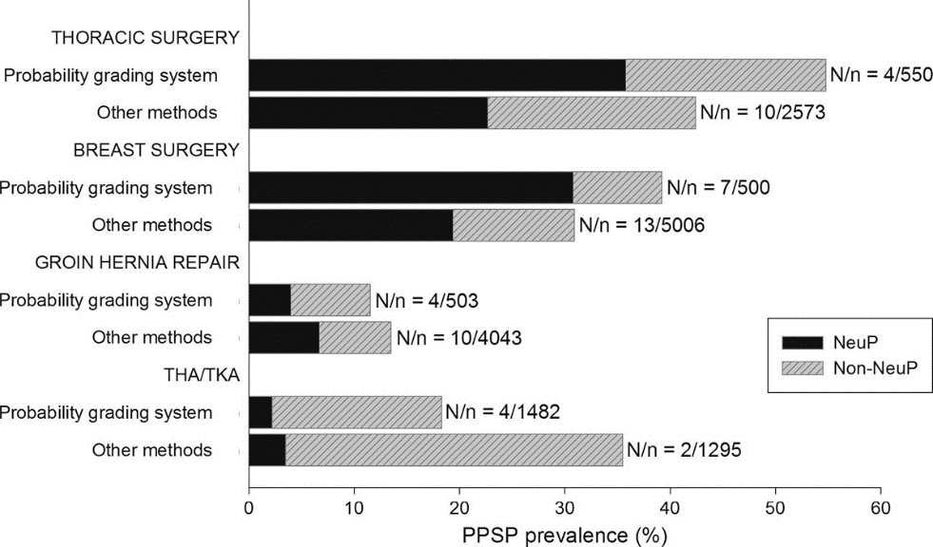
Considerations for PNS for Postoperative Pain
Greater efficacy for neuropathic pain than inflammatory pain
  High placebo response rate
  Most PPSP non-neuropathic
Temporary, percutaneous implants ideally suited for “dynamic” postsurgical pain
High rate (> 50%) of lead migration with permanent/ retained fragment with temporary devices, expensive
Indirect, but no direct evidence for preemptive analgesic effects
  Studies would require hundreds of patients per group
Effect size in RCTs relatively small
Tolerance to effect after 1-2 years
PNS vs. sham for migraines: Chen Y-F et al. PLoS One 2015; Proportion of pts with neuropathic & non-neuropathic pain after surgery: Haroutiunian et al. Pain 2013
Notes:
N: Lipton 125, Silberstein 157, Saper 50.

Slide 17
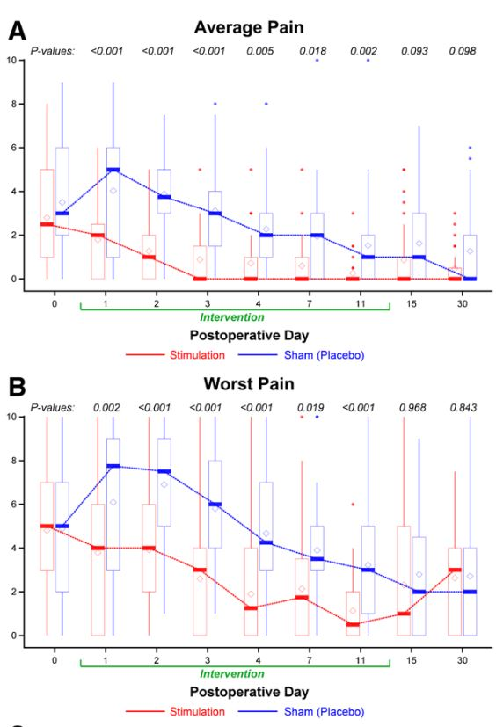
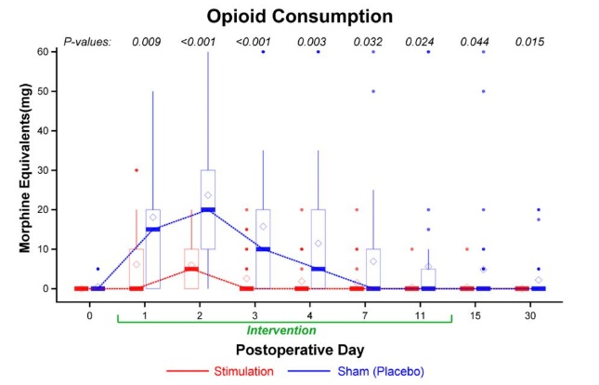
Randomized Controlled Trials Evaluating PNS
Ilfeld et al. Anesthesiology 2021
  66 pts scheduled for ambulatory orthopedic surgery (ACL, rotator cuff, bunionectomy, TKA)
  Electrode tested at 100 Hz, increasing current until sensation achieved
  Randomized to PNS or sham PNS postoperatively. All rec’d single-shot nerve block + GA; patients & investigators blinded
  PNS group rec’d stimulation at lowest perceived threshold for 2 weeks
  Mean pain intensity 1st week 1.1 + 1.1 vs. 3.1 + 1.7, median OME consumption 5 mg (0-30) vs. 48 (25-90) mg
  No differences in outcomes from 1-4 months except 0 in PNS group vs. 6 in sham group were on opioids
Notes:
ACL repair (femoral n), bunionectomy (sciatic n), rotator cuff (brachial plexus), knee arthroplasty, etc. Only programmer knew group allocation. Electric current was delivered at 100 Hz with the intensity slowly increased from zero. The pulse generator intensity setting spans a range of 0 (no current) Copyright © 2021, the American Society of Anesthesiologists. Unauthorized reproduction of this article is prohibited. Downloaded from http://pubs.asahq.org/anesthesiology/article-pdf/135/1/95/509261/20210700.0-00016.pdf by guest on 16 April 2022 Anesthesiology 2021; 135:95–110 97 Postoperative Peripheral Nerve Stimulation Ilfeld et al. to 100 (maximum), indicating a combination of amplitude (0 to 30 mA) and pulse duration (10 to 133 µs). Informed participants they did NOT have to perceive sensation like they did preoperative for benefit to occur (facilitates blinding). Patients prescribed short-acting opioids, Tylenol OTC as needed.

Slide 18
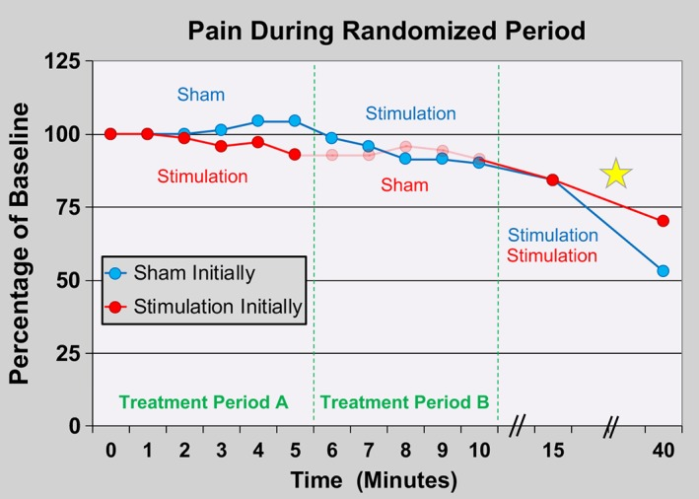
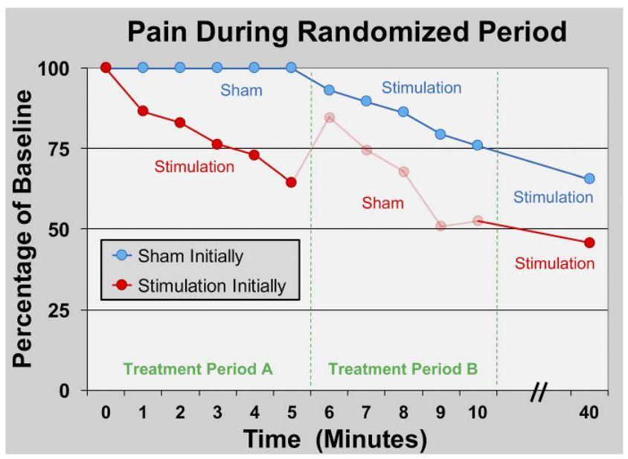
Short-Term Randomized & Observational Studies Evaluating PNS for Postoperative Pain
Author, Year | Design | Patients/ Surgery | Nerves | Duration | Results
Ilfeld, 2017 | Prosp | 5 pts < 60 d from TKA | Fem +/- Sciatic | < 1 d | 93% decr in rest pain, 27-30% during ROM
Ilfeld, 2017 | Prosp | 5 pts mean 42 d after TKA (6-97d) | Fem +/- Sciatic | < 1 d | 63% decr in rest pain, 14% & 50% during passive & active flexion
Ilfeld, 2019 | Prosp | 7 pts s/p TKA | Fem + Sciatic | Turned on < 24h after surgery x 8d -6 wk f/u | 6 of 7 had pain scores < 4 in 1st wk. 4 of 7 discontinued opioids within 1 wk
Ilfeld, 2019* | Rand, DB crossover, open-label f/u | 10 pts, ACL repair | Fem | 5” on/off, 5” washout; 2-4 wks open-label | Stim resulted in 7% decr vs. 4% incr w/ sham stim. With adductor canal block, 80% had pain scores < 1.5 thru POD-3
Ilfeld, 2018* | Rand, DB crossover, open-label f/u | 7 pts, hallux valgus osteotomy | Sciatic | 5” on/off, 5” washout; 2-4 wks open-label | Stim resulted in 35% decr vs. 0% incr w/ sham stim. During 30” open-label stim, pain scores decr 52%
Ilfeld, 2019 | Rand,DB crossover, open-label f/u | 14 pts, rotator cuff repair | Brachial plexus (BP) | 5” on/off, 5” washout; 2-4 wks open-label | No difference between active & sham stim. 64% required a n. block & 64% opioids in PACU.
Ilfeld, 2021 | Rand, DB | 66 pts, outpt orthopedic surg | BP, em or sciatic | 2 wks | Stim decr pain (mean 3.1 vs. 1.1) and opioid consumption (mean 48 MME vs. 5) over 1st 7 d. No diff @ 1 m except no (vs. 6) PNS pts on opioids
Brooke-Trainer, 2022 | Rand, open-label study comparing SMT to SMT/PNS | 16 pts s/p amputation after 5-7 d continuous n block | Fem + Sciatic | 8 wks | Decr avg. PLP 76% v 29% @ 5-8 wk, 76% v 58% @12 wk. Decr avg. RLP 86% v 52% @ 5-8 wk, 100% v 75% @ 12 wk. Opioid reduction: PNS > control.
Notes:
Chronic opioid use exclusion criteria for these studies except Brooke-Trainer (allowed up to 180 MME).

Slide 19
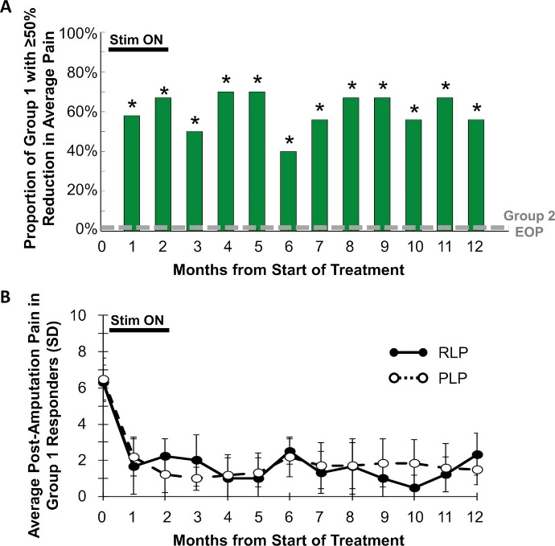
Short Course of PNS May Provide Long-Term Relief
Mechanisms
Reversing central & peripheral sensitization (breaking cycle of pain)
Improved sleep (raises pain thresholds & tolerance)
Long-term physiological effects
Improved activity, reversal of deconditioning
Improved mood
Placebo effect
Cohen et al. presented at MHSRS 2022, for LBP
Gilmore et al. RAPM 2019: Postamputation Pain

Slide 20
Summary of PNS for Postoperative Pain
SPRINT received FDA approval for implantation to treat postoperative (and post-traumatic) pain
  Scant evidence or basis for permanent implants
Strongest evidence as ‘rescue’ therapy for refractory pain
  May be beneficial in high-risk patients (high-risk surgery, individuals with poorly controlled baseline pain or multiple pain co-morbidities/ nociplastic pain, on high-dose opioids, etc.)
  Studies need to be performed regarding preemptive use in patients with preoperative pain (orthopedic procedures, limb amputation)
  Short-term therapy may provide long-term relief, but variability in study results
  Because of costs & risks, a ‘personalized’ medicine approach may be ideal

Slide 21
RCT Evaluating RFA before TKR Surgery
> 600,000 TKRs performed each year in U.S.
20%-45% will have persistent pain, with 15% describing pain as severe
Walega et al. RAPM 2019
  70 pts allocated to RFA vs. sham RFA 2-6 weeks before elective TKA
  Targeted 3 nerves with large-gauge electrodes and long heating times
    No prognostic blocks
  RFA as part of a multimodal pain management regimen had no effect on opioid use (mean MME over 48 h 144 in control group vs. 192 in RFA group), analgesia or function 48 h post-surgery
  There was also no long-term benefit on outcome measures through 6-months
Mishra et al. RAPM 2021
  60 pts allocated to RFA vs. sham RFA 2-4 weeks before elective TKA
  Targeted 3 nerves, and only RFA group rec’d LA
    No prognostic blocks
  RFA group younger, higher BMI and more male
  No differences in any outcome measure through 6-week follow-up
    Opioid use not reported, exluded pts with psych history or on > 100 MME

Slide 22
Are More Nerves Better?
Chen et al. RAPM 2021
  265 pts who underwent GN RFA
  Factors associated with RFA outcome: obesity, larger electrodes, > 80% pain relief with GNB, not being on opioids, no psychiatric morbidity, > 3 nerves, lower baseline pain score, non-TKR surgery
Fonkoue et al. Pain Med 2021
  55 pts randomized to GNB with 2 mL LA and steroid at Choi sites (SMGN, SLGN, IMGN) or revised sites (n=5) to include deeper n targets + RFN and IPBSN
  Revised targets > classic targets @ 1-hr and 1-day post-block
  > 40% of pts had prolonged relief at 3 months
Kose et al. Pain Med 2021
  DB study in which 80 pts were randomized to US-guided RFA at 5 sites (including RFN and IPBSN) vs. 3 sites after (+) GNB
  5 sites > 3 sites
  At 6 mo, 70% vs. 47.5% of pts in 5 & 3 nerve group had > 50% pain relief

Slide 23
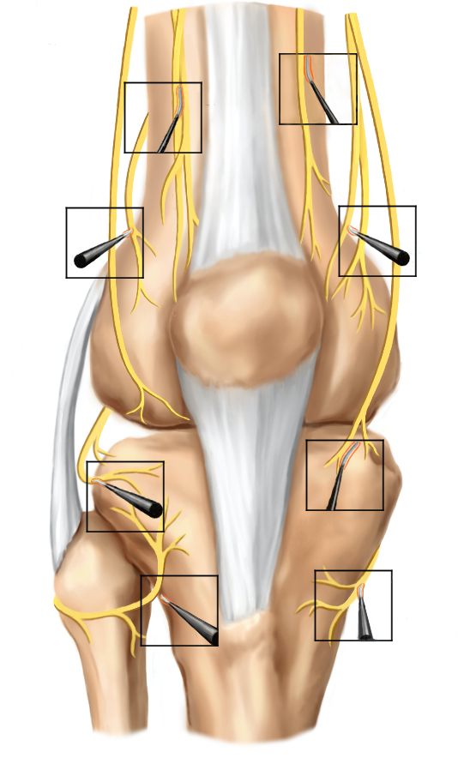
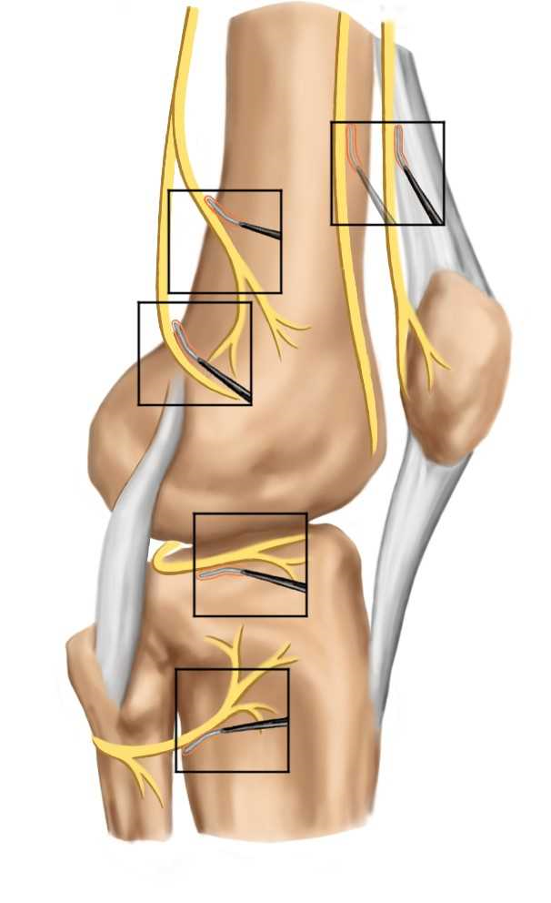
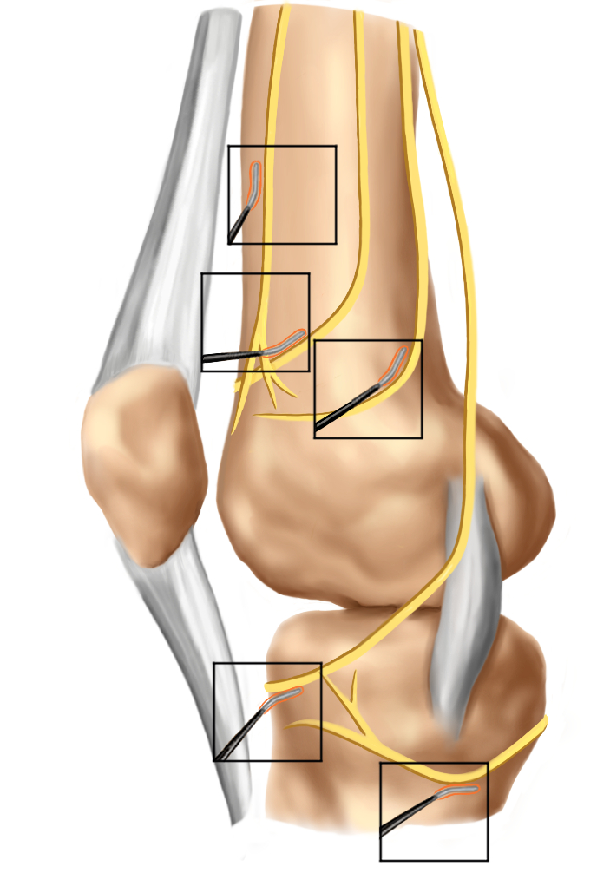
Anterior View
Lateral View
Medial View

Slide 24
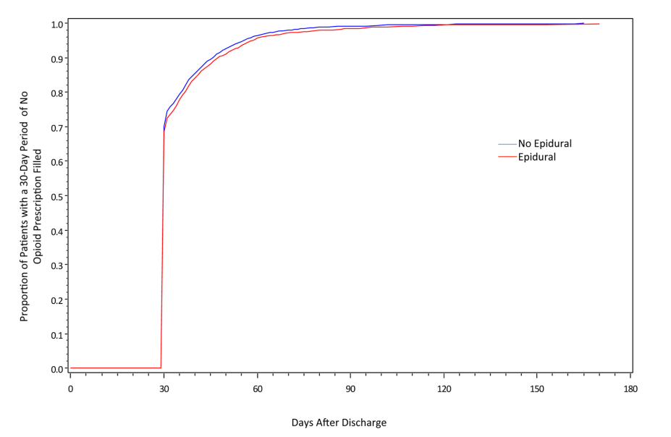
Can Epidurals Decrease Postoperative Opioid Prescriptions?
Ladha et al. Anesthesiology 2016
  Propensity-matched database review evaluating opioid prescriptions in 6432 opioid-naïve patients undergoing open abdominal surgery
  Primary outcome: Time-to-event for 30-day period without opioid refill after surgery
  No relationship between epidural placement & time to cessation of opioids (propensity-matched HR 0.96 (95% CI 0.91, 1.01) or 90-day MME doses
  Pts who rec’d epidural more likely to fill >2 opioid prescriptions within 90 d of surgery (30.4% vs 27.5%, p=0.0138).
Notes:
Excluded pts with metastatic cancer; 2:1 ratio for no epidural: epidural

Slide 25
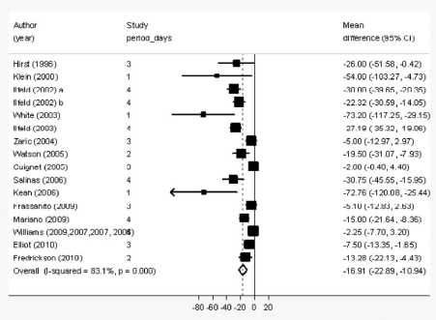
Can Regional Anesthesia Prevent Persistent Postsurgical Pain?
Weinstein et al. Cochrane Syst Database Rev 2018
  7 Studies (n=499) found epidural anesthesia reduced risk of PPSP after 3 mo. for thoracotomy (OR 0.52, 95% CI 0.32, 0.84)
  18 studies (n=1297) found RA reduced risk of PPSP after 3 mo. for breast ca. surgery (OR 0.43, 95% CI 0.28, 0.68) & for C-section (4 studies, n=551, OR 0.46, 95% CI 0.28, 0.78)
  3 studies (n=123) found inconclusive evidence for LA infiltration to reduce PPSP after ICBG (OR 0.20, 95% CI 0.04, 1.09)
  2 studies (n=97) found IV lidocaine reduced risk of PPSP after 3 mo. for breast ca. surgery (OR 0.20, 95% CI 0.04, 1.09)
Bingham et al. RAPM 2012
  In meta-analysis (7 studies, n=702), compared with single-shot PNB, continuous PNB associated with decreased pain on POD 0 Effect size 1.29; 95% CI 2.19, 0.40) and POD 2 (ES 2.03; 95% CI 2.78, 1.29), decreased opioid use (ES 15.70, 95% CI, 21.84 to 9.55), nausea/vomiting & increased satisfaction
Notes:
ICBG- iliac crest bone graft; Forrest plot is for opioid use in Bingham study.

Slide 26
Prospective Studies Evaluating Epidural Effect on
Preventing PLP
Author | # Pts | Random-ization | Blinding | Pre-op | Hrs. Pre-op | Intra-op | Post-op | Effect
Bach 1988 | 25 | + | - | + | 72 | + | - | +
Jahangiri 1994 | 24 | - | - | + | > 24 | + | + | +
Schug 1995 | 23 | - | - | + | 24 | + | + | +
Katsuly 1996 | 45 | + | ? | + |  | + | + | +
Nikolajsen 1997 | 60 | + | + | + | 18 | + | + | _
Lambert 2001 | 30 | + | - | + | 24 | + | + | No difference between epid & PN grps
Wilson 2008 | 53 | + | + | - | 0 | + | + | No difference between epid grps
Karanikolas 2011 | 65 | + | + | + | 48 | + | + | +
Yousef 2017 | 60 | + | + | - | NA | - | + | Epid Bup-Calc-Fent > Epid Bup @ 6 m and 1 yr, but not earlier
Notes:
Bach: Placed epidural 72h ahead of time. All pts rec’d epidural or spinal during operation and conventional analgesics postoperatively.
Jahangiri: Epidurals placed > 24 h ahead of time. Intraop was epidural & GA. Epidural cont’d 72h postoperatively.
Nikolajsen: Epidural placed 18 h preoperatively and cont’d for 2-3 days postoperatively.
Karanikolas: Placed epidural 48 h pre-op and cont’d for 48 h pre-op. Epi/epi/epi > PCA/epi/epi & PCA/GA/PCA > PCA/epi/PCA & Control
Wilson: Compared epidural ketamine/ bupiv vs. epidural bupivacaine. Epidurals placed immediately pre-op and cont’d for 48-72h.
Lambert: Epidurals placed 24h preoperatively. Compared against perineural bupivacaine given just before operation. Pts rec’d GA + epidural or perineural analgesia. Epidural or perineural analgesia cont’d for 72 h postoperatively. Only significant difference was less postoperative stump pain in epidural group.
Schug (letter): Started an avg of 24 h preoperatively and cont’d 48 h postop.

Slide 27
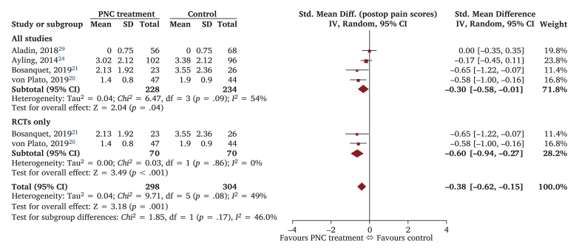
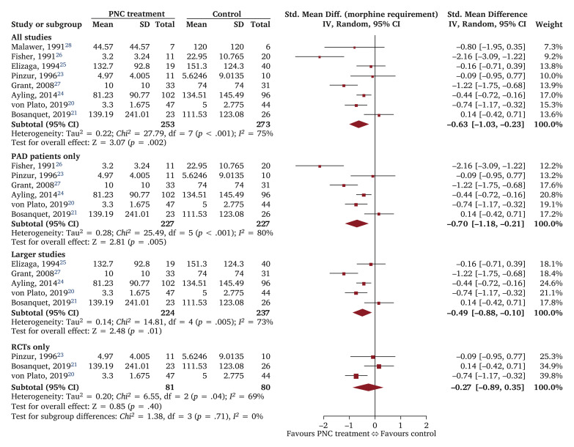
Meta-Analysis of Peripheral Nerve Catheters on Postamputation Pain
  Laloo et al. Eur J Vasc Endovasc Surg 2021
  10 studies (4 RCT, 6 retrospective), 350 rec’d PNC, 381 SoC
  PNC associated with reduction in postop pain (SMD −0.30, 95% CI −0.58 – −0.01, p = .04) and opioid requirements (SMD −0.63, 95% CI −1.03 – −0.23, p = .002) overall but not in RCTs only
  No significant difference in chronic RLP or PLP
Forrest plots showing postoperative pain scores & opioid consumption for PNC vs. control

Slide 28
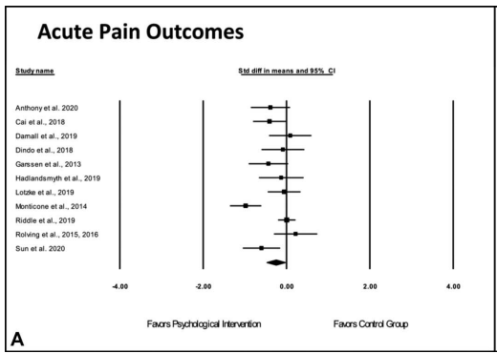
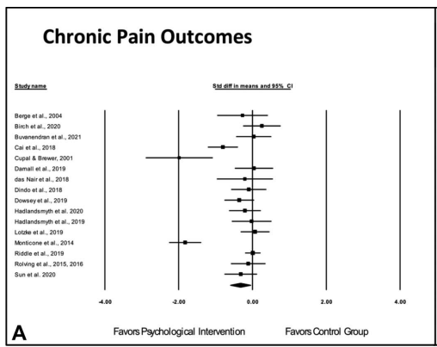
Can Preprocedural Psychological Interventions Improve Outcomes?
Co-morbid psychiatric conditions (depression, anxiety & substance use disorder) more common in surgical pts
Patients with psychiatric comorbidity more like to experience PPSP, chronic opioid use, and opioid use disorder
Mixed for psych interventions to reduce postsurgical pain
  Tong et al. 2020: Meta-analysis of 19 RCTs (n=1893) found pre-op psych interventions reduced postop anxiety (g = −0.26 (−0.49, −0.03), P=.02)) and improved mental QoL (g = 0.25 (0.02, 0.49), P=0.03) but not postop pain after orthopedic surgery (g = −0.15 (95% CI −0.42, 0.13), P=0.31)
  Nalinda et al. 2022: Meta-analysis of 21 RCTs found pre-op psych interventions reduced (sub)acute (d= -0.26 95% CI -0.48 to -0.04) & chronic (d= -0.33 95% CI -0.61 to 0.06) pain after surgery
    Stronger effect for interventions delivered after surgery & by psychologist
Tong et al. ANZ J Surg 2020; Nalinda et al. Pain 2022

Slide 29
Take Home Points
Evidence for small preemptive effect for ketamine perioperatively, and for ketamine to reduce opioid consumption
  Studies are inherently flawed
Ketamine may have greater effect on affective-motivational component than sensory-discriminative component
  Negative evidence based on preclinical studies evaluating QST
  Unclear whether it can ‘reverse central sensitization’
Ketamine is at least as effective as opioids for acute pain, but has a shorter duration and possibly more side effects

Slide 30
Take Home Points
RCTs evaluating genicular nerve RFA before TKR negative
    Neither used prognostic blocks & both used suboptimal technique
  Cadaveric studies and clinical trials suggest greater effectiveness when more nerves are targeted
  There is conflicting, positive evidence for the use of PNS to treat severe postsurgical pain
  Conflicting evidence for regional anesthesia to prevent postsurgical and PLP

