Slide 2
Please Silence Mobile Devices in all Sessions
Stay Connected. Visit the charging station and the “Hub” in the registration area.

Slide 3
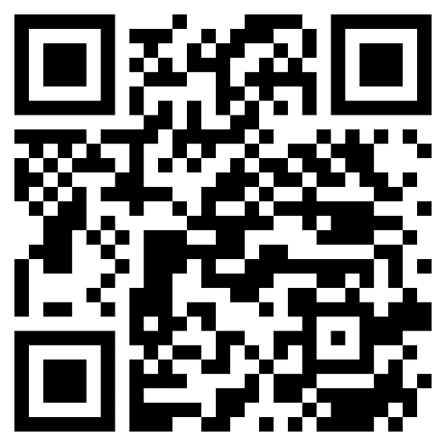
Pain & Addiction:
Essentials Online
A series of 6 online modules that cover the foundations of pain and addiction
Module 1: Science
Module 2: Stigma
Module 3: Screening & Assessment
Module 4: Pharmacological Treatment Approaches
Module 5: Nonpharmacological Treatment Approaches
Module 6: Interdisciplinary Approaches
Take the modules
together or purchase
individually

Slide 4
ASAM Annual 2023 Conference App
See what’s happening now, in real-time
Search and favorite items in the schedule
Explore sessions, posters, and exhibit hall
Engage with ASAM & fellow attendees via social media and direct messages.
Tip: Instructions to download the ASAM Event App are on the back of your badge!
Notes:
Shorten

Slide 5
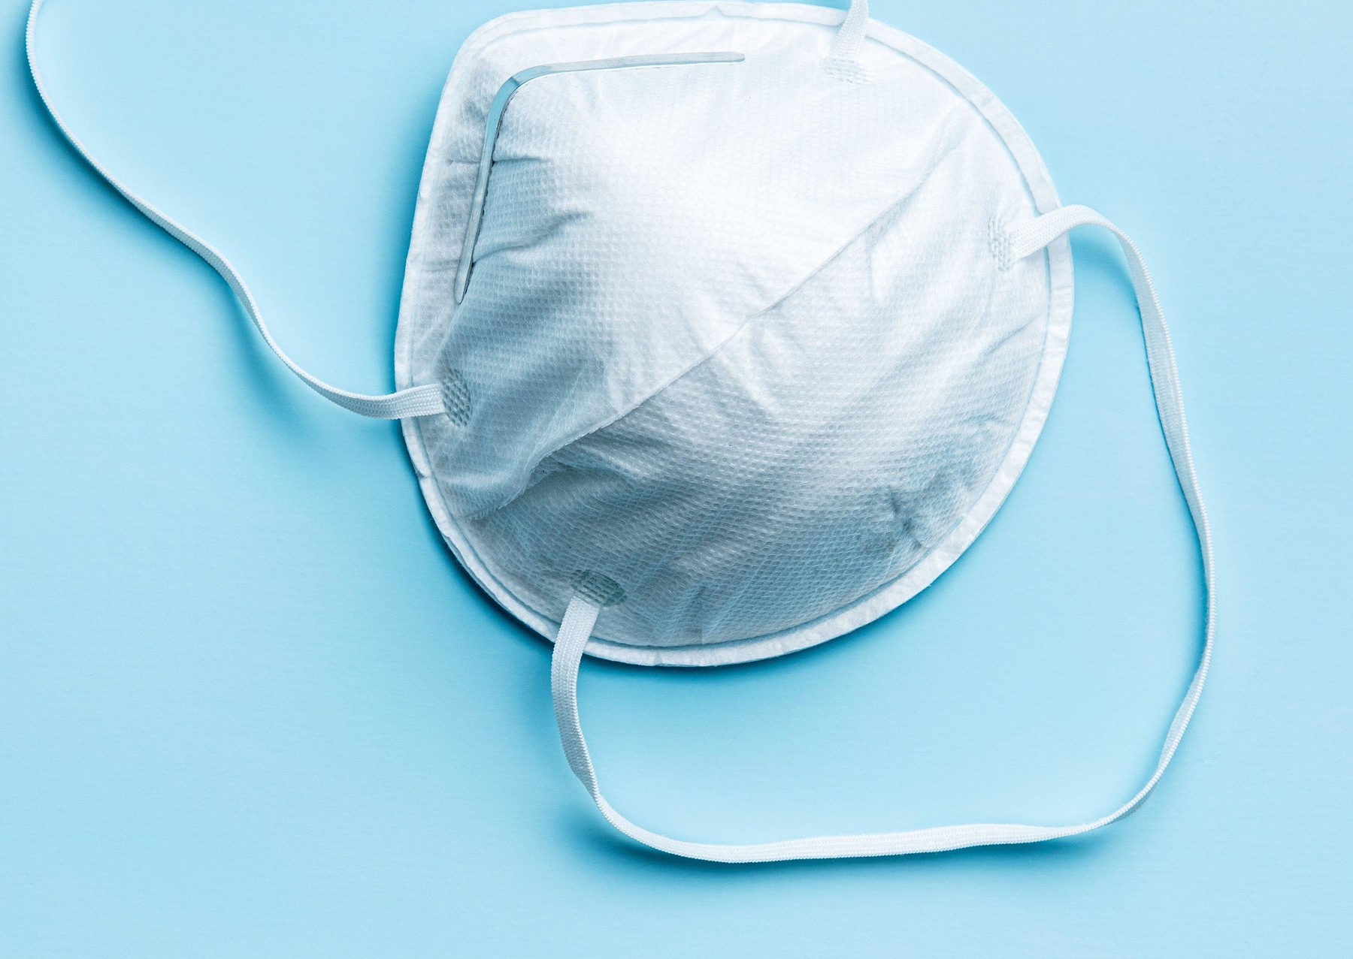
Health & Safety
Reminders
Masks are encouraged
Wash your hands frequently
Observe social distancing
Evaluate your own health

Slide 6
Connect with ASAM
@asamorg
@AddictionMedicine
AddictionMedicine
AddictionMedicine
Use Hashtag #ASAMAnnual
Notes:
Faded box

Slide 7
The Largest Library of
Addiction Medicine CME
Claim Credit: April 17, 2023 – April 17, 2024 On-Demand Course Sessions:
May 15, 2023 – May 15, 2026 eLearning.ASAM.org

Slide 8
Join or Renew Today!
Visit the ASAM Booth to learn more about membership
https://asam.org/membership
Notes:
Wrong your

Slide 9
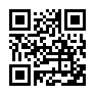
July 27 – 28, 2023 | Live Virtual Course
Register Today!

Slide 10
The first ASAM Patient Placement Criteria came out in 1991. The ASAM Criteria - 4th Edition comes out in Fall 2023. Visit the ASAM Booth to learn more!

Slide 11
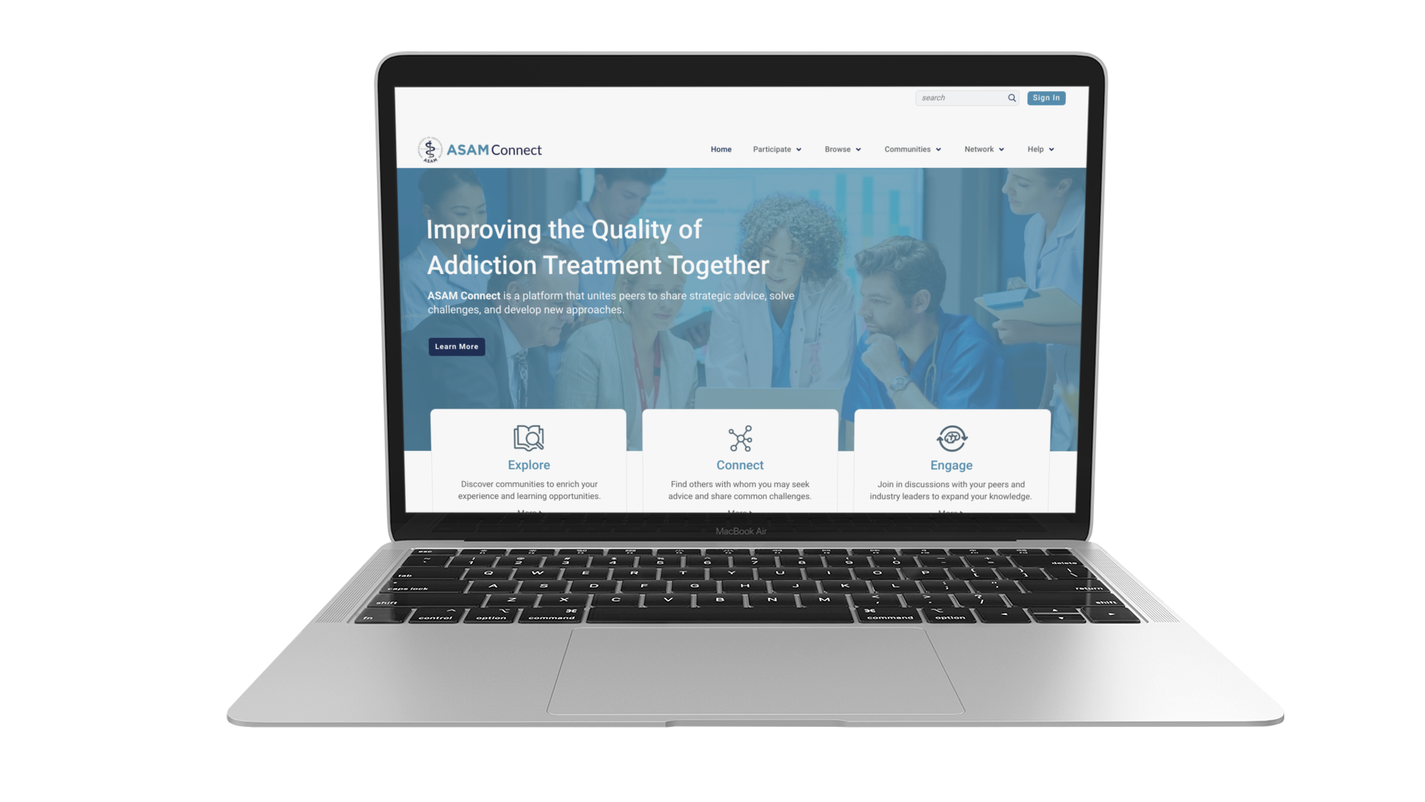
NEW Member Exclusive Benefit
ASAM Connect is an online community platform that unites peers to share practice advice, solve challenges, and develop new approaches.
connect.ASAM.org

Slide 12
Q&A with Presenters through the app!
Find the session
Click “Q&A” button
Press “Ask Question” button
Type in your question, click “Submit”
Tip: Instructions to download the ASAM Event App are on the back of your badge!
Notes:
Shorten

Slide 13
Treatment for tobacco use disorder during addiction treatment is associated with a 25% increased likelihood of long-term abstinence from alcohol and illicit drugs. Check out ASAM’s New Clinical Guidance.

Slide 14
Call for Abstracts Opens in
September 2023!

