Slide 1
Starting the Journey: Presentations in Emergency Departments
Andrew Herring, MD Chief Division of Addiction Medicine Alameda Health System, Oakland, CA
Pain & Addiction: Common Threads: Navigating pain and addiction challenges across transitions of care.
April 13, 2023, Washington, DC.

Slide 2
Disclosures
Andrew Herring, MD
Pain & Addiction: Common Threads
April 13, 2023
No Disclosures
Certifications
American Board of Emergency Medicine
American Board of Preventative Medicine-Addiction Medicine
American Board of Pain Medicine

Slide 3
Emergency Departments are a beautiful triumph of democracy
Crowding and costs are manufactured by non-clinical factors
Free, 24-7
Comprehensive—medicine, food, shelter
Ketamine is cheap, easy, and every ER doc knows how to use it
Don’t believe the hype
Notes:
This slide is to address”why”
work with the ER and to break down barriers of collaboration that are so common

Slide 4
Integrated systems of care should be standard
Clinic
Clinic
Bad pharmacist
Jail/Prison
Shelter
Emergency Department 24-7 partner to fill in treatment gaps and apply high-intensity treatments

Slide 5
First ER buprenorphine study

Slide 6
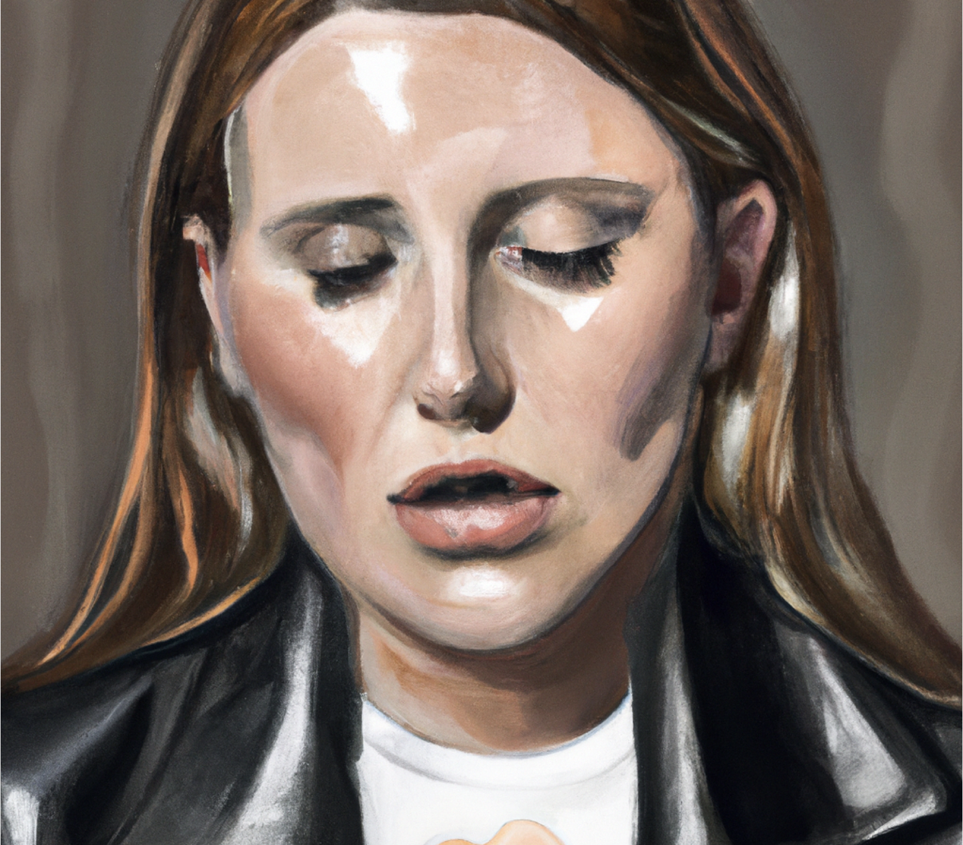
“Smokes 2 grams fentanyl daily”
Restrained driver in high speed rollover motor vehicle crash
3 broken ribs and a pulmonary contusion
Last use of fentanyl 8 hours ago
Last use of methamphetamine 4 hours ago
Caulfield, Mackenzie Duncan Gregory, et al. "Transitioning a patient from injectable opioid agonist therapy to sublingual buprenorphine/naloxone for the treatment of opioid use disorder using a microdosing approach." BMJ Case Reports CP 13.3 (2020): e233715.

Slide 7
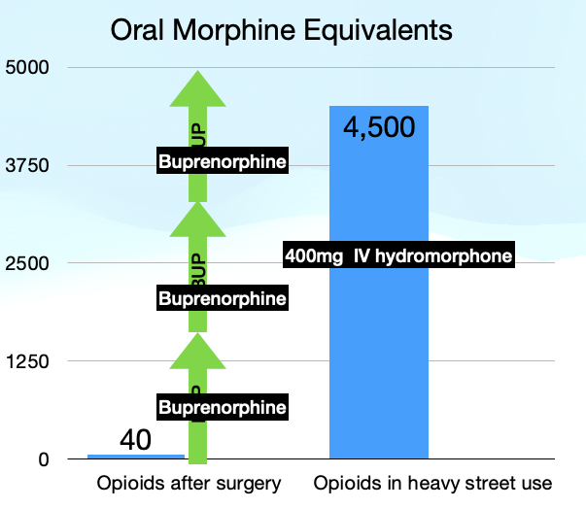
Step 1: Dose opioids appropriately
Ab
Caulfield, Mackenzie Duncan Gregory, et al. "Transitioning a patient from injectable opioid agonist therapy to sublingual buprenorphine/naloxone for the treatment of opioid use disorder using a microdosing approach." BMJ Case Reports CP 13.3 (2020): e233715.

Slide 10
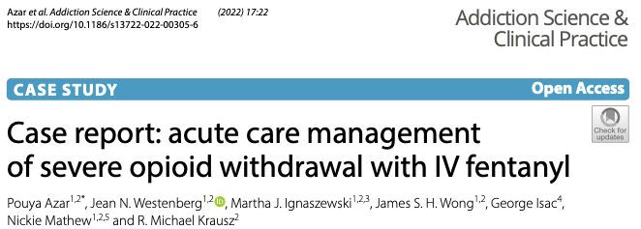
200mcg IV fentanyl every 10 minutes till comfortable

Slide 11
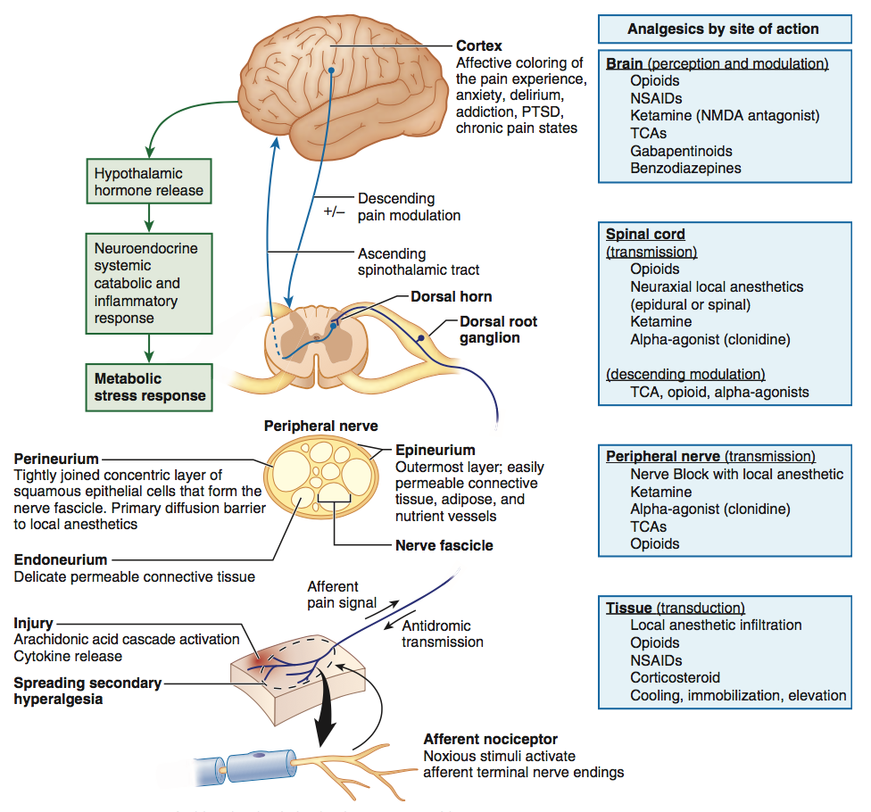
Lots of receptors lots of interventions
Experience of pain is complex
Expression of pain is complex
Using multiple medication classes and non-pharmacologic interventions is standard
Treatment of pain and opioid withdrawal is the same

Slide 13
How to use ketamine
Total of 0.5 mg / kg is a good target for lasting effects
40mg IV over an hour
20mg IV over 15-20 x 2
The slower the infusion the lower the risk of fear and confusion.
Motivational interviewing promotes placebo and enjoyment

Slide 14
Regional Anesthesia
Nerve Block for Rib Fracture
Hip and Femoral fractures
Rib Fractures
Shoulder dislocation
Many others

Slide 15
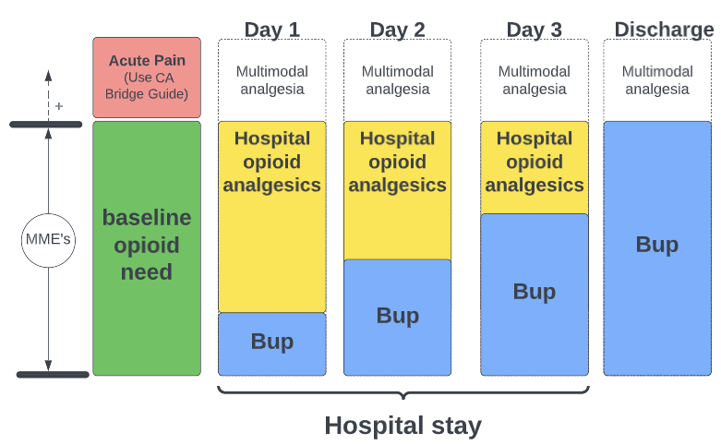
Opioid Assisted Bup Induction
How about starting BUP?
Opioids continued and even increased
Bup ramp over 2-5 days
Begin at ≤ 1mg SL
AGONIST: morphine ER 60mg Q 6 ATC; Hydromorphone 8mg PO PRN BUP: Day 1 0.5mg SL Q 3H Day 2 1mg Q 3H Day 3 Sublocade

Slide 16
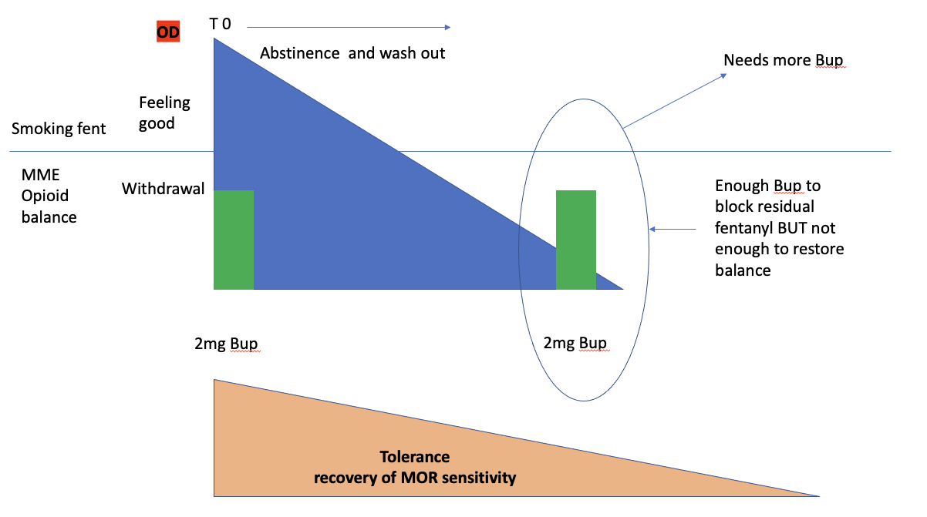

Slide 17
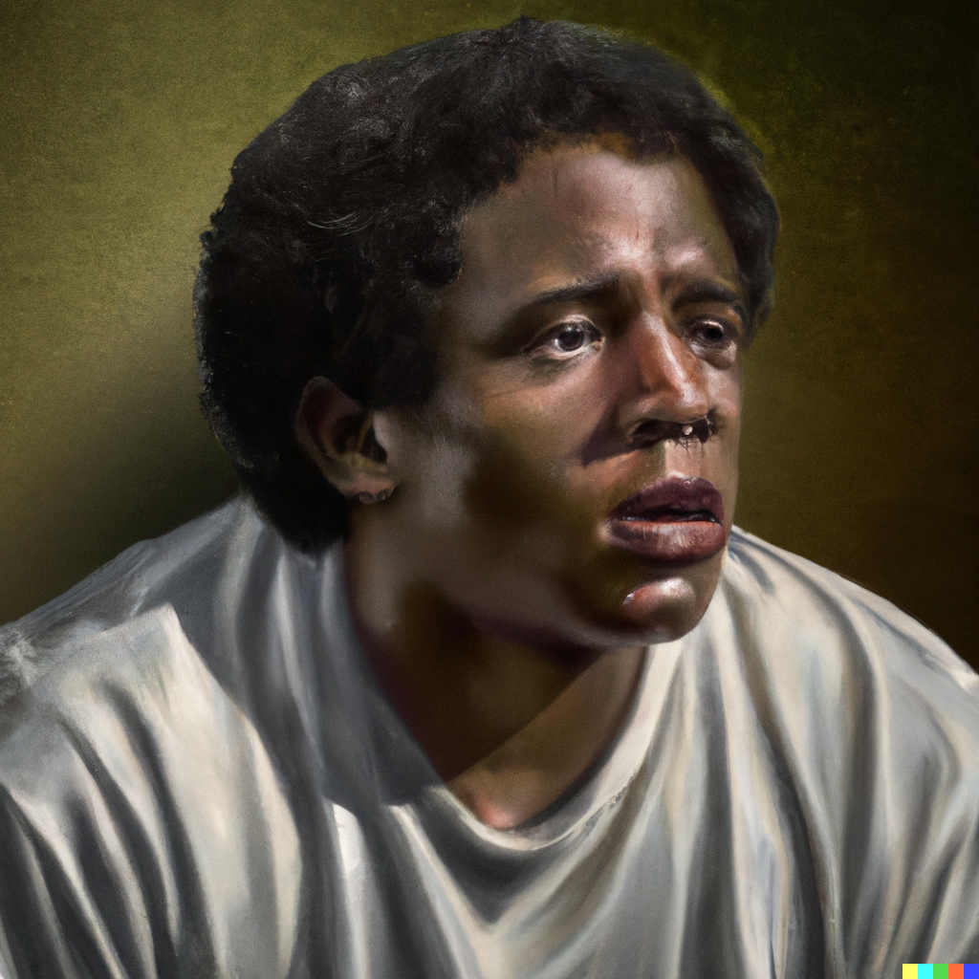
Sickle Cell Crisis on Bup
Case 2
SSD
Heroin use
On Bup 24mg/day x 6 months
Presents with typical back and leg pain

Slide 18
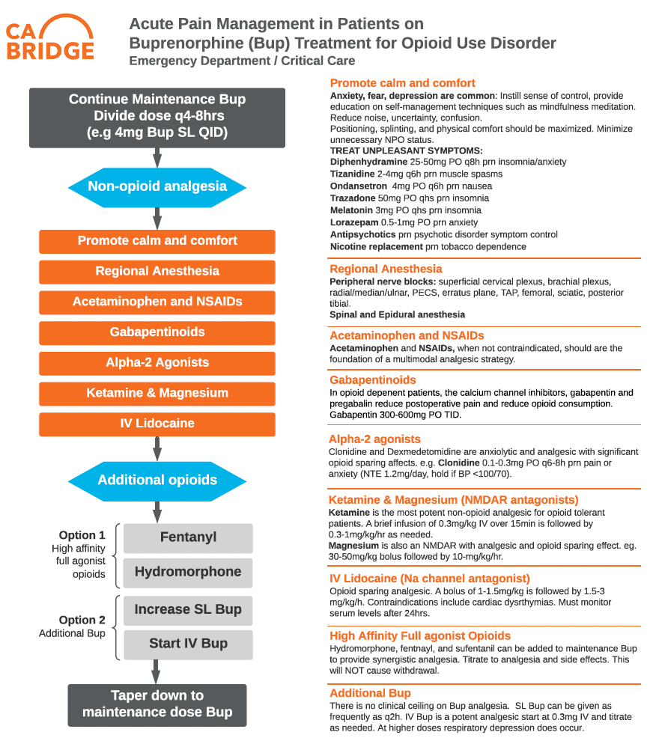
Sickle Cell Crisis on Bup

Slide 19
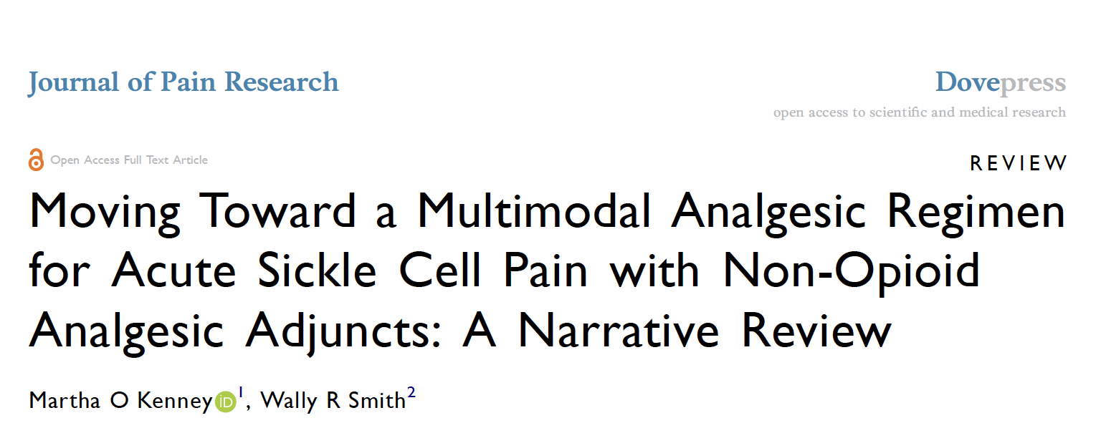
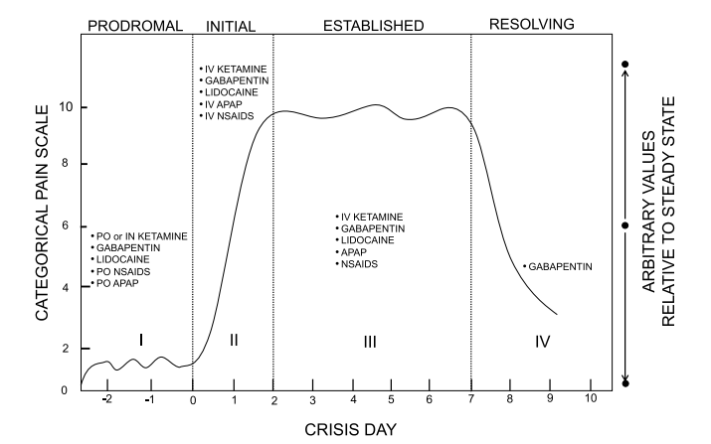
Acetaminophen NSAIDs IV Lidocaine Gabapentin KETAMINE

Slide 20
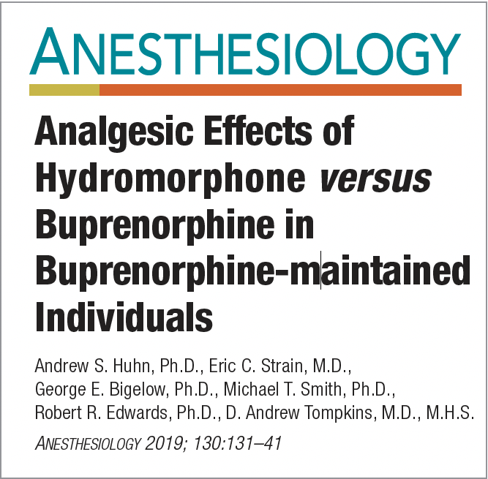
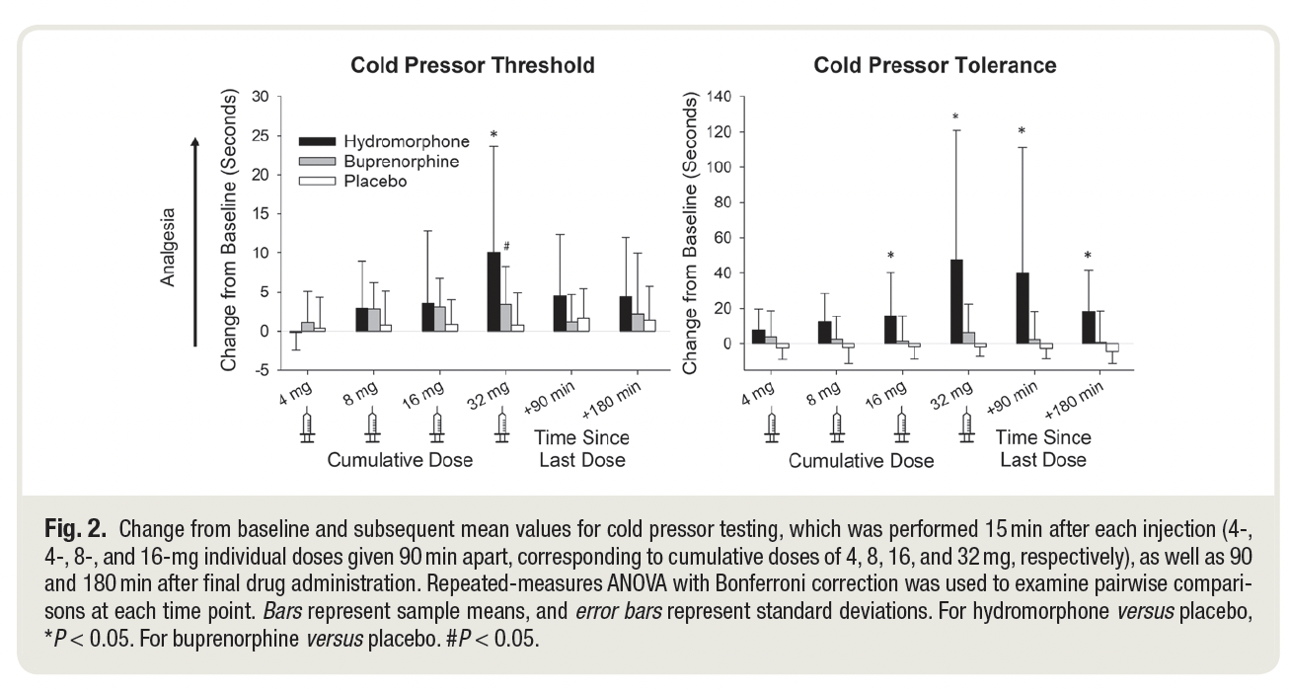
Sickle Cell Crisis on Bup
Maintained on 16mg / day Bup
At trough (17hrs) since last dose
16-32 IV Bup or hydromorphone needed for strong analgesic response

Slide 21
Final Takeaways/Summary
Emergency Department treatment of pain and oud is a fantastic opportunity to help patients with OUD
Buprenorphine can be initiated or continued in nearly all cases
Exotic treatments like IV ketamine are common and easily administered in the ED
ER clinicians love supportive partners!
Notes:
Take this time at the end of your presentation to review key takeaways and information that audiences should remember in the future. If practical, apply this to clinical practice.

Slide 22
References
O’Neill, A., & Lirk, P. (2022). Multimodal Analgesia. Anesthesiology Clinics, 40(3), 455-468.
Kenney, M. O., & Smith, W. R. (2022). Moving toward a multimodal analgesic regimen for acute sickle cell pain with non-opioid analgesic adjuncts: a narrative review. Journal of Pain Research, 879-894.
Hailozian, C., Luftig, J., Liang, A., Outhay, M., Ullal, M., Anderson, E. S., ... & Herring, A. A. (2022). Synergistic effect of ketamine and buprenorphine observed in the treatment of buprenorphine precipitated opioid withdrawal in a patient with fentanyl use. Journal of Addiction Medicine.
Greenwald, M. K., Herring, A. A., Perrone, J., Nelson, L. S., & Azar, P. (2022). A neuropharmacological model to explain buprenorphine induction challenges. Annals of Emergency Medicine.
https://cabridge.org/
Notes:
ASAM requests the APA citation format
Link: https://owl.purdue.edu/owl/research_and_citation/apa_style/apa_formatting_and_style_guide/general_format.html

