Slide 1
My Journey:
A Patient's Experience on Buprenorphine for Chronic Pain
Stacy Kerns in Collaboration with Greg Rudolf, MD, DFASAM
Pain & Addiction: Common Threads Course XXIV
April 13, 2023
Notes:
Title slide and slide 2: Present before starting video
Part 1 of video
Slide 3
Part 2 of video
Slide 4
Part 3 of video
Slides 5-7
Part 4 of video
Slides 8-10
Part 5 of video
Slides 11-16
Part 6 of video
Slides 17-19

Slide 2


Individual Differences Influencing Pain Experience
“Analgesic Tone”
Epigenetics
Individual’s processing of pain signals and their subsequent subjective response, influenced by:
The study of functional (and potentially heritable) changes in the regulation of gene activity and expression due to the environment that are not dependent
on gene sequence.
Genetics
Adverse Childhood Events
Life Stressors in Adulthood
Anxiety, Depression, PTSD
Substance use, including prescribed opioid treatment
  Includes both acute and chronic use, but chronic more typically impactful
Notes:
“Analgesic Tone”: individual’s processing of pain signals and their subsequent subjective response, influenced by:
Genetics
Adverse Childhood Events
Life Stressors in Adulthood
Anxiety, Depression, PTSD
Substance Use including prescribed opioid treatment
Includes both acute and chronic use but chronic more typically impactful
EPIGENETICS: the study of functional (and potentially heritable) changes in the regulation of gene activity and expression due to the environment that are not dependent on gene sequence

Slide 3

VIDEO PART 1 https://vimeo.com/807377910/f87f2f7297
Notes:
Title slide and slide 2: Present before starting video
Part 1 of video
Slide 3
Part 2 of video
Slide 4
Part 3 of video
Slides 5-7
Part 4 of video
Slides 8-10
Part 5 of video
Slides 11-16
Part 6 of video
Slides 17-19

Slide 4

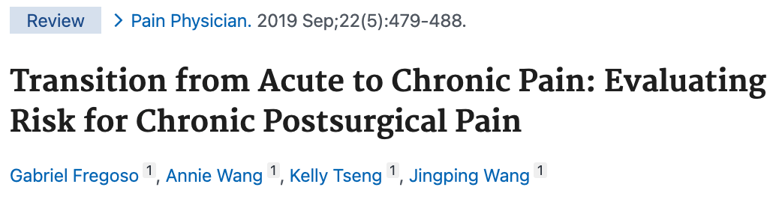
Chronic Post-Surgical Pain (CPSP): Preventable?
Common and severe complication of surgery
Peripheral and central sensitization are key mechanism
in the transition from acute to chronic pain
Pathophysiology, predisposing risk factors, predictive models, and prevention have been explored in the literature
Fregoso G, Wang A, Tseng K, Wang J. Transition from Acute to Chronic Pain: Evaluating Risk for Chronic Postsurgical Pain. Pain Physician. 2019 Sep;22(5):479-488. PMID: 31561647.
Notes:
Fregoso G, Wang A, Tseng K, Wang J. Transition from Acute to Chronic Pain: Evaluating Risk for Chronic Postsurgical Pain. Pain Physician. 2019 Sep;22(5):479-488. PMID: 31561647.

Slide 5
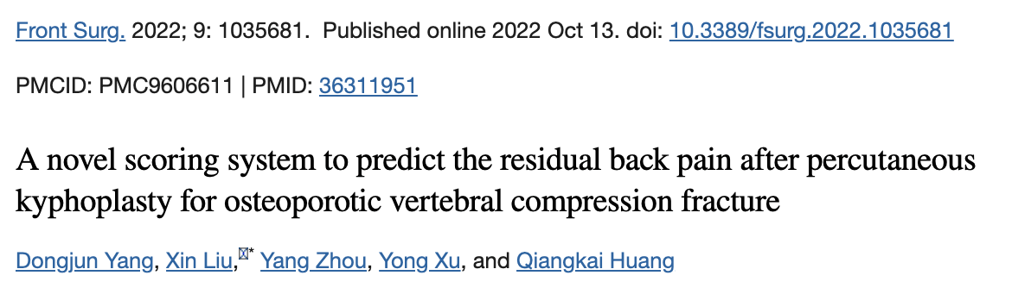
Chronic Post-Surgical Pain (CPSP): Preventable?
(Continued)
Incidence can potentially be reduced
through early identification of perioperative, genetic, physiologic, and psychologic factors.
Aggressive multimodal post-op analgesia appears helpful
Ketamine, gabapentinoids, alpha-agonists,
COX-2 inhibitors, regional anesthesia
Role for buprenorphine as post-op opioid of choice? https://doi.org/10.1016/j.anclin.2010.08.015
Yang, et al. 2022 proposed a novel scoring system to predict residual back pain after kyphoplasty for vertebral compression fracture.
Vadivelu N, Anwar M. Buprenorphine in postoperative pain management. Anesthesiol Clin. 2010 Dec;28(4):601-9. doi: 10.1016/j.anclin.2010.08.015. PMID: 21074740.
Yang D, Liu X, Zhou Y, Xu Y, Huang Q. A novel scoring system to predict the residual back pain after percutaneous kyphoplasty for osteoporotic vertebral compression fracture.
Front Surg. 2022;9:1035681. Published 2022 Oct 13. doi:10.3389/fsurg.2022.1035681
Notes:
Yang D, Liu X, Zhou Y, Xu Y, Huang Q. A novel scoring system to predict the residual back pain after percutaneous kyphoplasty for osteoporotic vertebral compression fracture. Front Surg. 2022;9:1035681. Published 2022 Oct 13. doi:10.3389/fsurg.2022.1035681
Vadivelu N, Anwar M. Buprenorphine in postoperative pain management. Anesthesiol Clin. 2010 Dec;28(4):601-9. doi: 10.1016/j.anclin.2010.08.015. PMID: 21074740.
Buprenorphine in Postoperative Pain Management
Nalini Vadivelu, MD
Muhammad Anwar, MD
DOI:https://doi.org/10.1016/j.anclin.2010.08.015

Slide 6
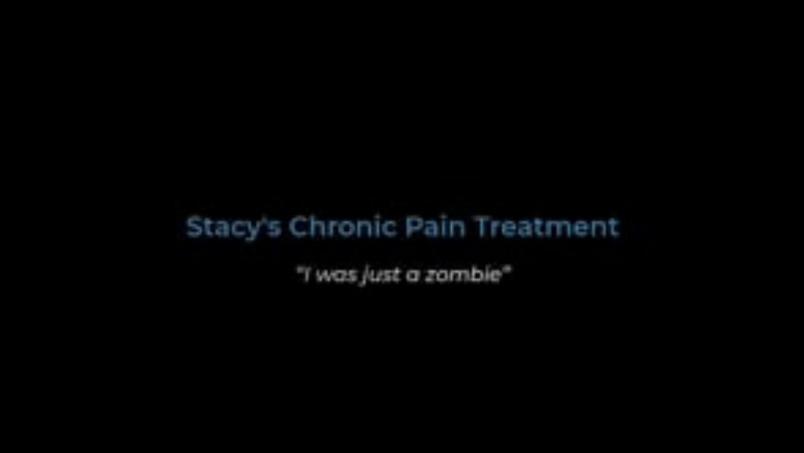
VIDEO PART 2 https://vimeo.com/807375354/43aa99f58b
Notes:
Title slide and slide 2: Present before starting video
Part 1 of video
Slide 3
Part 2 of video
Slide 4
Part 3 of video
Slides 5-7
Part 4 of video
Slides 8-10
Part 5 of video
Slides 11-16
Part 6 of video
Slides 17-19

Slide 7
Clinical Considerations
OPIOIDS
Stacy’s MED = ?
Pain and functional assessments
Screening for risk of misuse, OUD, overdose
Mental health eval
PAIN
OUD
Notes:
The obligatory "Venn Diagram"
We're all here for the "Pain and Addiction Common Threads" Course so naturally there is implicit understanding of the overlap between pain and OUD. Most of us already recognize that having persistent pain is a risk factor for developing OUD and that having OUD is associated with higher prevalence of chronic pain.
In this talk I will touch on the pain-opioids overlap which can also move in both directions, in that opioids are typically used to treat pain, but they can sometimes lead to amplification of pain signals. More on that shortly.

Slide 8
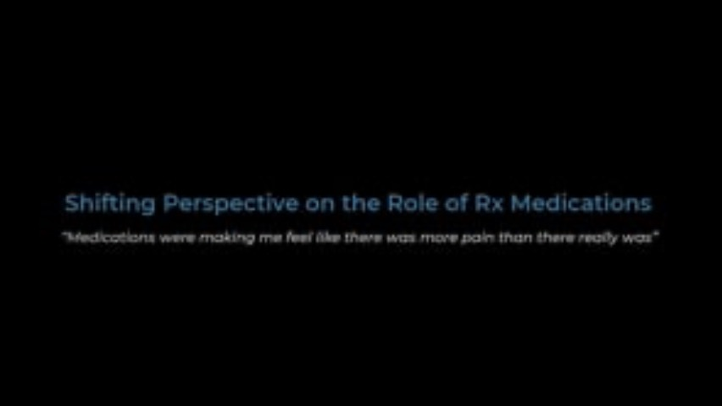
VIDEO PART 3 https://vimeo.com/807380111/5954b9c57f
Notes:
Title slide and slide 2: Present before starting video
Part 1 of video
Slide 3
Part 2 of video
Slide 4
Part 3 of video
Slides 5-7
Part 4 of video
Slides 8-10
Part 5 of video
Slides 11-16
Part 6 of video
Slides 17-19

Slide 9
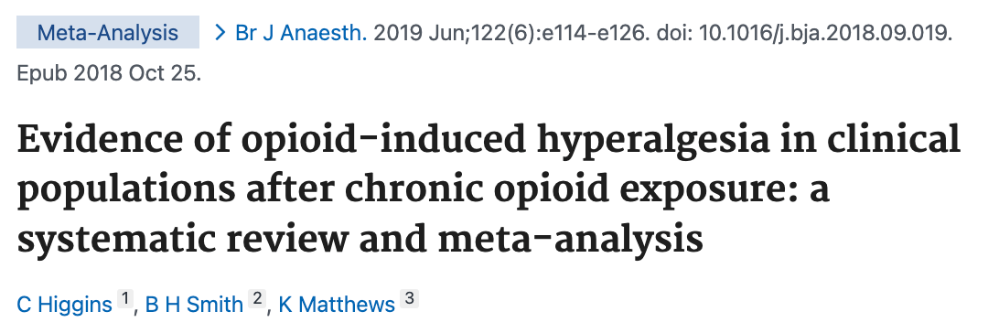
Opioid-Induced Hyperalgesia (OIH)
A state of increasing nociceptive sensitivity caused by exposure to opioids
Neuroplasticity in CNS and PNS involving:
  Sensitization in glutaminergic (NMDA) & alpha-adrenergic pathways
  Dynorphin (ligand which acts primarily at kappa opioid receptors)
  Overactivity of adenyl-cyclase-1 enzyme → increased endogenous opioid tone
  Faulty descending inhibition of pain signals (gate control theory)
Higgins C, Smith BH, Matthews K. Evidence of opioid-induced hyperalgesia in clinical populations after chronic opioid exposure: a systematic review and meta-analysis. Br J Anaesth. 2019 Jun;122(6):e114-e126. doi: 10.1016/j.bja.2018.09.019. Epub 2018 Oct 25. PMID: 30915985.
Notes:
DO DEFINITION ON SLIDE THEN READ:
OIH is not a new concept and was written about in the medical literature as early as late 1800's.
It's been eloquently discussed here by our own Dr Rieb in the last couple of years.
It's worth discussing again as it remains a major contributing factor to the overall burden of chronic pain whenever prolonged opioids are involved, yet it very often is not recognized or discussed in the exam room. And the tragedy of that is, we are missing an opportunity, because OIH is quite treatable.
Higgins C, Smith BH, Matthews K. Evidence of opioid-induced hyperalgesia in clinical populations after chronic opioid exposure: a systematic review and meta-analysis. Br J Anaesth. 2019 Jun;122(6):e114-e126. doi: 10.1016/j.bja.2018.09.019. Epub 2018 Oct 25. PMID: 30915985.

Slide 10
Opioid-Induced Hyperalgesia (OIH)
(Continued)
’’
OIH can be modulated by buprenorphine due to its antihyperalgesic effect.
Also,
  alpha agonists (eg, tizanidine)
  COX-2 inhibitors
  gabapentinoids
  ketamine
‘
Whilst there is some evidence
to suggest that tolerance and dependence should be a concern
when administering opioids,
OIH should also be of concern
to pain specialists.
’’
(Higgins, 2019)
Notes:
DO DEFINITION ON SLIDE THEN READ:
OIH is not a new concept and was written about in the medical literature as early as late 1800's.
It's been eloquently discussed here by our own Dr Rieb in the last couple of years.
It's worth discussing again as it remains a major contributing factor to the overall burden of chronic pain whenever prolonged opioids are involved, yet it very often is not recognized or discussed in the exam room. And the tragedy of that is, we are missing an opportunity, because OIH is quite treatable.
Higgins C, Smith BH, Matthews K. Evidence of opioid-induced hyperalgesia in clinical populations after chronic opioid exposure: a systematic review and meta-analysis. Br J Anaesth. 2019 Jun;122(6):e114-e126. doi: 10.1016/j.bja.2018.09.019. Epub 2018 Oct 25. PMID: 30915985.

Slide 11
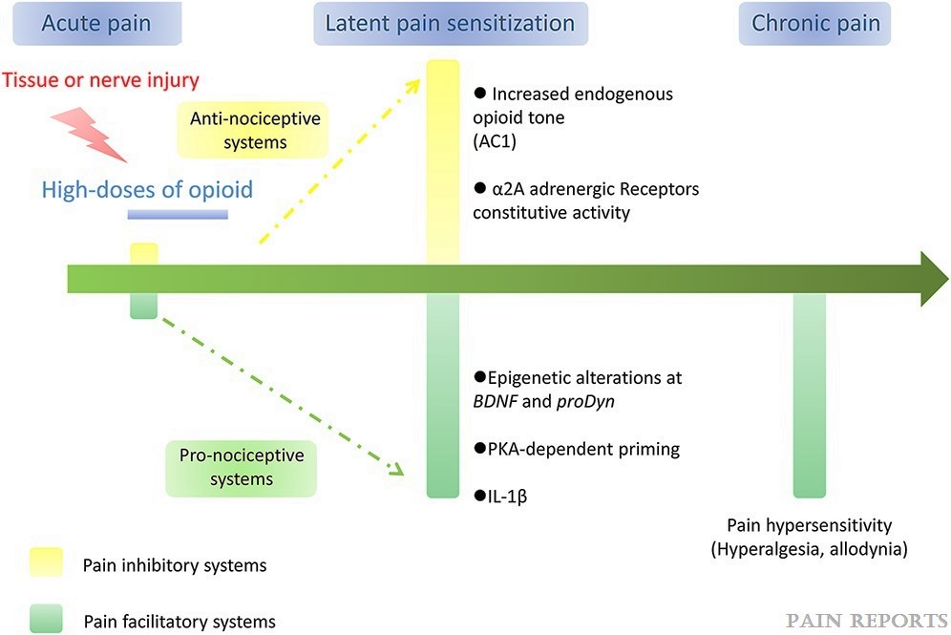
Schematic of
Opioid-Induced Hyperalgesia
Copyright © 2020 International Association for the Study of Pain
Notes:
Copyright © 2020 International Association for the Study of Pain
Schematic: Figure 2, Hypothesis on the transition from acute to chronic facilitate by opioid administration (Opioid-Induced Hyperalgesia)
Rivat, Cyrila; Ballantyne, Janeb,*. The dark side of opioids in pain management: basic science explains clinical observation. PAIN Reports 1(2):p e570, August 2016. | DOI: 10.1097/PR9.0000000000000570

Slide 12
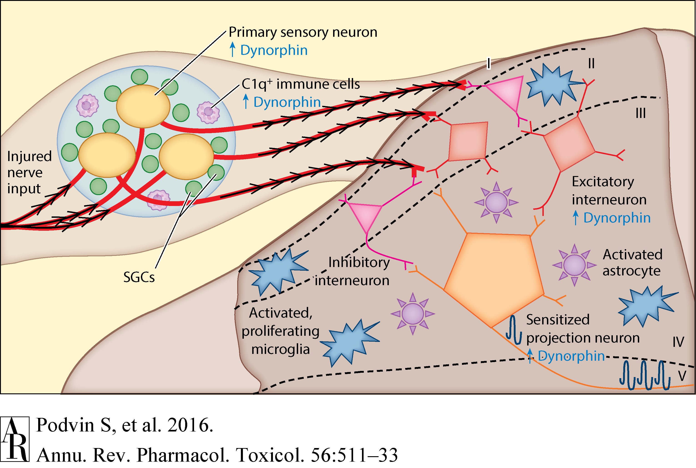
Upregulation of Dynorphin in Chronic Pain: Acts Primarily on KOR
(Podvin, 2016)
Notes:
The Emerging Role of Spinal Dynorphin in Chronic Pain: A Therapeutic Perspective
Sonia Podvin, Tony Yaksh, Vivian Hook
Annual Review of Pharmacology and Toxicology 2016 56:1, 511-533
(Volume publication date January 2016)
https://doi.org/10.1146/annurev-pharmtox-010715-103042

Slide 13
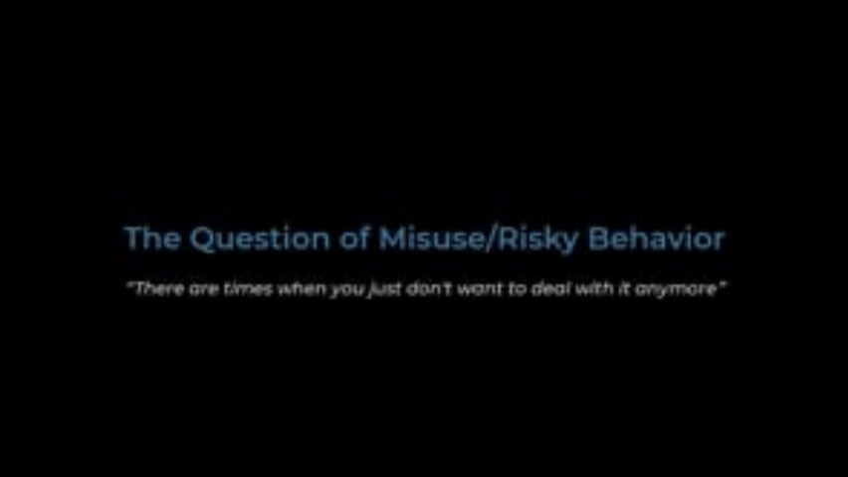
VIDEO PART 4 https://vimeo.com/807380208/26b1d4fc1d
Notes:
Title slide and slide 2: Present before starting video
Part 1 of video
Slide 3
Part 2 of video
Slide 4
Part 3 of video
Slides 5-7
Part 4 of video
Slides 8-10
Part 5 of video
Slides 11-16
Part 6 of video
Slides 17-19

Slide 14

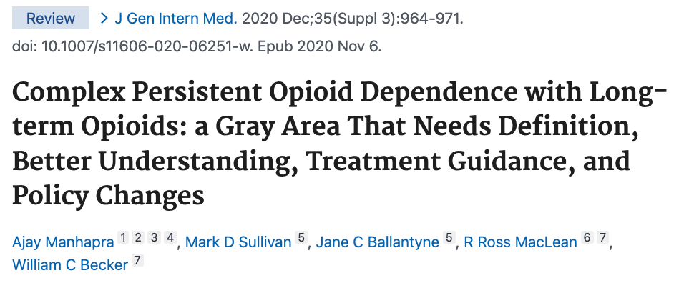


Prescription Opioid Dependence vs OUD
‘
‘
Clinical Hallmarks of
complex persistent opioid dependence:
Complex persistent opioid dependence
(Ballantyne 2012):
Though lacking a DSM-5 diagnosis of OUD
many patients on chronic opioids may have
complex persistent opioid dependence.
Qualitatively distinct and more severe
than simple persistent opioid dependence.
Patients are unwilling or unable to taper despite clear functional deterioration
Classic OUD-like behaviors often emerge with opioid dose reduction or cessation
(old term: pseudoaddiction)
Manhapra A, Sullivan MD, Ballantyne JC, MacLean RR, Becker WC. Complex Persistent Opioid Dependence with Long-term Opioids: a Gray Area That Needs Definition, Better Understanding, Treatment Guidance, and Policy Changes. J Gen Intern Med. 2020 Dec;35(Suppl 3):964-971. doi: 10.1007/s11606-020-06251-w. Epub 2020 Nov 6. PMID: 33159241; PMCID: PMC7728942.
Notes:
Manhapra A, Sullivan MD, Ballantyne JC, MacLean RR, Becker WC. Complex Persistent Opioid Dependence with Long-term Opioids: a Gray Area That Needs Definition, Better Understanding, Treatment Guidance, and Policy Changes. J Gen Intern Med. 2020 Dec;35(Suppl 3):964-971. doi: 10.1007/s11606-020-06251-w. Epub 2020 Nov 6. PMID: 33159241; PMCID: PMC7728942.

Slide 15

Who are the “High-Risk” Patients for Overdose?
RIOSORD
Risk Index for Overdose or
Severe Opioid-induced Respiratory Depression
17 questions
Developed by Zedler et al.
Validated in veteran population of >2M
Points add to 115, weighted depending
on each variable’s importance
  i.e., 50MED=5, >100MED=16 points
Rx naloxone!
‘
History of:
Psychiatric disorder
Cardiopulmonary disease
Liver/kidney disease
Use of an extended-release
or long-acting opioid
Concurrent use of a benzodiazepine
or certain antidepressants
High MED
Recent hospitalizations/ED visits
Zedler BK, Saunders WB, Joyce AR, Vick CC, Murrelle EL. Validation of a Screening Risk Index for Serious Prescription Opioid-Induced Respiratory Depression or Overdose in a US Commercial Health Plan Claims Database. Pain Med. 2018;19(1):68-78. doi:10.1093/pm/pnx009
Notes:
Zedler BK, Saunders WB, Joyce AR, Vick CC, Murrelle EL. Validation of a Screening Risk Index for Serious Prescription Opioid-Induced Respiratory Depression or Overdose in a US Commercial Health Plan Claims Database. Pain Med. 2018;19(1):68-78. doi:10.1093/pm/pnx009

Slide 16
Is Buprenorphine a Good Idea for Stacy?
’’
‘
?
Is her opioid dosing too high to recommend switching to buprenorphine without significantly tapering first?
If we decide to transition to buprenorphine, how do we do
it humanely and effectively?
Another strategy would be to try
her on buprenorphine. It is not certain whether buprenorphine would give her good pain relief.
Another issue is that insurance carriers sometimes refuse to
pay for buprenorphine.
?
’’
Chart note: UW Pain, 2 years earlier

Slide 17
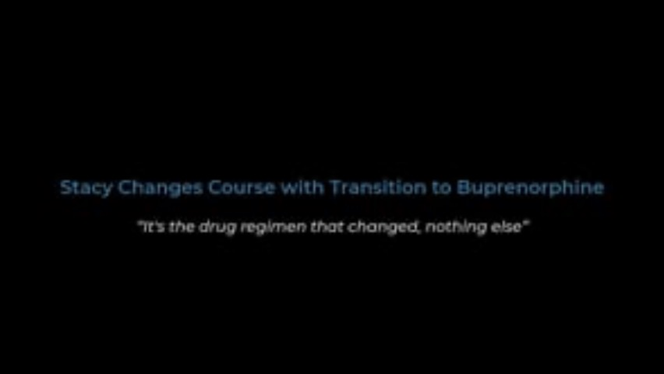
VIDEO PART 5 https://vimeo.com/807380237/f3921be901
Notes:
Title slide and slide 2: Present before starting video
Part 1 of video
Slide 3
Part 2 of video
Slide 4
Part 3 of video
Slides 5-7
Part 4 of video
Slides 8-10
Part 5 of video
Slides 11-16
Part 6 of video
Slides 17-19

Slide 18

Discussing Tolerance, Negative Reinforcement
& Opioid-Induced Hyperalgesia (OIH)
Clear, non-judgmental PATIENT-CENTERED discussion of concerns about role of opioids in the plan
  not only aberrant behaviors and safety concerns,
  but also (especially!) potential unintended consequences
  on pain symptoms and overall functioning
  tolerance/hyperalgesia
  unstable mood/energy levels
  impaired sleep (esp. common with short-acting opioids)
Withdrawal symptoms
Dysphoria (hyperkatifeia)
Unstable pain control
Negative reinforcement
to take another dose

Slide 19
Discussing Tolerance, Negative Reinforcement
& Opioid-Induced Hyperalgesia (OIH)
(Continued)
Discussion should happen after:
  Detailed pain history
  Medication/substance use history
  Physical exam
  Review of data/records

Slide 20




Recommending Buprenorphine for Treatment for Pain, OIH &
OUD/Complex Persistent Opioid Dependence
Use Case Example
High affinity & slow dissociation | → | Long half-life
Pts appreciate stable opioid levels, lack of negative reinforcement
Implications on transition
to SL formulation
Strong analgesic potency
(25-100x morphine)
No ceiling effect for analgesia
(Dahan, 2006)
Literature/guidelines often propagate misconceptions
Good pharm review article:
Gudin, J 2020: Pain and Therapy
Partial mu opioid receptor agonist
Ceiling effect for respiratory depression: SAFER OPIOID
Affects primarily spinal-level opioid receptors (less brain)
Different intrinsic activity
at mu opioid receptor
A. Dahan, A. Yassen, R. Romberg, E. Sarton, L. Teppema, E. Olofsen, M. Danhof, Buprenorphine induces ceiling in respiratory depression but not in analgesia,
British Journal of Anaesthesia, Volume 96, Issue 5, 2006, Pages 627-632, ISSN 0007-0912 https://doi.org/10.1093/bja/ael051.
Gudin, J., & Fudin, J. (2020). A narrative pharmacological review of buprenorphine: a unique opioid for the treatment of chronic pain. Pain and Therapy, 9, 41-54.
Notes:
A. Dahan, A. Yassen, R. Romberg, E. Sarton, L. Teppema, E. Olofsen, M. Danhof, Buprenorphine induces ceiling in respiratory depression but not in analgesia,
British Journal of Anaesthesia, Volume 96, Issue 5, 2006, Pages 627-632, ISSN 0007-0912
https://doi.org/10.1093/bja/ael051.
Gudin, J., & Fudin, J. (2020). A narrative pharmacological review of buprenorphine: a unique opioid for the treatment of chronic pain. Pain and Therapy, 9, 41-54.

Slide 21
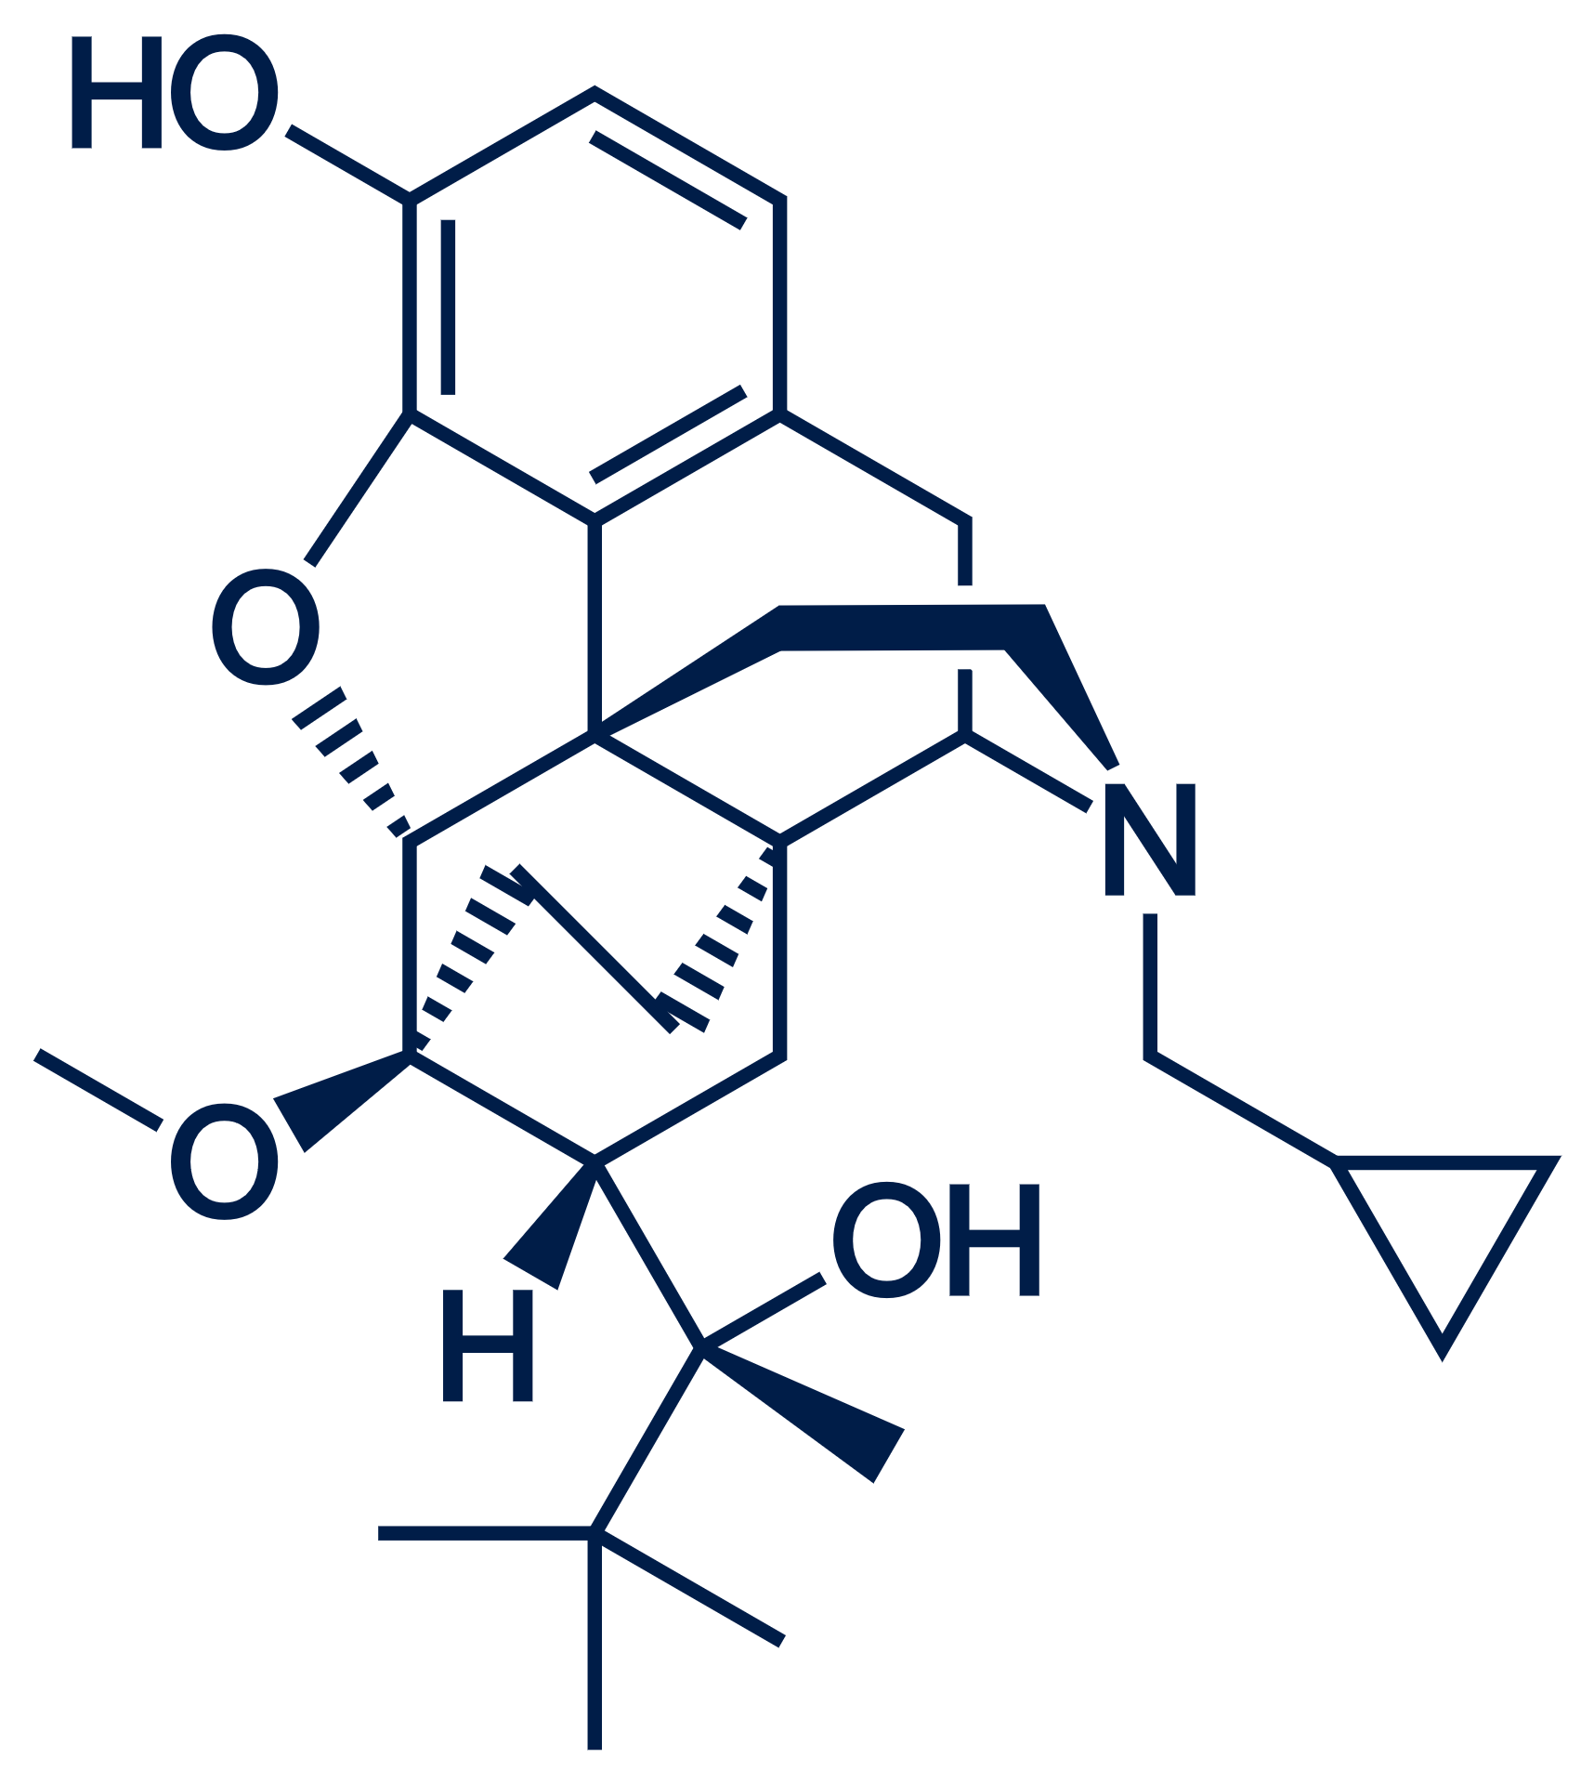
Buprenorphine’s Unique Advantages in Safety and Sustainability
Use Case Example
Buprenorphine’s intrinsic activity
at the MOR is different
(structural activity difference).
Despite lower total G-protein signaling with buprenorphine, effective analgesic threshold is met and maintained
even with low % receptor occupancy, while adverse effects,
risk of misuse/addiction/overdose are correspondingly lower.
G-protein signaling leads to analgesia (as with all other opioids),
but unlike others, with buprenorphine, it does NOT lead to phosphorylation
at multiple amino acids which causes gradual down regulation of analgesia
signaling → sustainable pain relief with buprenorphine.
Notes:
Its intrinsic activity at the MOR is different (structural activity difference)
G-protein signaling leads to analgesia as with all other opioids, but unlike others, with buprenorphine it does NOT lead to phosphorylation at multiple amino acids which cause gradual downregulation of analgesia signaling→ sustainable pain relief with buprenorphine
Despite lower total G-protein signaling with buprenorphine, effective analgesic threshold is met and maintained even with low % receptor occupancy, while adverse effects, risk of misuse/addiction/overdose are correspondingly lower
(ON THE NEXT SLIDE)
2) Buprenorphine’s active metabolite norbuprenorphine mostly does not cross the blood brain barrier (tissue activity difference)→ minimal brain effect
Spinal injection of naloxone blocks analgesia for buprenorphine, morphine and fentanyl; supraspinal naloxone blocks morphine and fentanyl analgesia but not buprenorphine
THESE FEATURES ARE WHAT WE REALLY MEAN WHEN WE SAY “BUPRENORPHINE IS A PARTIAL M-OR AGONIST”

Slide 22






Buprenorphine’s Unique Advantages in Safety and Sustainability
Use Case Example
(Continued)
Buprenorphine’s active metabolite norbuprenorphine mostly does not cross the blood brain barrier
(tissue activity difference), minimal brain effect.
These features are what
we really mean when we say
“Buprenorphine is a
partial MOR agonist”
Spinal injection of naloxone blocks analgesia
for buprenorphine, morphine and fentanyl;
supraspinal naloxone blocks morphine &
fentanyl analgesia, but not buprenorphine.

Slide 23
Buprenorphine’s Anti-Hyperalgesic Effects
& Other Important Pharmacologic Features in Pain Treatment
  Less “negative reinforcement loop”
  from opioid use (aka hyperkatifeia)
Blocks voltage-gated sodium channels via the local anesthetic binding site | → | Antihyperalgesia
Blocks effect of dynorphin | → | Antihyperalgesia
Kappa opioid receptor antagonist
Sodium channel blockade
(Koob, 2019))
(Leffler 2012)
Delta
opioid receptor antagonist
ORL-1 (nociception) receptor agonist
  Contributes to analgesia
  Improves negative emotional states
  Helps limit tolerance and hyperalgesia
  Unclear analgesic potency; some antihyperalgesia;
  No opioid side effects, such as resp depression, itch
  (Zaveri, 2016)
  (Pradhan, 2011) (Gudin, 2020)
Antagonist of dopamine transport | → | Useful in Tx of non-opioid SUD?
Notes:
Kappa Opioid receptor antagonist
blocks effect of dynorphin→ antihyperalgesia, less “negative reinforcement loop” from opioid use (aka hyperkatifeia) (Koob, 2019)
Sodium channel blockade (Leffler 2012)
blocks voltage-gated sodium channels via the local anesthetic binding site→ antihyperalgesia
ORL-1 (nociceptin) receptor agonist
unclear analgesic potency, some antihyperalgesia; no opioid side effects such as resp depression, itch
antagonist of dopamine transport→ useful in non-opioid SUD Tx? (Zaveri, 2016)
Delta opioid receptor antagonist
contributes to analgesia
improves negative emotional states (Pradhan, 2011)
helps limit tolerance and hyperalgesia (Gudin, 2020)
Koob GF. Drug Addiction: Hyperkatifeia/Negative Reinforcement as a Framework for Medications Development. Pharmacol Rev. 2021;73(1):163-201. doi:10.1124/pharmrev.120.000083
Leffler A, Frank G, Kistner K, Niedermirtl F, Koppert W, Reeh PW, Nau C. Local anesthetic-like inhibition of voltage-gated Na(+) channels by the partial μ-opioid receptor agonist buprenorphine. Anesthesiology. 2012 Jun;116(6):1335-46. doi: 10.1097/ALN.0b013e3182557917. PMID: 22504149.
Zaveri NT. Nociceptin Opioid Receptor (NOP) as a Therapeutic Target: Progress in Translation from Preclinical Research to Clinical Utility. J Med Chem. 2016;59(15):7011-7028. doi:10.1021/acs.jmedchem.5b01499
Pradhan AA, Befort K, Nozaki C, Gavériaux-Ruff C, Kieffer BL. The delta opioid receptor: an evolving target for the treatment of brain disorders. Trends Pharmacol Sci. 2011;32(10):581-590. doi:10.1016/j.tips.2011.06.008
Gudin J, Fudin J. Peripheral Opioid Receptor Antagonists for Opioid-Induced Constipation: A Primer on Pharmacokinetic Variabilities with a Focus on Drug Interactions. J Pain Res. 2020 Feb 25;13:447-456. doi: 10.2147/JPR.S220859. PMID: 32158255; PMCID: PMC7049282.

Slide 24
Use of SL Buprenorphine for Pain
Is it OK to use sublingual off-label for pain?
?
Practical Tips:
(there is no standard guideline)
Write “for pain” on Rx
Try using “opioid dependence” for insurance authorization if asked
    Remember, this is not the same as OUD and needn’t be stigmatizing
  Pain typically not a covered indication
  for SL formulation
  Presence/absence of naloxone not clinically
  significant in pain context, though naloxone
  may contribute to adverse effect
!
Yes! And why would you?
Transition from high MED opioids (>90) →
may require higher potency SL formulation to be perceived as effective
Can not access other formulations
through insurance
Want to have some dosing flexibility
(others must be fixed dose)
Notes:
Is it OK to use sublingual off-label for pain? YES!
Why would you?
transition from high MED opioids (>90) → may require higher potency SL formulation to be perceived as effective
Can not access other formulations through insurance
Want to have some dosing flexibility (others must be fixed dose)
Practical tips (no standard guideline):
write “for pain” on Rx, use your regular DEA # (not X)
Try using “opioid dependence” for insurance authorization if asked
remember, this is not the same as OUD and needn’t be stigmatizing
pain typically not a covered indication for SL
presence/absence of naloxone not clinically significant in pain context, though naloxone may contribute adverse effects

Slide 25
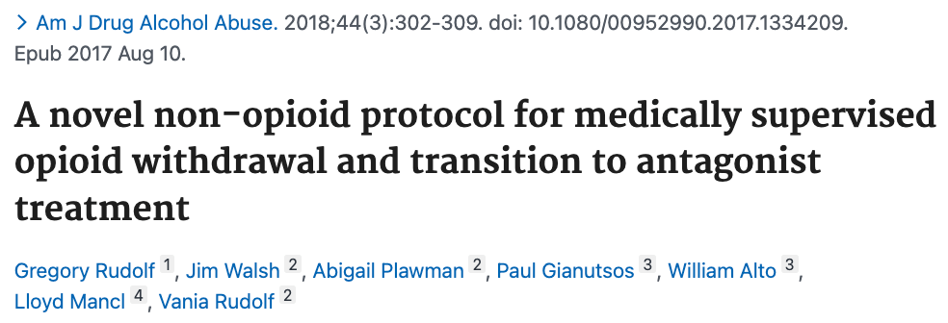

Opioid Withdrawal Protocol
for transition to buprenorphine, naltrexone, or opioid tapering/cessation
Dose range variables to consider:
▪︎ Prior opioid use level ▪︎ Age ▪ BMI ▪︎
tizanidine
4-8mg po QID scheduled
gabapentin
300mg TID and 600mg qhs scheduled
hydroxyzine
50-100mg QID scheduled
(hold for sedation)
1
2
3
4
Ancillaries
dicyclomine
20mg po q6h
prn abdominal cramps
trazodone, or
50-100mg
mirtazapine
7.5-15mg
at bedtime as needed
for insomnia
ropinarole
0.5-1mg BID,
1-2mg qhs
consider for restlessness
Rudolf G, Walsh J, Plawman A, Gianutsos P, Alto W, Mancl L, Rudolf V. A novel non-opioid protocol for medically supervised opioid withdrawal and transition
to antagonist treatment. Am J Drug Alcohol Abuse. 2018;44(3):302-309. doi: 10.1080/00952990.2017.1334209. Epub 2017 Aug 10. PMID: 28795846.
Notes:
Opioid Withdrawal Protocol for transition to buprenorphine, naltrexone, or opioid tapering/cessation
Dose range variable (consider prior opioid use level, age, BMI)
Tizanidine 4-8mg po QID scheduled
Gabapentin 300mg TID and 600mg qhs scheduled
Hydroxyzine 50-100mg QID scheduled (hold for sedation)
Ancillaries including dicyclomine 20mg po q6h prn abdominal cramps, trazodone 50-100mg or mirtazapine 7.5-15mg at bedtime as needed for insomniaConsider ropinarole 0.5-1mg BID, 1-2mg qhs for restlessness
Rudolf G, Walsh J, Plawman A, Gianutsos P, Alto W, Mancl L, Rudolf V. A novel non-opioid protocol for medically supervised opioid withdrawal and transition to antagonist treatment. Am J Drug Alcohol Abuse. 2018;44(3):302-309. doi: 10.1080/00952990.2017.1334209. Epub 2017 Aug 10. PMID: 28795846.

Slide 26
VIDEO PART 6 https://vimeo.com/807380237/f3921be901
Notes:
Title slide and slide 2: Present before starting video
Part 1 of video
Slide 3
Part 2 of video
Slide 4
Part 3 of video
Slides 5-7
Part 4 of video
Slides 8-10
Part 5 of video
Slides 11-16
Part 6 of video
Slides 17-19

Slide 27
2019 HHS Pain Management Best Practices Interagency Task Force:
Role of Stigma
Patients Face Stigma:
Patients with painful conditions and comorbidities such as anxiety, depression or substance use disorder (SUD) face additional barriers to treatment because of stigma.
Chronic pain is common among individuals with SUD, including opioid misuse, yet stigma remains
a major barrier to implementation of programs
and treatments for chronic pain or opioid use disorder, such as MOUD and naloxone.
Patients with co-occurring problematic opioid
use and chronic noncancer pain report
significant perceived stigma associated with buprenorphine and methadone treatment.
Jianguo Cheng, MD, PhD, FIPP, Molly Rutherford, MD, MPH, FASAM, Vanila M Singh, MD, MACM, The HHS Pain Management Best Practice Inter-Agency Task Force Report Calls for Patient-Centered and Individualized Care, Pain Medicine, Volume 21, Issue 1, January 2020, Pages 1–3, https://doi.org/10.1093/pm/pnz303
Notes:
Jianguo Cheng, MD, PhD, FIPP, Molly Rutherford, MD, MPH, FASAM, Vanila M Singh, MD, MACM, The HHS Pain Management Best Practice Inter-Agency Task Force Report Calls for Patient-Centered and Individualized Care, Pain Medicine, Volume 21, Issue 1, January 2020, Pages 1–3, https://doi.org/10.1093/pm/pnz303
https://www.hhs.gov/sites/default/files/pmtf-final-report-2019-05-23.pdf

Slide 28
2019 HHS Pain Management Best Practices Interagency Task Force:
Role of Stigma
Clinicians Face Stigma:
Clinicians who treat acute and chronic pain, particularly with opioids, may experience stigma from colleagues and society in general.
That stigma, in addition to fear of scrutiny from state medical boards and the Drug Enforcement Administration (DEA), may dissuade them from using opioids appropriately.
Stigma leads to over-referral
and patient abandonment.
Jianguo Cheng, MD, PhD, FIPP, Molly Rutherford, MD, MPH, FASAM, Vanila M Singh, MD, MACM, The HHS Pain Management Best Practice Inter-Agency Task Force Report Calls for Patient-Centered and Individualized Care, Pain Medicine, Volume 21, Issue 1, January 2020, Pages 1–3, https://doi.org/10.1093/pm/pnz303
Notes:
Jianguo Cheng, MD, PhD, FIPP, Molly Rutherford, MD, MPH, FASAM, Vanila M Singh, MD, MACM, The HHS Pain Management Best Practice Inter-Agency Task Force Report Calls for Patient-Centered and Individualized Care, Pain Medicine, Volume 21, Issue 1, January 2020, Pages 1–3, https://doi.org/10.1093/pm/pnz303
https://www.hhs.gov/sites/default/files/pmtf-final-report-2019-05-23.pdf

Slide 29
What Contributed to Delayed Progress in Stacy’s Management?
Over-prescription
of opioids
Failure to recognize OIH as a significant clinical issue/lack
of awareness of management
strategies for OIH
Lack of confidence
in buprenorphine’s ability to provide clinical benefit for pain
Lack of confidence
in being able to negotiate insurance obstacles
(eg, SL for pain)
Anticipated challenges in executing transition to buprenorphine
1
2
3
4
5
Notes:
overprescription of opioids
failure to recognize OIH as a significant clinical issue/lack of awareness of management strategies for OIH
lack of confidence in buprenorphine’s ability to provide clinical benefit for pain
lack of confidence in being able to negotiate insurance obstacles (eg SL for pain)
anticipated challenges in executing transition to buprenorphine

Slide 30

Thank You
Notes:
Stacy
Deirdre McGlynn at ASAM for great work on video
My colleagues and mentors for their support and inspiration
You for being there for your patients and trying to help get them to a better place

Slide 31
References
Fregoso G, Wang A, Tseng K, Wang J. Transition from Acute to Chronic Pain: Evaluating Risk for Chronic Postsurgical Pain. Pain Physician. 2019 Sep;22(5):479-488. PMID: 31561647.
Yang D, Liu X, Zhou Y, Xu Y, Huang Q. A novel scoring system to predict the residual back pain after percutaneous kyphoplasty for osteoporotic vertebral compression fracture. Front Surg. 2022;9:1035681. Published 2022 Oct 13. doi:10.3389/fsurg.2022.1035681
Vadivelu N, Anwar M. Buprenorphine in postoperative pain management. Anesthesiol Clin. 2010 Dec;28(4):601-9. doi: 10.1016/j.anclin.2010.08.015. PMID: 21074740.
Higgins C, Smith BH, Matthews K. Evidence of opioid-induced hyperalgesia in clinical populations after chronic opioid exposure: a systematic review and meta-analysis. Br J Anaesth. 2019 Jun;122(6):e114-e126. doi: 10.1016/j.bja.2018.09.019. Epub 2018 Oct 25. PMID: 30915985.
Schematic: Figure 2, Hypothesis on the transition from acute to chronic facilitate by opioid administration (Opioid-Induced Hyperalgesia)
Rivat, Cyrilª; Ballantyne, Jane^{b,*}. The dark side of opioids in pain management: basic science explains clinical observation. PAIN Reports 1(2):p e570, August 2016. | DOI: 10.1097/PR9.0000000000000570
Schematic: Upregulation of Dynorphin in Chronic Pain: Acts Primarily on KOR
The Emerging Role of Spinal Dynorphin in Chronic Pain: A Therapeutic Perspective
Sonia Podvin, Tony Yaksh, Vivian Hook Annual Review of Pharmacology and Toxicology 2016 56:1, 511-533
Vol. 56:511-533 (Volume publication date January 2016) https://doi.org/10.1146/annurev-pharmtox-010715-103042
Manhapra A, Sullivan MD, Ballantyne JC, MacLean RR, Becker WC. Complex Persistent Opioid Dependence with Long-term Opioids: a Gray Area That Needs Definition, Better Understanding, Treatment Guidance, and Policy Changes. J Gen Intern Med. 2020 Dec;35(Suppl 3):964-971. doi: 10.1007/s11606-020-06251-w. Epub 2020 Nov 6. PMID: 33159241; PMCID: PMC7728942.
Dahan, A. Yassen, R. Romberg, E. Sarton, L. Teppema, E. Olofsen, M. Danhof, Buprenorphine induces ceiling in respiratory depression but not in analgesia, British Journal of Anaesthesia, Volume 96, Issue 5, 2006, Pages 627-632, ISSN 0007-0912 https://doi.org/10.1093/bja/ael051.
Notes:
ASAM requests the APA citation format
Link: https://owl.purdue.edu/owl/research_and_citation/apa_style/apa_formatting_and_style_guide/general_frmat.html

Slide 32
References
Gudin, J., & Fudin, J. (2020). A narrative pharmacological review of buprenorphine: a unique opioid for the treatment of chronic pain. Pain and Therapy, 9, 41-54.
Zedler BK, Saunders WB, Joyce AR, Vick CC, Murrelle EL. Validation of a Screening Risk Index for Serious Prescription Opioid-Induced Respiratory Depression or Overdose in a US Commercial Health Plan Claims Database. Pain Med. 2018;19(1):68-78. doi:10.1093/pm/pnx009
Koob GF. Drug Addiction: Hyperkatifeia/Negative Reinforcement as a Framework for Medications Development. Pharmacol Rev. 2021;73(1):163-201. doi:10.1124/pharmrev.120.000083
Leffler A, Frank G, Kistner K, Niedermirtl F, Koppert W, Reeh PW, Nau C. Local anesthetic-like inhibition of voltage-gated Na(+) channels by the partial μ-opioid receptor agonist buprenorphine. Anesthesiology. 2012 Jun;116(6):1335-46. doi: 10.1097/ALN.0b013e3182557917. PMID: 22504149.
Zaveri NT. Nociceptin Opioid Receptor (NOP) as a Therapeutic Target: Progress in Translation from Preclinical Research to Clinical Utility. J Med Chem. 2016;59(15):7011-7028. doi:10.1021/acs.jmedchem.5b01499
Pradhan AA, Befort K, Nozaki C, Gavériaux-Ruff C, Kieffer BL. The delta opioid receptor: an evolving target for the treatment of brain disorders. Trends Pharmacol Sci. 2011;32(10):581-590. doi:10.1016/j.tips.2011.06.008
Gudin J, Fudin J. Peripheral Opioid Receptor Antagonists for Opioid-Induced Constipation: A Primer on Pharmacokinetic Variabilities with a Focus on Drug Interactions. J Pain Res. 2020 Feb 25;13:447-456. doi: 10.2147/JPR.S220859. PMID: 32158255; PMCID: PMC7049282.
Rudolf G, Walsh J, Plawman A, Gianutsos P, Alto W, Mancl L, Rudolf V. A novel non-opioid protocol for medically supervised opioid withdrawal and transition to antagonist treatment. Am J Drug Alcohol Abuse. 2018;44(3):302-309. doi: 10.1080/00952990.2017.1334209. Epub 2017 Aug 10. PMID: 28795846.
Jianguo Cheng, MD, PhD, FIPP, Molly Rutherford, MD, MPH, FASAM, Vanila M Singh, MD, MACM, The HHS Pain Management Best Practice Inter-Agency Task Force Report Calls for Patient-Centered and Individualized Care, Pain Medicine, Volume 21, Issue 1, January 2020, Pages 1–3, https://doi.org/10.1093/pm/pnz303
Notes:
ASAM requests the APA citation format
Link: https://owl.purdue.edu/owl/research_and_citation/apa_style/apa_formatting_and_style_guide/general_format.html

