Slide 1
Pain, Substance Use Disorders, and Suicide
Martin D. Cheatle, PhD
Associate Professor of Psychiatry and Anesthesiology
Perelman School of Medicine, University of Pennsylvania

Slide 2
MDC has no conflict of interest related to this presentation
Funding
1R01DA044015-01A1 NIH
1R01NR017853-01A1 NIH
U01-DK123813 NIH
R21DA048986 NIH
R21-NR019047-01 NIH

Slide 3
Learning Objectives
Identify the key risk factors for suicidal ideation and behavior in patients with pain and concomitant substance use disorder
Evaluate the efficacy of pharmacologic and non-pharmacologic interventions in managing pain and reducing the risk of suicide in patients with pain, mood disorders and concomitant substance use disorder

Slide 4
Pain, Substance Use Disorders and Suicide: Risk Assessment and Mitigation
Introduction
Risk Factors
Mediators
Risk Mitigation
Assessment
Interventions
Summary
Future Directions

Slide 5
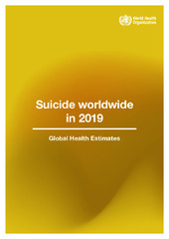
Global Statistics on Suicide
More than 700 000 people die due to suicide every year.
Every 40 seconds someone in the world dies by suicide
For every suicide there are many more people who attempt suicide.
77% of global suicides occur in low- and middle-income countries.
Experiencing conflict, disaster, violence, abuse, or loss and a sense of isolation are strongly associated with suicidal behavior. Suicide rates are also high amongst vulnerable groups who experience discrimination

Slide 6
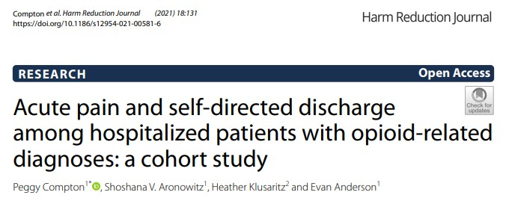
A large database of all hospitalizations at acute care hospitals during 2017 in the city of Philadelphia was evaluated to identify adults with opioid-related conditions and compare the characteristics of admissions ending with routine discharge versus those ending in self-directed discharge
Sixteen percent of the 7972 admissions involving opioid-related conditions culminated in self-directed discharge, which was more than five times higher than in the general population.

Slide 7
Results
Those admitted with an acutely painful diagnosis were almost twice as likely to complete a self-directed discharge, and for patients with multiple admissions, rates of acutely painful diagnoses increased with each admission coinciding with a burgeoning pattern of worsening infectious morbidity over time and increasing depression.
“Each admission represents a potential opportunity to provide harm reduction and treatment interventions addressing both substance use and pain.”

Slide 8
Chronic Pain, SUD and Suicide

Slide 9
Chronic Pain and Risk of Suicide
There is robust literature that there is a high prevalence of SI in patients with pain ranging from 18% to > 50%
Ratcliffe GE, Enns MW, Belik SL, Sareen J. Chronic pain conditions and suicidal ideation and suicide attempts: an epidemiologic perspective. Clin J Pain 2008; 24 : 204-210.
Substance Abuse and Mental Health Services Administration Office of Applied Studies. Drug Abuse Warning Network, 2007: Estimates of Drug-Related Emergency Department Visits. Rockville, MD; 2010.
Racine M, Choinière M, Nielson WR. Predictors of Suicidal Ideation in Chronic Pain Patients: An Exploratory Study. Clin J Pain. 2013 Jul 24. [Epub ahead of print]
Cheatle M, Wasser T, Foster C, Olugbodi A, Bryan J. Prevalence of suicidal ideation in patients with chronic noncancer pain referred to a behaviorally based pain program. Pain Phys, in press.
Edwards RR, Smith MT, Kudel I, Haythornthwaite J. Pain-related catastrophizing as a risk factor for suicidal ideation in chronic pain. Pain 2006;126 : 272-279.
A systematic review by Tang and Crane revealed that the risk of successful suicide was doubled in patients with CP as compared to non-pain controls
Tang NK, Crane C. Suicidality in chronic pain: A review of the prevalence, risk factors and psychological links. Psychol Med 2006; 36 :575-586.

Slide 10
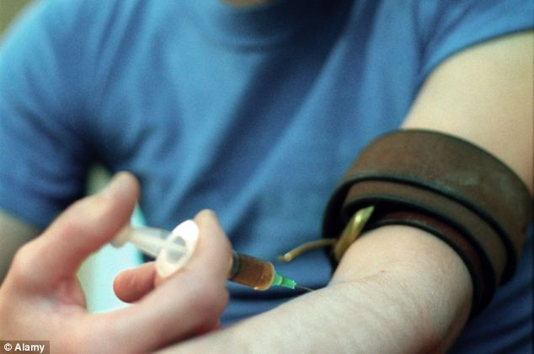
Suicidal Ideation and Behavior and SUD
Approximately 40% of patients seeking treatment for substance use disorders report a history of suicide attempts ¹⁻³
Compared to the general population, those with alcohol use disorders are almost 10 times more likely to die by suicide and those who inject drugs are about 14 times more likely to die by suicide.⁴
1)Roy A, Janal MN. Risk factors for suicide among alcohol-dependent patients. Arch Suicide Res. 2007; 11:211–217; 2) Roy A. Characteristics of cocaine dependent patients who attempt suicide. Arch Suicide Res. 2009; 13:46–51;3). Roy A. Risk factors for attempting suicide in heroin addicts. Suicide Life Threat Behav. 2010; 40:416–420; 4) Wilcox HC, Conner KR, Caine ED. Association of alcohol and drug use disorders and completed suicide: an empirical review of cohort studies. Drug Alcohol Depend. 2004; 76:S11–S19.

Slide 11
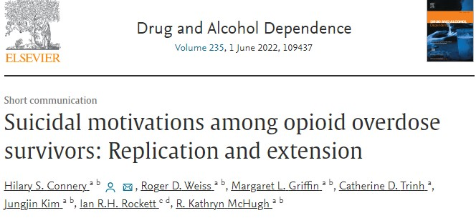
Sixty adults receiving inpatient detoxification and stabilization who reported a history of opioid overdose completed questions about suicidal cognition prior to their most recent overdose.
Desire to die was common in adults with opioid use disorder prior to nonfatal opioid overdose events, and 1 in 5 people with a history of opioid overdose reported intention to die prior to their most recent opioid overdose.

Slide 12
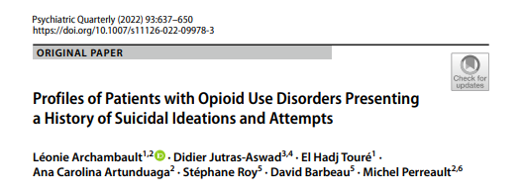
Suicide rates are higher for people with an opioid use disorder, compared to the general population.
This study characterized opioid agonist treatment entrants who present with a history of suicidal ideations or suicide attempts, according to concurrent comorbidity profiles, in an opioid use disorder treatment facility.

Slide 13
Results
In multivariate analysis, patients with a diagnosis or symptoms of a mood disorder were 2.48 [1.01 – 6.11] times more likely to report suicidal ideations and 2.64 [1.05 – 6.62] times more likely to report suicide attempts. Those with a diagnosis or symptoms of an anxiety disorder were 2.41 [1.01 – 5.81] times more likely to report suicidal ideations. Patients who report chronic pain were 2.59 [1.06 – 6.35] times more likely to report suicidal ideations as well

Slide 14
Suicide Risk in Patients with Chronic Pain with and without co-occurring Opioid Use Disorder Martin Cheatle, PhD, Nicholas Giordano, RN, PhD, Kristy Themelis, PhD, Nicole K. Y. Tang, DPhil (accepted for publication Pain Medicine)
This cross-sectional study evaluated 609 adults with chronic non-cancer pain treated with long-term opioid therapy (≥ 6 months) who either developed an OUD (cases, n = 175) or displayed no evidence of an OUD (controls, n = 434).
The primary outcome was risk of suicidal ideation (SBQ-R). Covariates included demographics, pain severity, psychiatric history, pain coping, social support and mental defeat.
Of the total 609 subjects, 18 % were at high risk for SI and of those at high risk, 51.8 % were individuals with chronic pain and co-occurring OUD as compared to 23.6% in the low-risk group.

Slide 15
Multivariable Model Estimating Odds Ratio of Suicidal Ideation with Variables from Significant Single Variable Regression Output (N=609)
Multivariable modeling revealed that mental defeat, pain catastrophizing, depression and having chronic pain and co-occurring OUD significantly increased the odds of reporting higher suicidality.

Slide 16
Pain and Suicidal Ideation: Risk Factors and Mediators

Slide 17
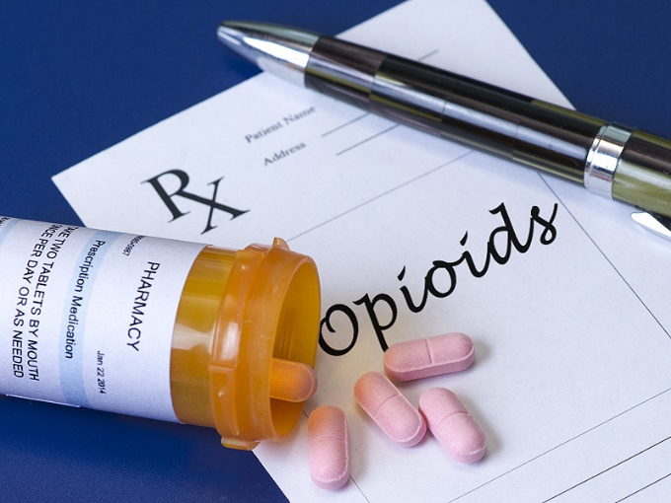
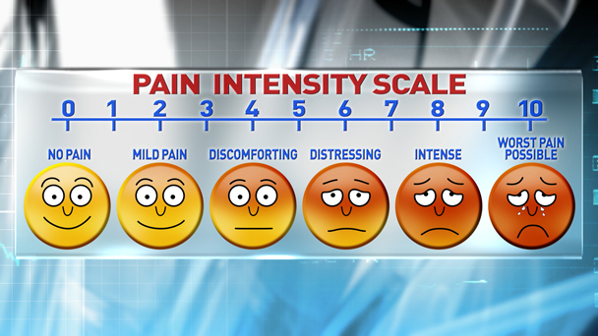
Risk Factors
Sleep
Pain Intensity
Pain Duration
Pain Type
Opioid Dosing

Slide 18
Methods: A cohort of 221,817 veterans initiating pain care was divided into four subgroups:
a) no/mild pain + no insomnia (LowPainNoINS),
b) no/mild pain + insomnia (LowPain-INS),
c) moderate/severe pain + no insomnia (HighPain-NoINS),
d) moderate/severe pain + insomnia (HighPain-INS).

Slide 19
RESULTS
Results revealed that those with both moderate/severe pain and insomnia are more likely to have a history of suicide attempts and are at greater risk of a suicide attempt relative to those with insomnia with low/mild pain and those with moderate/severe pain with no insomnia.
Suicide prevention efforts for chronic pain and insomnia could address pain and insomnia within the same intervention or in parallel
Psychosomatic Medicine: September 2021 - Volume 83 - Issue 7 - p 733-738

Slide 20
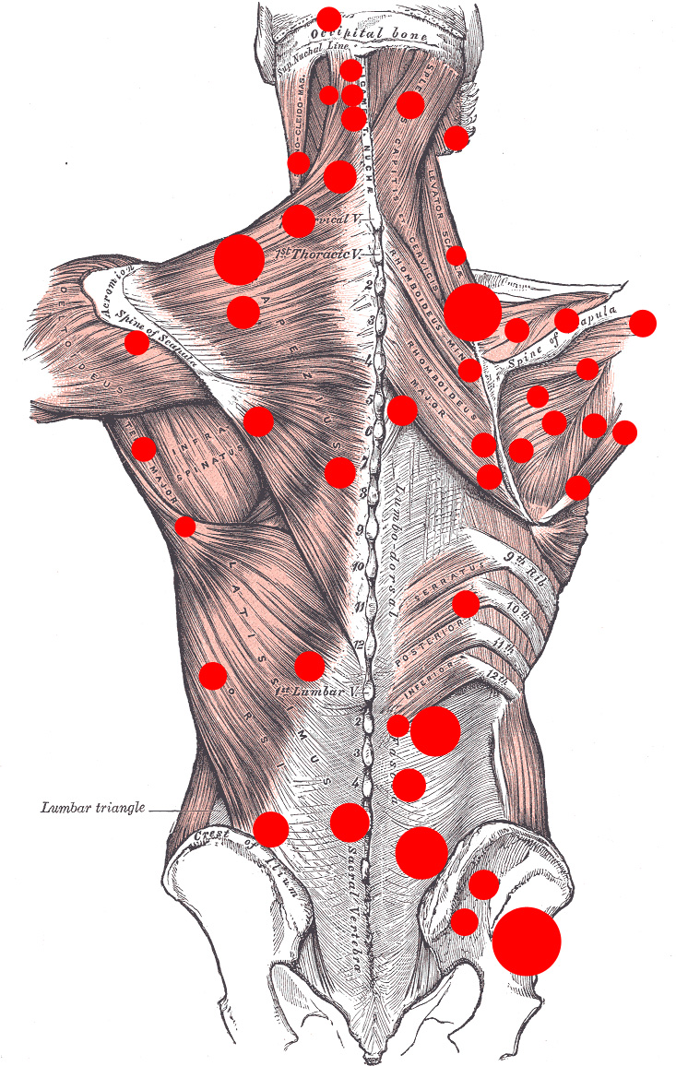
Vulnerable Pain Populations

Slide 24
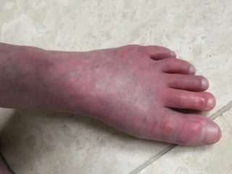
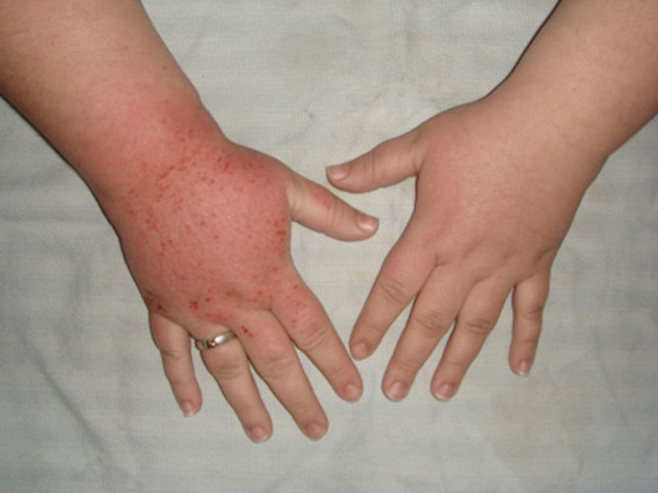
CRPS and Suicide
CRPS is an extremely painful condition with typically significant restriction in function, refractory to most interventions and commonly is associated with depression, a sense of hopelessness and anxiety.
An epidemiological study on CRPS discovered that 49.3% of patients with CRPS considered suicide and suicide attempt rate was 15.1% These rates are higher than those of the general population and other pain populations
Sharma A, Agarwal S, Broatch J, Raja SN. A web-based cross-sectional epidemiological survey of complex regional pain syndrome. Reg Anesth Pain Med. 2009 Mar-Apr;34(2):110-5; Edwards RR, Smith MT, Kudel I, Haythornthwaite J. Pain-related catastrophizing as a risk factor for suicidal ideation in chronic pain. Pain. 2006 Dec 15;126(1-3):272-9.

Slide 25
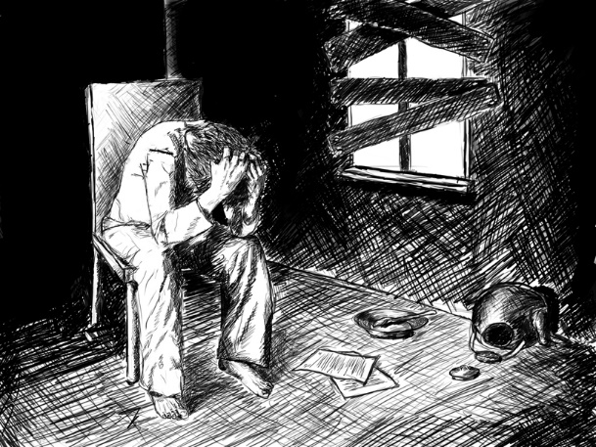
Possible Mediators
Catastrophizing
Burdensomeness
Social Isolation
Mental Defeat

Slide 26
Mental defeat
Depression - Social Rank Theory
PTSD – CBT & Exposure therapy
Gilbert & Allan, 1998
Ehlers et al., 1998

Slide 27
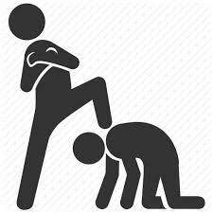
Mental defeat in chronic pain
A concept to characterise the deeper impact of pain on self-concept
A state of mind marked by a sense of a loss of autonomy, agency and human integrity
A type of self-processing, where persistent pain results in negative beliefs about the self in relation to pain
PAIN
Tang et al, 2007 CJP; Tang et al., 2010; PAIN

Slide 28
Mental defeat
“Defeat of the mind”
“The pain is taking over and you cannot cope with what you are supposed to do”
“I just felt everything had beaten me and there’s nothing I could do. I couldn’t fight anymore.”
“The pain belittles you as a person”
“It’s like you’re not a human being”
PAIN
Tang, Salkovskis et al., 2009; BJCP, 48; 1-20

Slide 29
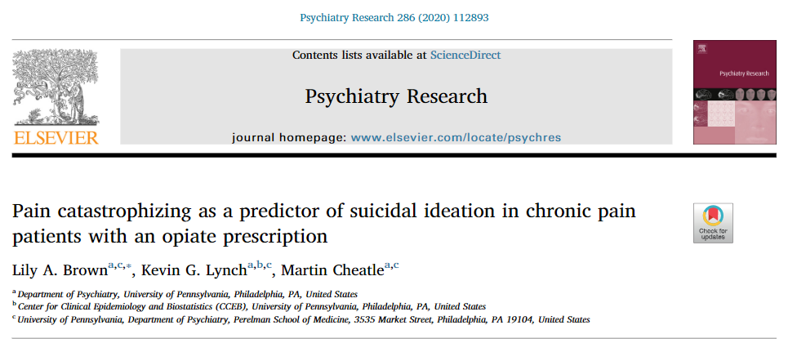
This study examined the longitudinal association between two styles of pain coping, catastrophizing and hoping/praying, as predictors of subsequent SIB, as well as possible mediators of this association among patients with chronic pain receiving long-term opioid therapy.
Participants (n = 496) were adults with chronic nonmalignant pain
Participants were assessed for pain coping, suicidal ideation, depression, and pain interference at baseline, and were reassessed for SI, depression, and pain interference at 6- and 12-month follow-ups.

Slide 30
Results
Catastrophizing was a significant predictor of increased subsequent SIB, whereas hoping/praying did not protect against future SIB. The relationship between catastrophizing and future SIB was mediated by depression, but not pain interference.
Catastrophizing was an important predictor of subsequent SIB due to its effect on increasing depression among patients with chronic nonmalignant pain

Slide 31
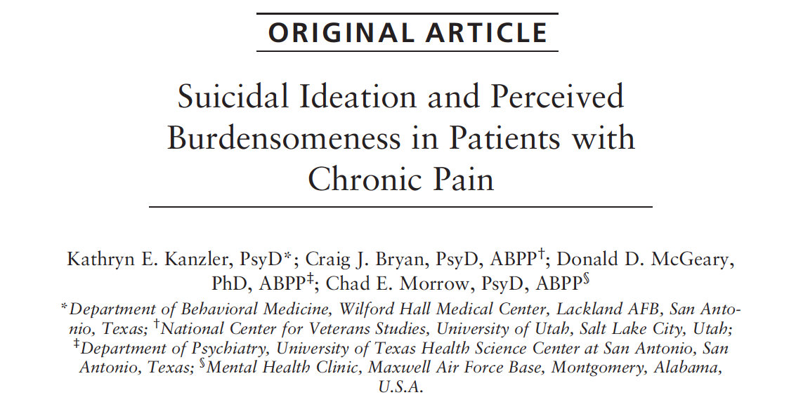
113 patients referred for pain related health complaints to a Clinical Health Psychology clinic
Intake interview included BDI-II, MPQ and one question on burdensomeness “It would be better for everyone involved if I were to die’’ on a 5-point Likert scale measuring frequency of having the thought (1 = ‘‘Never or none of the time’’ to 5 = ‘‘Always or a great many times’’)
Results revealed that perceived burdensomeness was the sole significant predictor of SI (b = 3.068, P = 0.004, OR = 21.503 [2.680 to 172.547]).
Pain Pract. 2012 Nov;12(8):602-9

Slide 32
A retrospective chart review of 466 patients with CNCP treated in a behaviorally based pain program
Results revealed a high rate of SI (26%).
Logistic regression revealed that history of sexual/ physical abuse (Beta=0.825; p<0.020; OR=2.657 [95% CI=1.447-4.877]), family history of depression (Beta=0.471; p<0.006; OR= 1.985 [95% CI= 1.234-3.070]) and being socially withdrawn (Beta=0.482; p< 0.001; OR= 2.226 [95% CI= 1/413-3.505]) were predictive of SI

Slide 33
Interpersonal Theory of Suicide
Desire
for
Suicide
Thwarted
Belongingness
I am alone.
Perceived
Burdensomeness
I am a burden.
Capability
for
Suicide
Lethal
(or near lethal)
Suicide
Attempts
Joiner TE, Pettit JW, Walker RL, et al. Perceived burdensomeness
and suicidality: two studies on the suicide notes of those attempting and those completing suicide. J Soc Clin Psychol. 2002;21:531–545.

Slide 34
Risk Mitigation
Risk Assessment
Intervention

Slide 35
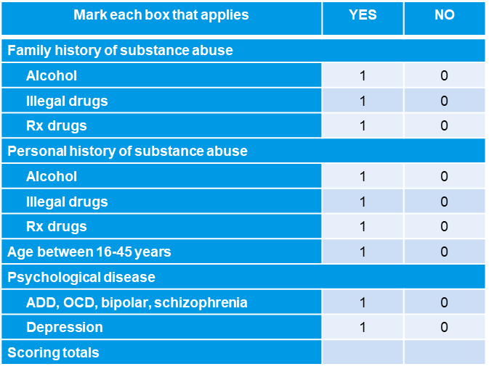
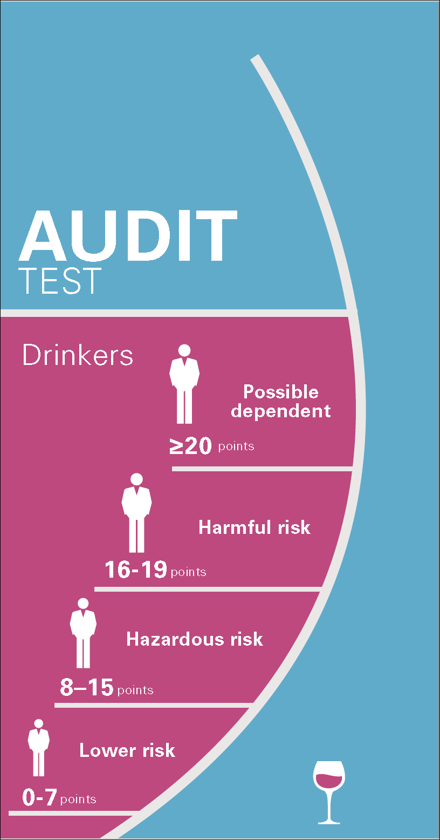
Assessment
Mental Health Screening
Pain Catastrophizing
Sleep Disturbance
Suicide Risk
OUD/SUD Screening
Mental Defeat

Slide 36
Mental Health Screening Tools

Slide 37
Sleep Assessment Scales
Questionnaire | Time frame | # of items
Sleep quality
Pittsburg Sleep Quality Index | Past month | 19
Sleep Questionnaire | Indefinite | 59
Sleep Disturbance Questionnaire | Indefinite | 12
SF-B | Past 2 weeks | 12
Sleep onset
Nocturnal Sleep Onset Scale | Past 2 weeks | 2
General
Steelman Insomnia Symptom Questionnaire | Past week | 13
Athens Insomnia Scale | Past month | 8
Pittsburgh Insomnia Rating Scale | Past week | 65
Leeds Sleep Evaluation Questionnaire | Indefinite | 10

Slide 38
Pain Catastrophizing Scale

Slide 39
Pain Self Perception Scale

Slide 40
Opioid Abuse and SUD Screening Tools

Slide 41
Opioid Risk Tool (ORT)

Slide 42
The discriminant predictive validity of the ORT was evaluated in a cohort of patients with CNCP on LTOT that displayed no evidence of developing an OUD and a sample of patients with CNMP that developed an OUD after commencing opioid therapy.
A revised unweighted ORT (ORT-OUD) removing the history of preadolescent sexual abuse item was notably superior in predicting the development of OUD in patients with CNMP on LTOT

Slide 44
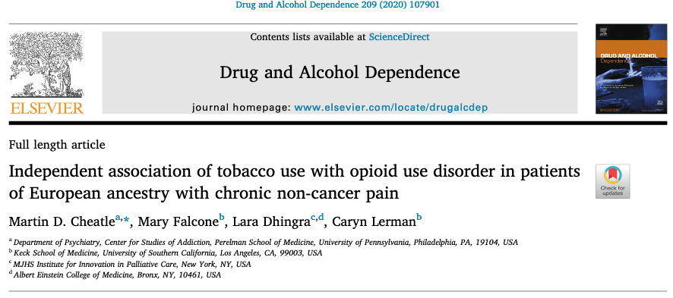
Evaluated the independent association of tobacco use and OUD in a cohort of 582 patients with CNCP and no h/o OUD (controls) and 218 patients with CNCP who developed an OUD after initiating Rx opioids (cases)
Approximately 80% of the cases reported tobacco use the past 7 days as compared to 22 % of the controls
Controlling for all known other risk factors for SUD (psychiatric co-morbidities, pain intensity, sociodemographics, etc) current tobacco use was strongly associated with OUD

Slide 45
Confidence Intervals for Primary and Secondary Analyses.

Slide 46
Suicide Assessment Tools
SAFE-T Pocket Card: Suicide Assessment Five-Step Evaluation and Triage (SAFE-T)
Columbia–Suicide Severity Rating Scale (C-SSRS)
Suicide Behavior Questionnaire-Revised (SBQ-R)
Patient Health Questionnaire-9 PHQ-9 Question # 9
P4 Suicidality Screener
Beck Scale for Suicide Ideation (BSSI)

Slide 47
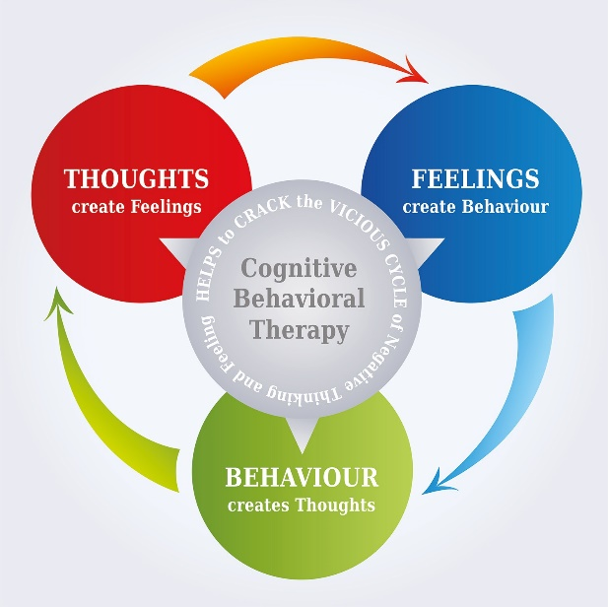
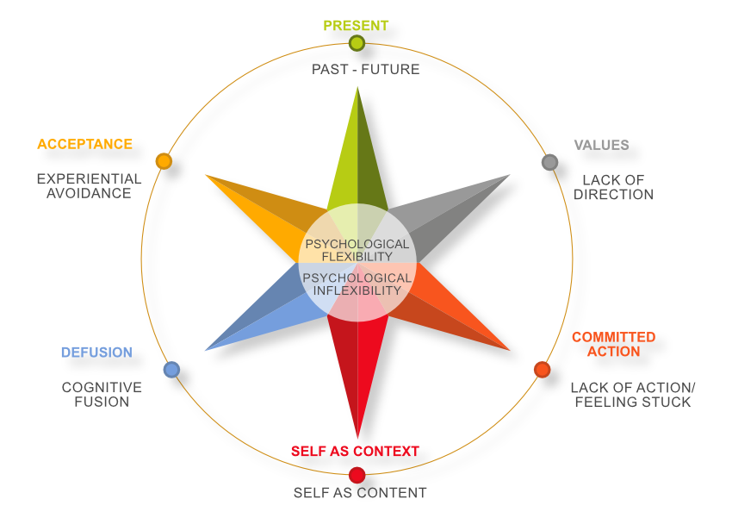
Risk Mitigation
Non-Pharmacologic
Pharmacologic

Slide 48
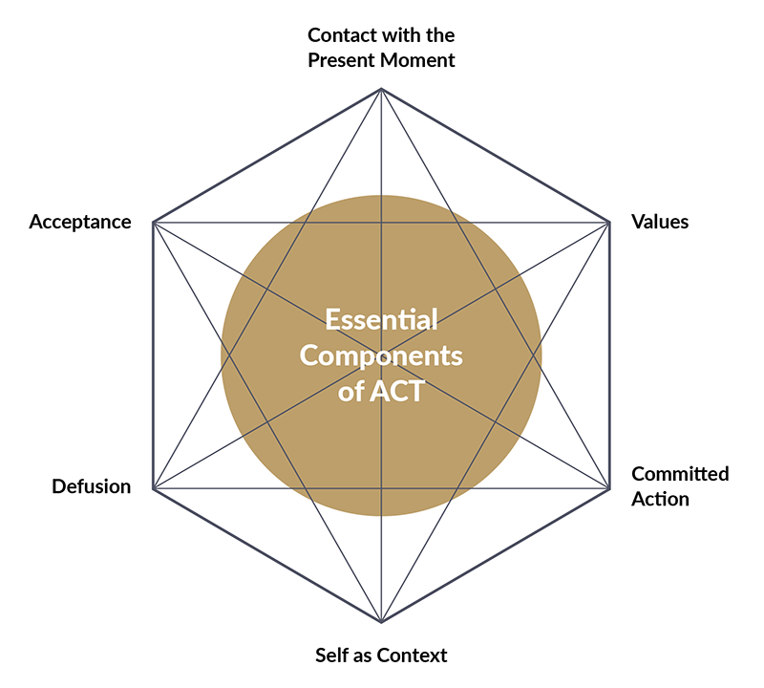
Non-Pharmacotherapy for Pain and SUD
CBT
ACT
Social Support

Slide 49
Cognitive Behavioral Therapy
CBT focuses on maladaptive thought patterns (catastrophizing) and behaviors (kinesiophobia) that occur frequently in patients with CNCP
The objective of CBT is to guide the patient in recognizing and re-conceptualizing his/her personal view of pain, identifying their role in the process of healing and promoting the patient being proactive rather than passive, and competent rather than incompetent
CBT include specific skill acquisition (relaxation therapy, stress management, cognitive restructuring) followed by skill consolidation and rehearsal, and relapse training (Turk, Flor, 2006)

Slide 50
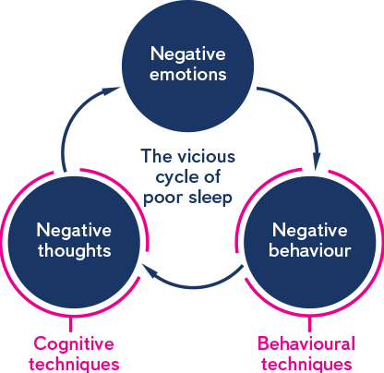
Cognitive Behavioral Therapy for Insomnia
CBT-I has been demonstrated to be equally effective or even superior to pharmacotherapy in patients with chronic primary insomnia.

Slide 51
CBT-I cont’d
CBT-I consists of:
Psychoeducation about sleep and insomnia
Stimulus control
Sleep restriction
Sleep hygiene
Relaxation training
Cognitive restructuring

Slide 52
ACCEPTANCE AND COMMITMENT THERAPY
Acceptance and Commitment Therapy (ACT) is a form of CBT that is a directive and experiential type of therapy based on rational frame theory. The goal of ACT is to experience life mindfully and reinforce psychological flexibility.
The core processes of ACT include:
-Contact with the present moment
-Self-as-context
-Defusion
-Acceptance
-Values
-Committed action
There are 5 randomized control trials on the use of ACT in chronic pain demonstrating efficacy in improving mood and function.

Slide 53
CBT/ACT for Pain and Substance Use Disorders
Cognitive Behavioral Therapy and Pharmacotherapy for the Treatment of Tobacco Use Disorder in Primary Care for Resident Physicians
McDougal JC, Ock S, Demers LB, Sokolove RL. MedEdPORTAL. 2019 Mar 15;15:10812.
Establishing the feasibility, acceptability and preliminary efficacy of a multi-component behavioral intervention to reduce pain and substance use and improve physical performance in older persons living with HIV
Moore AA, Lake JE, Glasner S, Karlamangla A, Kuerbis A, Preciado D, Jenkins J, Dominguez BX, Candelario J, Liao DH, Tang L, Reid MC. J Subst Abuse Treat. 2019 May;100:29-38.
An evaluation of the feasibility, acceptability, and preliminary efficacy of cognitive-behavioral therapy for opioid use disorder and chronic pain
Barry DT, Beitel M, Cutter CJ, Fiellin DA, Kerns RD, Moore BA, Oberleitner L, Madden LM, Liong C, Ginn J, Schottenfeld RS. Drug Alcohol Depend. 2019 Jan 1;194:460-467.
Development and Preliminary Evaluation of an Integrated Cognitive-Behavior Treatment for Chronic Pain and Substance Use Disorder in Patients with the Hepatitis C Virus
Morasco BJ, Greaves DW, Lovejoy TI, Turk DC, Dobscha SK, Hauser P. Pain Med. 2016 Dec;17(12):2280-2290.
Integrated Behavioral Treatment for Veterans With Co-Morbid Chronic Pain and Hazardous Opioid Use: A Randomized Controlled Pilot Trial
Vowles KE, Witkiewitz K, Cusack KJ, Gilliam WP, Cardon KE, Bowen S, Edwards KA, McEntee ML, Bailey RW.J Pain. 2020 Jul-Aug;21(7-8):798-807.
Neurophysiological mechanisms in acceptance and commitment therapy in opioid-addicted patients with chronic pain
Smallwood RF, Potter JS, Robin DA. Psychiatry Res Neuroimaging. 2016 Apr 30;250:12-4.
Systematic Reviews of Mindfulness and Acceptance and Commitment Therapy for Alcohol Use Disorder: Should we be using Third Wave Therapies?
Byrne SP, Haber P, Baillie A, Costa DSJ, Fogliati V, Morley K.Alcohol Alcohol. 2019 Mar 1;54(2):159-166.

Slide 54
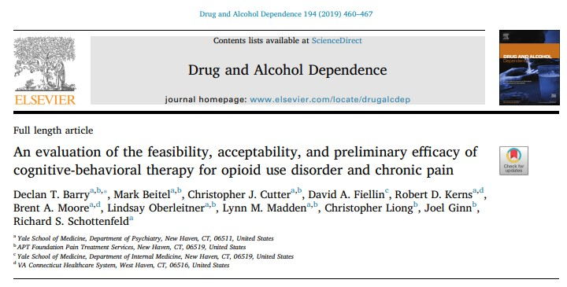
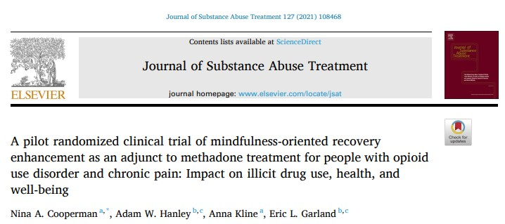
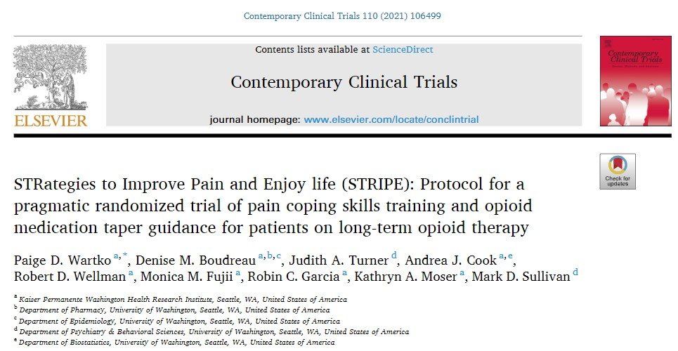
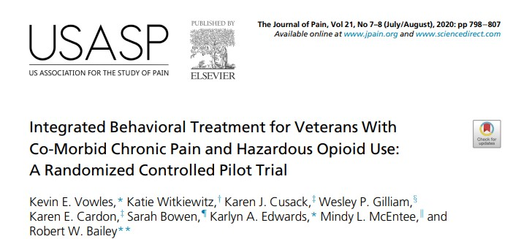
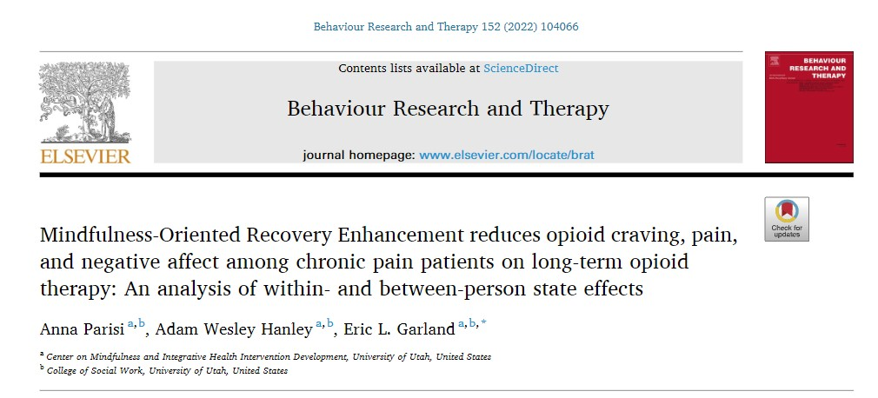
CBT/ACT for Pain and OUD

Slide 55
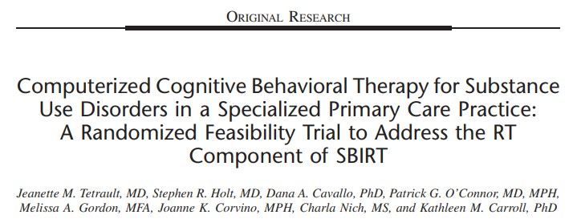
A randomized clinical trial evaluating feasibility, satisfaction, and substance use outcomes for 58 individuals with SUD were randomized to standard care or standard care plus access to a web-based SUD intervention (computer-based training in cognitive behavioral therapy, or CBT4CBT).
Self-reported substance use and urine toxicology screens were assessed at 8 weeks after randomization.
Tetrault JM, Holt SR, Cavallo DA, O'Connor PG, Gordon MA, Corvino JK, Nich C, Carroll KM. Computerized Cognitive Behavioral Therapy for Substance Use Disorders in a Specialized Primary Care Practice: A Randomized Feasibility Trial to Address the RT Component of SBIRT. J Addict Med. 2020 Dec;14(6):e303-e309

Slide 56
Results
77% of those assigned to this condition accessed the program at least once; of those, 77% completed all 7 modules. Satisfaction with the program was very high. Participants reported >90% days abstinent for all classes of drugs; with no significant differences between conditions.
Tetrault JM, Holt SR, Cavallo DA, O'Connor PG, Gordon MA, Corvino JK, Nich C, Carroll KM. Computerized Cognitive Behavioral Therapy for Substance Use Disorders in a Specialized Primary Care Practice: A Randomized Feasibility Trial to Address the RT Component of SBIRT. J Addict Med. 2020 Dec;14(6):e303-e309

Slide 57
The mediating effect of social support and co-morbid opioid use disorder on depression and risk of suicidal ideation in adults with chronic pain. Cheatle, MD; Barone, S; Giordano, N. (in preparation for submission)
The aim of this study was to evaluate the role of social support and diagnosis of co-morbid OUD on depression and risk of suicidal ideation in patients with CNCP.
This cross-sectional study evaluated 609 patients with CNCP treated with long-term opioid therapy (≥ 6 months) who either developed an OUD (cases, n = 175) or displayed no evidence of an OUD (controls, n = 434).
The primary outcome was risk of suicidal ideation assessed on the SBQ-R. Covariates included demographics, pain severity, psychiatric history, pain coping, and social support.

Slide 58
Unadjusted bootstrap mediation analysis
 | Estimate | Standard Error | p-value
Average Causal Mediation Effects | 0.09 | 0.03 | 0.003
Average Direct Effects | 2.40 | 0.39 | <0.001
Total Effect | 2.49 | 0.42 | 0.001
Results revealed that social support (DSSI) and having co-morbid OUD partially mediates the relationship between depression and risk of suicidal ideation.
Supports the importance of promoting social support in patients with pain and OUD mitigating risk of suicide

Slide 59
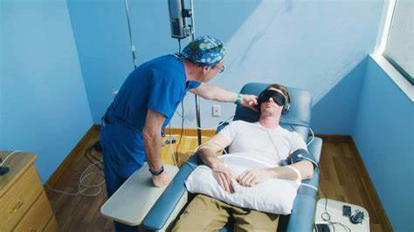
Medication For Opioid Use Disorder/Pain/Suicidal Ideation
Methadone
Buprenorphine
Extended Release and Oral Naltrexone
Ketamine

Slide 60
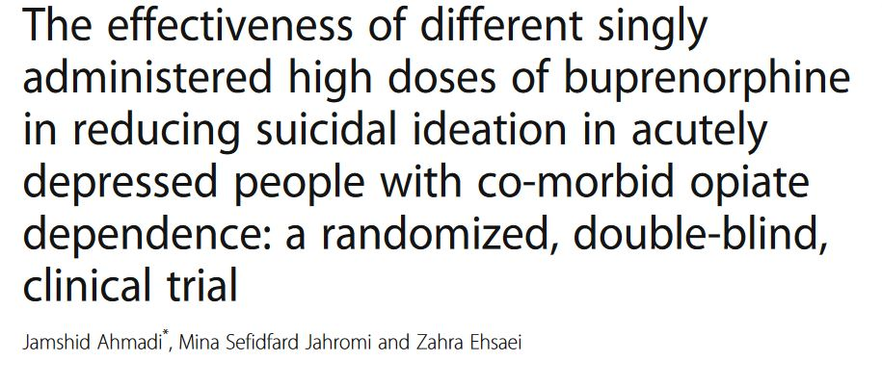
Fifty-one suicidal male inpatients who fulfilled the DSM-5 criteria for both OUD and MDD were randomized to three groups (n = 17 per group) to receive a single, sublingual dose of buprenorphine (32 mg, 64 mg, or 96 mg).
Patients completed the 3-day trial course. The outcomes illustrated a significant reduction in BSSI scores within each of the three groups, p < 0.01., but no difference in results between the groups, p = 0.408.
The results suggest that a single high dose of buprenorphine could rapidly treat suicidal ideations.
Trials 2018 Aug 29;19(1):462.

Slide 61
Beck Scale for Suicidal Ideation (BSSI) results for the three groups during the 3 days following buprenorphine administration (repeated measures)

Slide 62
A randomized double-blind placebo-controlled trial of ultra-low-dose sublingual buprenorphine as an adjunctive treatment.
Severely suicidal patients without substance abuse were randomly assigned to receive either buprenorphine or placebo (in a 2:1 ratio), in addition to their ongoing individual treatments
Patients who received ultra-low-dose buprenorphine had a greater reduction in Beck Suicide Ideation Scale scores than patients who received placebo, both after 2 weeks (mean difference -4.3, 95% CI=-8.5, -0.2) and after 4 weeks (mean difference=-7.1, 95% CI=-12.0, -2.3)
Am J Psychiatry. 2016 Oct 1;173(10):1043

Slide 63
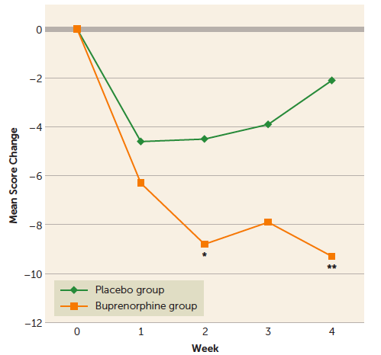

Slide 64
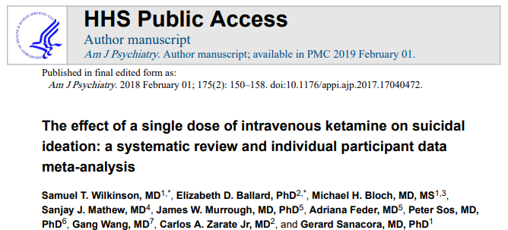
This was a systematic review and individual participant data meta-analysis examining the effects of a single dose of ketamine on suicidal ideation.
Method—Individual participant data were obtained from 10 of 11 identified comparison intervention studies (using either saline or midazolam as control). The analysis included only participants with suicidal ideation at baseline (n=167).
The primary outcome measures were the suicide items from clinician-administered Montgomery Asberg Depression Rating Scale (MADRS) or Hamilton Depression Rating Scale (HAM-D)) and self-reported scales (Quick Inventory of Depressive Symptomatology-Self Report (QIDS-SR) or Beck Depression Inventory (BDI), obtained for up to one-week post-ketamine administration.

Slide 65
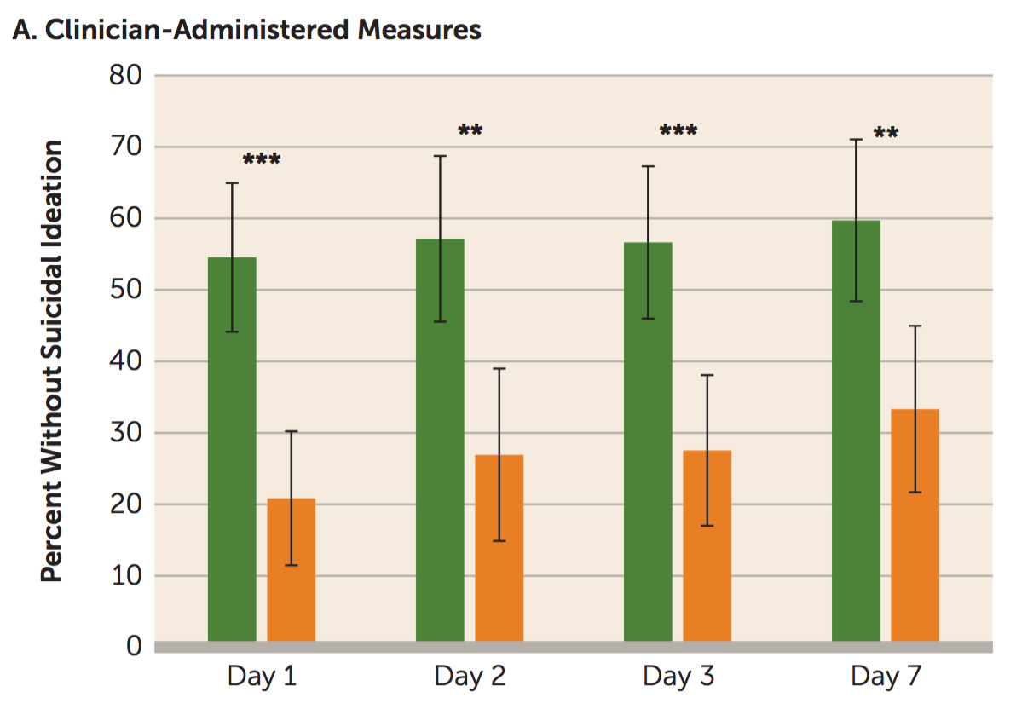
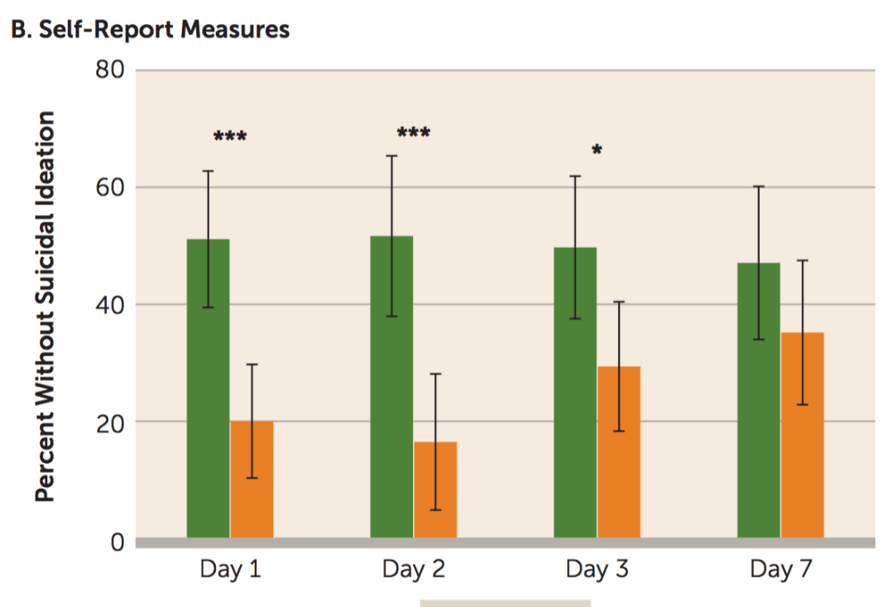
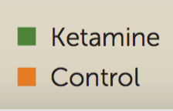
Ketamine
Meta-analysis (11 studies): one infusion of ketamine
Results—Ketamine rapidly reduced (one day) suicidal ideation on both the clinician administered (p<0.001) and self-reported outcome measures (p<0.001). Effect sizes were moderate-to-large (Cohen’s d=0.51–0.85) at all time points post-dose.

Slide 66
Prospective, double blind, superiority, randomised placebo controlled trial.
156 participants were recruited and randomised to placebo (n=83) or ketamine (n=73)
Two 40 minute intravenous infusions of ketamine (0.5 mg/kg) or placebo (saline) were administered at baseline and 24 hours
Abbar M, Demattei C, El-Hage W, Llorca PM, Samalin L, Demaricourt P, Gaillard R, Courtet P, Vaiva G, Gorwood P, Fabbro P, Jollant F. Ketamine for the acute treatment of severe suicidal ideation: double blind, randomised placebo controlled trial. BMJ. 2022 Feb 2;376:e067194. doi: 10.1136/bmj-2021-067194. PMID: 35110300; PMCID: PMC8808464.

Slide 67
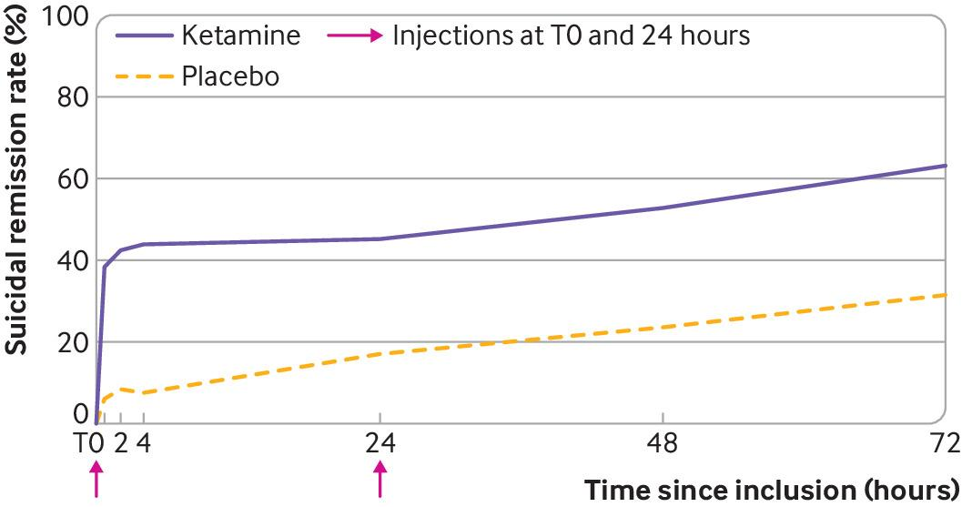
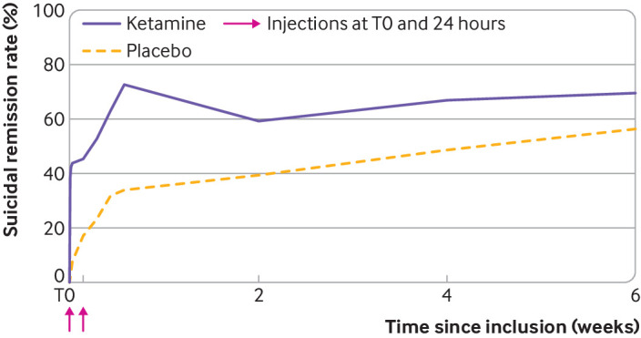
More participants receiving ketamine reached full remission of suicidal ideas at day 3 than those receiving placebo (63% vs 31.6 %) which was maintained at 6 weeks

Slide 68
Summary
Suicidal ideation is highly prevalent in patients with chronic pain and patients with SUDD
Patients suffering from both pain and SUD are particularly vulnerable to the risk of suicide
Effective pain management in hospitalized patients with pain and OUD should be standard of care
Possible mediators of the relationship between pain, SUD and suicidal risk include sense of burdensomeness, mental defeat, social isolation and poor stress-coping abilities, in particular, catastrophizing
Risk modifiable risk factors for SI in patients with pain include sleep disturbance, pain intensity, pain coping, social support and treating co-morbid SUD
Globally poor access to mental health services needs to be addressed

Slide 69
Future Directions
Develop and test novel delivery systems for CBT/ACT and other non-pharmacologic interventions especially in the most vulnerable populations
Investigate phenotypic and genotypic characteristics of suicidal ideation and behavior in patients with pain and pain and SUD
Further explore the potential efficacy of buprenorphine and ketamine formulations and other novel pharmacologic agents to co-treat pain, SUD and suicidal ideation.

Slide 70
Acknowledgements
Grant 1RO1DA032776-01 from the National Institute on Drug Abuse, National Institutes of Health
University of Pennsylvania, USA
Charles P. O’Brien, MD, PhD
Wade Berrettini, MD, PhD
Kevin Lynch, PhD
Peggy Compton, RN, PhD
University of Washington, USA
Dennis C. Turk, PhD
Emory University, USA
Nicholas Giordano, RN, PhD
Harvard University, USA
Mohammed Issa, MD
Robert Jamison, PhD
University of Warwick
Nicole K.Y. Tang, Dphil
Kristy Themelis, PhD

Slide 71
THANK YOU !!
Martin D. Cheatle, Ph.D.
cheatle@pennmedicine.upenn.edu

Slide 72
References
Tang NK, Crane C. Suicidality in chronic pain: A review of the prevalence, risk factors and psychological links. Psychol Med 2006; 36 :575-586
Cheatle MD. Depression, chronic pain, and suicide by overdose: on the edge. Pain Med. 2011 Jun;12 Suppl 2(Suppl 2):S43-8.
Brown LA, Lynch KG, Cheatle M. Pain catastrophizing as a predictor of suicidal ideation in chronic pain patients with an opiate prescription. Psychiatry Res. 2020 Feb 21;286:112893.
Racine M. Chronic pain and suicide risk: A comprehensive review. Prog Neuropsychopharmacol Biol Psychiatry. 2018 Dec 20;87(Pt B):269-280.
Abbar M, Demattei C, El-Hage W, Llorca PM, Samalin L, Demaricourt P, Gaillard R, Courtet P, Vaiva G, Gorwood P, Fabbro P, Jollant F. Ketamine for the acute treatment of severe suicidal ideation: double blind, randomised placebo controlled trial. BMJ. 2022 Feb 2;376
Wilson KG, Kowal J, Henderson PR, McWilliams LA, Péloquin K. Chronic pain and the interpersonal theory of suicide. Rehabil Psychol. 2013 Feb;58(1):111-115
Tang NK, Beckwith P, Ashworth P. Mental Defeat Is Associated With Suicide Intent in Patients With Chronic Pain. Clin J Pain. 2016 May;32(5):411-9.
Serafini G, Adavastro G, Canepa G, De Berardis D, Valchera A, Pompili M, Nasrallah H, Amore M. The Efficacy of Buprenorphine in Major Depression, Treatment-Resistant Depression and Suicidal Behavior: A Systematic Review. Int J Mol Sci. 2018 Aug 15;19(8):2410
Notes:
ASAM requests the APA citation format
Link: https://owl.purdue.edu/owl/research_and_citation/apa_style/apa_formatting_and_style_guide/general_format.html

