Slide 1
Pain and Addiction: Common Threads Course XXIV
Patient Case: Jenny

Slide 2
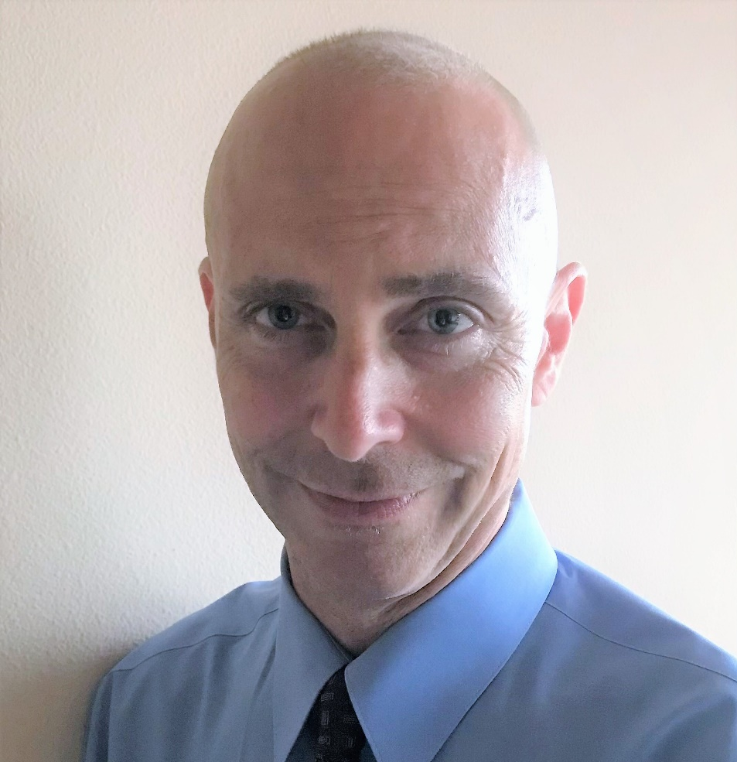
Patient Case
Pain & Addiction: Common Threads Course XXIV
Gregory D. Rudolf, MD, DFASAM
No Disclosures

Slide 3
Patient Background: Jenny
33 y/o white female
Originally from MT
Living in Seattle past 10 years
Recently left an abusive relationship
Staying in various shelters or with friends
On the street for the past 5 weeks
Looking for stable housing
Using methamphetamine/fentanyl daily (smoking)
Started using with prev BF about 5 yrs ago
2-year period of abstinence until 6 months ago when partner escalated domestic abuse
Has one child who is in foster care from the prior relationship
Unemployed
HS grad with some community college
Worked as a restaurant server most of the past 10 years.
Not in over a year, partner did not want her to work outside the home.
Formerly had dreams of being a musician/visual artist.

Slide 4
Patient Case History: Jenny
Nodded off after using last night
Fell on R wrist/hand
Started screaming due to pain→ person she was using with saw obvious wrist fracture and called 911
Medics took patient by ambulance and despite pain, she was slipping out of consciousness in the ambulance→ given naloxone on the way to the ED

