Slide 1
The Latest on Buprenorphine – Pharmacology, Formulations and Misconceptions
Mark Greenwald, PhD
Gertrude Levin Endowed Chair in Addiction and Pain Biology
Professor, Associate Chair, and Director of Substance Abuse Research Division
Dept. of Psychiatry and Behavioral Neurosciences; and Dept. of Pharmacy Practice
Wayne State University, Detroit, MI, USA
mgreen@med.wayne.edu
Pain & Addiction Common Threads

Slide 2
Disclosure information 1
Indivior
  Compensated: consultant/speaker re: BUP-XR for treatment of OUD and neurobiology of addiction
  Not compensated: collaborator/coauthor on several projects and manuscripts (published and ongoing)
NIH-funded clinical research projects related to OUD
  R01 DA015462, R21/R33 DA044946, F30 DA052118, U01 HL050551 (HEAL) and R34 DA053758
Peter F. McManus Charitable Trust
  Grant (PI): rTMS investigation of stress reactivity in OUD
NET Recovery Corp.
  Contract (PI): Clinical trials of neuromodulation (medical device) treatment of OUD
Notes:
Disclosure slide option #2 for multiple presenters. Select either option 1 or option 2, you don’t need to have both.

Slide 3
Disclosure information 2
Park Therapeutics
  Pending NIH grant application (Co-PI): Development of mu-opioid/nociceptin receptor agonist for treatment of OUD
MI CARES
  Grant subcontract (Co-investigator): Online program to educate U.S. physicians, medical students and advanced practice professionals in addiction medicine
Arborsense, Inc.
  Paid consultant for novel drug detection methodology
Notes:
Disclosure slide option #2 for multiple presenters. Select either option 1 or option 2, you don’t need to have both.

Slide 4
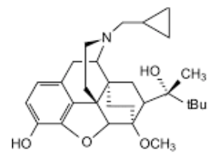



Learning objectives
Improve understanding of the pharmacology of BUP relating to its safety and efficacy in treating opioid use disorder (OUD)
Identify and clear up common misconceptions and unanswered questions surrounding BUP induction and maintenance
Improve clinician confidence in BUP dosing practices for management of OUD and co-occurring pain

Slide 5
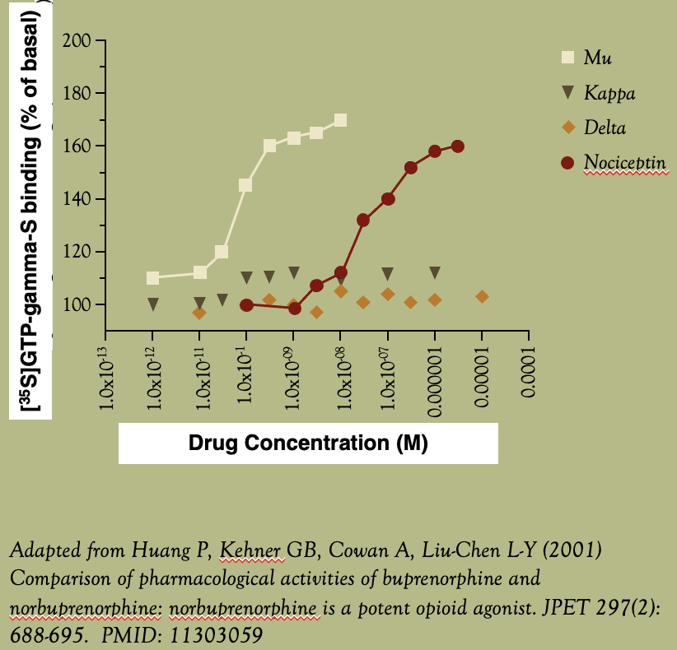
Buprenorphine selectively activates mu-opioid receptors (µORs) at physiologically relevant concentrations
“Partial agonist” misconception: µOR partial agonism does not mean BUP clinical effects are universally limited. Rather, partial agonism refers to limited activation of GPCR machinery (figure). Clinical effects – which are mediated downstream via different intracellular signaling pathways –can differ in their intrinsic activity. This means there is not a ceiling effect for every outcome measure.
“A drug, acting at a single receptor subtype, can have multiple intrinsic efficacies that differ depending on which of the multiple responses coupled to a receptor is measured.” (Berg and Clarke, 2018)
Kappa/delta receptor involvement? No convincing evidence yet in animals or humans that BUP antagonism at kappa or delta receptors mediates its clinical efficacy for treating OUD.
“Nociception misconception”: BUP-induced GPCR activation is ≈1000x more potent at µORs than nociceptin receptors, therefore, nociceptin receptors are not mediating BUP effects at clinically relevant doses.
Occam’s razor: BUP effects are – based on current knowledge –selectively attributable to its partial agonist effects at the µOR.

Slide 6
Addressing some misconceptions
Opioid blockade: What is it and how is it achieved?
  Efficacy of BUP to attenuate certain effects of an opioid (e.g. fentanyl, hydromorphone), so that the opioid’s effects – typically liking (abuse potential), or toxicity such as respiratory depression – are comparable to placebo challenge (Greenwald et al. 2014; adopted by FDA for phase II studies).
  Figure: Mechanism is likely cross-tolerance, leading to a rightward shift (reduction in potency) of the illicit opioid. A formerly lethal dose is no longer lethal.
  Misconception: Naloxone co-formulated with BUP is not the agent producing opioid blockade, nor was that ever the intent.
BUP is a weak/ineffective analgesic in OUD (Incorrect, although there are limits, as will be discussed)
  Confusion arises because of its dual indication for OUD and pain, and addressing both issues when there is comorbid pain and OUD, e.g. what formulation(s) and dose(s) to use?

Slide 7
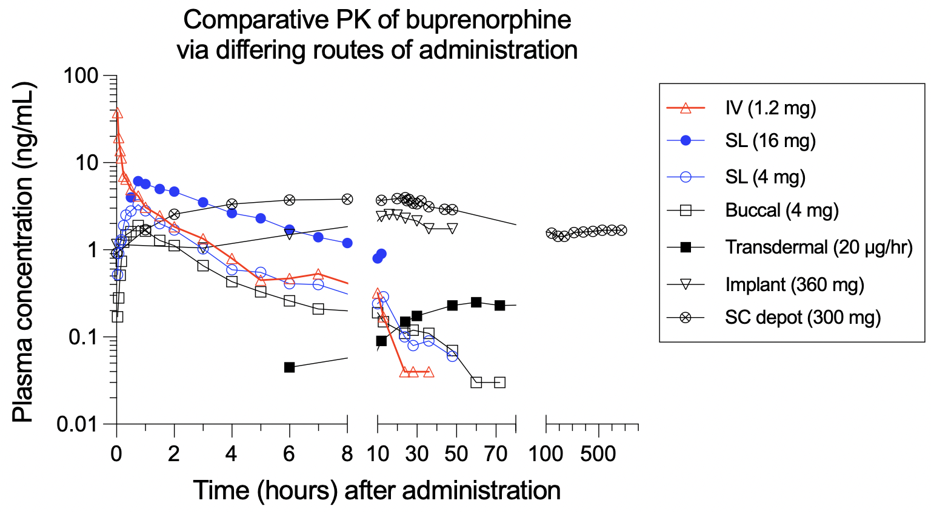
BUP routes/formulations and pharmacokinetics (PK)
Routes/formulations that are FDA-approved for OUD and analgesia
  Injection (IV, IM and SC depot)
  Transmucosal (SL tablet or buccal film)
  Transdermal (patch)
  Implant (surgical) – no longer marketed in USA
Data references:
Andresen T, et al. (2011) Pharmacokinetic/pharmacodynamic relationships of transdermal buprenorphine and fentanyl in experimental human pain models. Basic Clin Pharmacol Toxicol 108: 274-284.
Kuhlman JJ, et al. (1996) Human pharmacokinetics of intravenous, sublingual, and buccal buprenorphine. J Anal Toxicol 20: 369-378.
Laffont CM, et al. (2016) Population pharmacokinetic modeling after repeated administrations of RBP-6000, a new, subcutaneously injectable, long-acting, sustained-release formulation of buprenorphine, for the treatment of opioid use disorder. J Clin Pharmacol 56: 806-815. {Data provided by the study sponsor.}
McAleer SD, et al. (2003) Pharmacokinetics of high-dose buprenorphine following single administration of sublingual tablet formulations in opioid naïve healthy male volunteers under a naltrexone block. Drug and Alcohol Dependence 72: 75-83.
White J, et al. (2009) Open-label dose-finding trial of buprenorphine implants (Probuphine®) for treatment of heroin dependence. Drug Alcohol Depend 103: 37-43.
Notes:
The figure shows the comparative plasma pharmacokinetics of BUP, administered as single acute doses through various routes – IV, sublingual tablet, buccal film, transdermal patch, subcutaneous depot, and surgical implant (discontinued from market). These data are compiled from several published studies. The X-axis is divided into early, middle and late phases, and the Y-axis is plotted on a log₁₀ scale, so you can more easily see differences across routes across time.
IV administration leads to an immediate, large spike in plasma levels that descends rapidly in the first few hours, and then more gradually, toward baseline levels. Transmucosal formulations (SL and buccal) reach peak plasma levels ≈ 45 min after administration and gradually decrease. For IV and transmucosal routes, the terminal phase is similar. Kinetics for the other formulations show a “flip-flop”. For the transdermal patch for treating chronic pain, lower BUP doses are delivered, consequently, plasma levels are considerably lower than other formulations. Transdermal administration results in plasma levels that rise very gradually to reach a steady state around 60 hr after applying the patch. The SC depot injection leads to an increase in plasma levels that is slower than transmucosal but faster than transdermal, reaching asymptotic levels several hours after administration, and these levels are maintained over a 1-month period.

Slide 8
Neuropharmacological rationale:
Application of receptor theory to MOUDs
Target for treating OUD is mu-opioid receptor (µOR), implicated in reinforcing and physical dependence related effects of opioids
With addiction medicines, we're trying to maximize efficacy & minimize side effects within a therapeutic window along a continuum (mediated by µOR occupancy)
Mu-opioid receptors (human)
But we need to be clear: which efficacy measures?
Therapeutic window
Greenwald MK, et al. (2003) Effects of buprenorphine maintenance dose on mu-opioid receptor binding potential, plasma concentration, and antagonist blockade in heroin-dependent volunteers. Neuropsychopharmacology
28: 2000-2009.
Ineffective
but safe
Effective
and safe
Effective
but unsafe
Ineffective
and unsafe
Increasing receptor occupancy
(or plasma concentration)

Slide 9
Estimated ordering and variability of µOR occupancy requirements for differing therapeutic thresholds in persons with OUD
Illicit “on-top” opioid use
Obvious
under-dosing
Less-obvious
under-dosing
Where we
need to be for
harm reduction
Block
respiratory
depression
Block
opioid-
seeking
Opioid
craving
suppression
Block
opioid
liking
Opioid
withdrawal
suppression
Increasing µ-receptor occupancy -> (or decreasing µ-receptor availability)

Slide 10
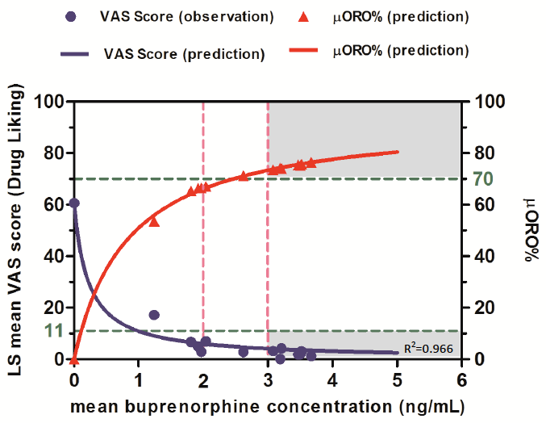
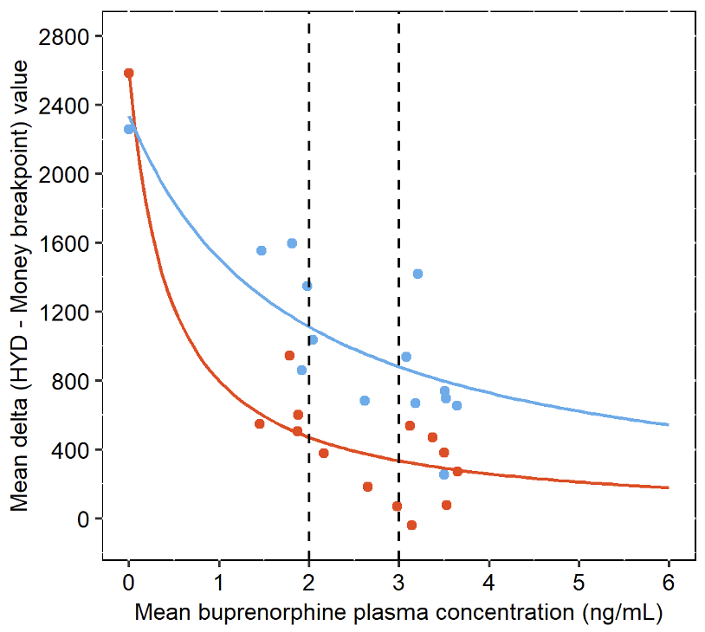
Higher BUP plasma concentrations and µOR occupancy block opioid liking and reduce opioid-seeking behavior
Morning: Challenge with hydromorphone (18 mg)
Subjective drug liking
Afternoon: Work for units of total morning hydromorphone dose vs. money on 12-trial choice, progressive ratio schedule
Drug-seeking behavior
18 mg
(1.5 mg units)
6 mg
(0.5 mg units)
Nasser AF, Greenwald MK, et al. (2016) Sustained-release buprenorphine (RBP-6000) blocks the effects of opioid challenge with hydromorphone in subjects with opioid use disorder. J Clin Psychopharmacol 36: 18-26.
Unpublished analysis, based on Nasser et al. (2016)

Slide 11
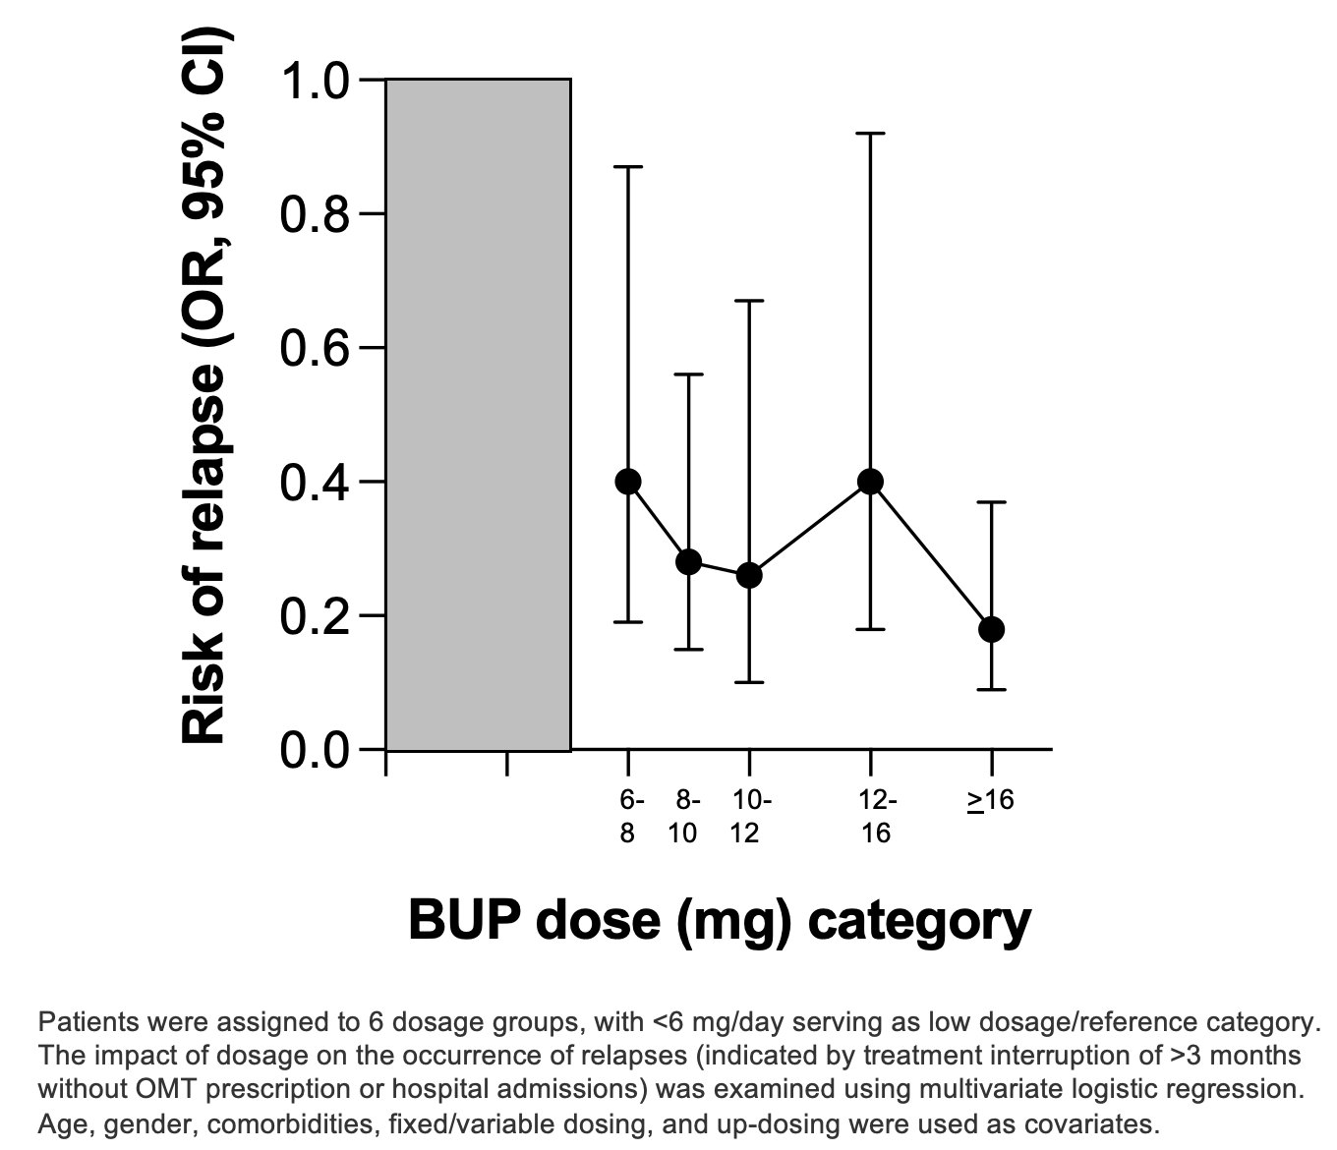
Higher BUP maintenance doses reduce the odds of relapse
NB: Not only is mean OR lower for high-dose BUP, but 95% CI is also smaller.
This translates into a more clinically certain reduction in risk of relapse.
Reimer J, et al. (2020) Impact of buprenorphine dosage on the occurrence of relapses in patients with opioid dependence. Eur Addict Res 26(2): 77-84.

Slide 12
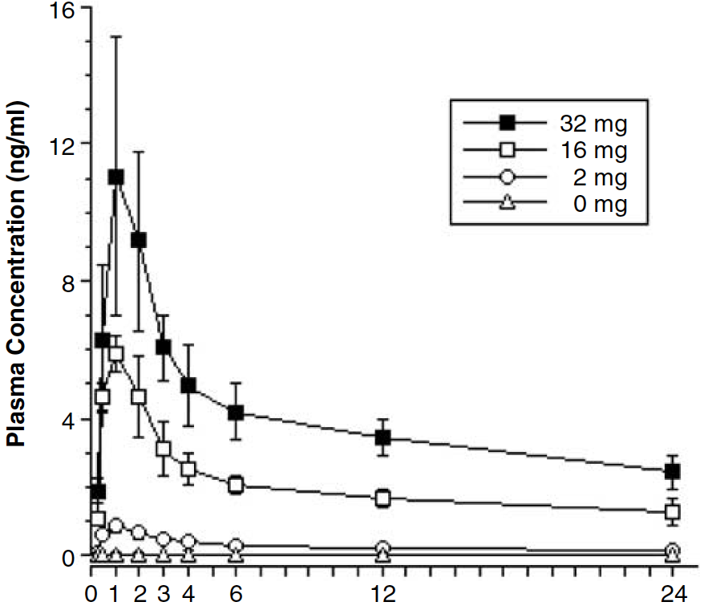
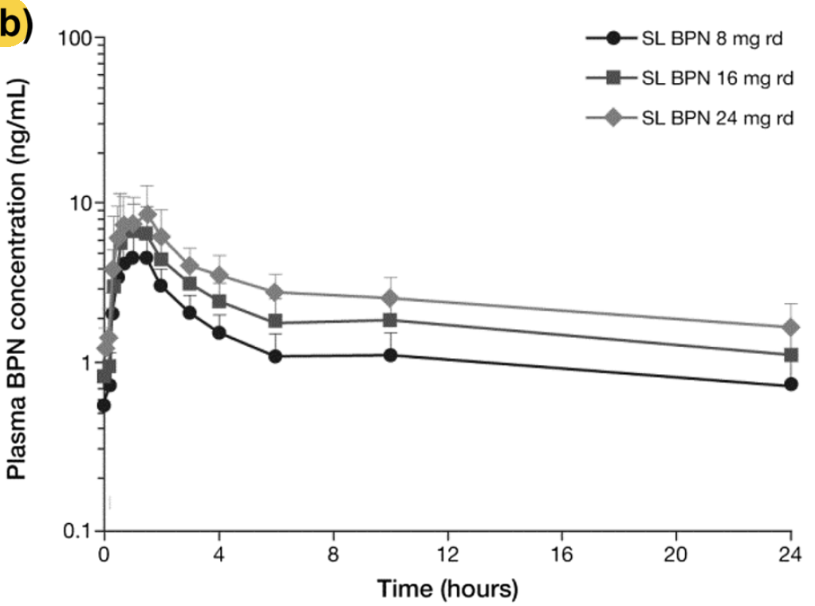
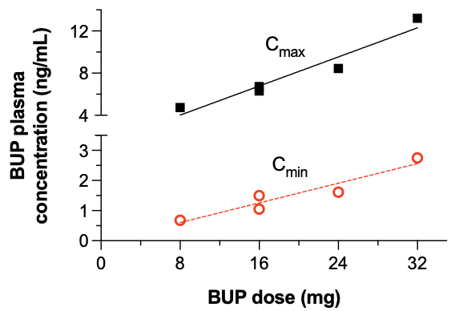
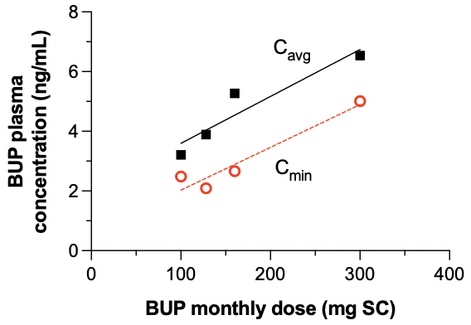
Misconception: For maintenance dosing, don’t focus on C_{max};
instead, aim for C_{min} (think: harm reduction)
Dose-linear relationship between BUP daily dose and C_{max} & C_{min}
Greenwald MK et al. (2003) Effects of buprenorphine maintenance dose on mu-opioid receptor binding potential, plasma concentration, and antagonist blockade in heroin-dependent volunteers. Neuropsychopharmacology 28: 2000-2009.
Albayaty M, et al. (2017) Pharmacokinetic evaluation of once-weekly and once-monthly buprenorphine subcutaneous injection depots (CAM2038) versus intravenous and sublingual buprenorphine in healthy volunteers under naltrexone blockade: an open-label phase 1 study. Adv Ther 34: 560-575.
Adapted from: Coe MA, et al. (2019) Buprenorphine pharmacology review: update on transmucosal and long-acting formulations. J Addict Med 13: 93-103.

Slide 13
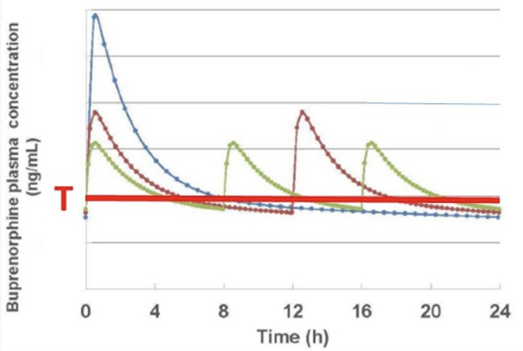
Divided dosing in BUP treatment of individuals who experience chronic pain, are pregnant, or are “fast metabolizers”
Simulated plasma concentrations of buprenorphine utilizing physiologically based pharmacokinetic modeling of nonpregnant subjects.
Thick red line (“T”) represents the threshold for clinically relevant opioid withdrawal symptoms.
  Again, think C_{min}!
Three times daily dosing (green line) results in a steadier plasma level and less time below withdrawal threshold compared to twice daily (red-purple) or once daily (blue) dosing (10.8, 14.4 and 16.3 hours, respectively).
Caritis SN, et al. (2017) An evidence-based recommendation to increase the dosing frequency of buprenorphine during pregnancy. Am J Obstet Gynecol. 217: 459.e1-459.e6

Slide 14
Addressing more misconceptions
Precipitated opioid withdrawal (POW): What is it, and when does it occur?
  Produced by an opioid partial agonist (e.g. BUP) or antagonist (e.g. NAL) with relatively high affinity and at sufficient concentrations in the presence of moderate to higher concentrations of a full agonist (e.g. fentanyl), especially when that agonist has been taken chronically (leading to neuroadaptations).
  Abrupt net reduction in agonist activity at spare functional mu-opioid receptors; this dynamic shift (∆) in receptor complexes between BUP and the prior opioid agonist (related to BUP K_{on} vs. opioid K_{off} and slow rate of BUP penetration into central compartment) leads to rapid onset in expression of withdrawal signs/symptoms
  Misconception: Challenging with an opioid agonist on top of BUP does not lead to POW!
  Misconception: POW is sometimes described clinically as on/off phenomenon (‘flipping a switch’), but it can be measured along a continuum of severity
Cumulative BUP dosing: If BUP leads to POW, then additional BUP doses will not always cause more withdrawal
  After initial BUP dose that leads to POW, follow-on higher BUP doses typically suppress withdrawal
  Implication: Long induction periods unnecessary

Slide 15
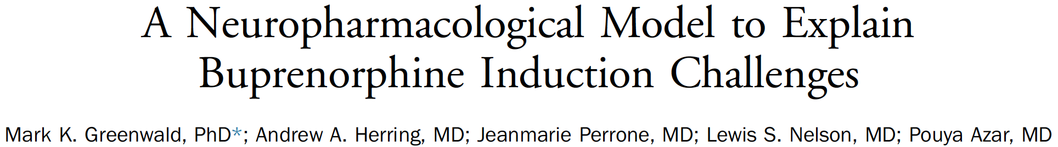
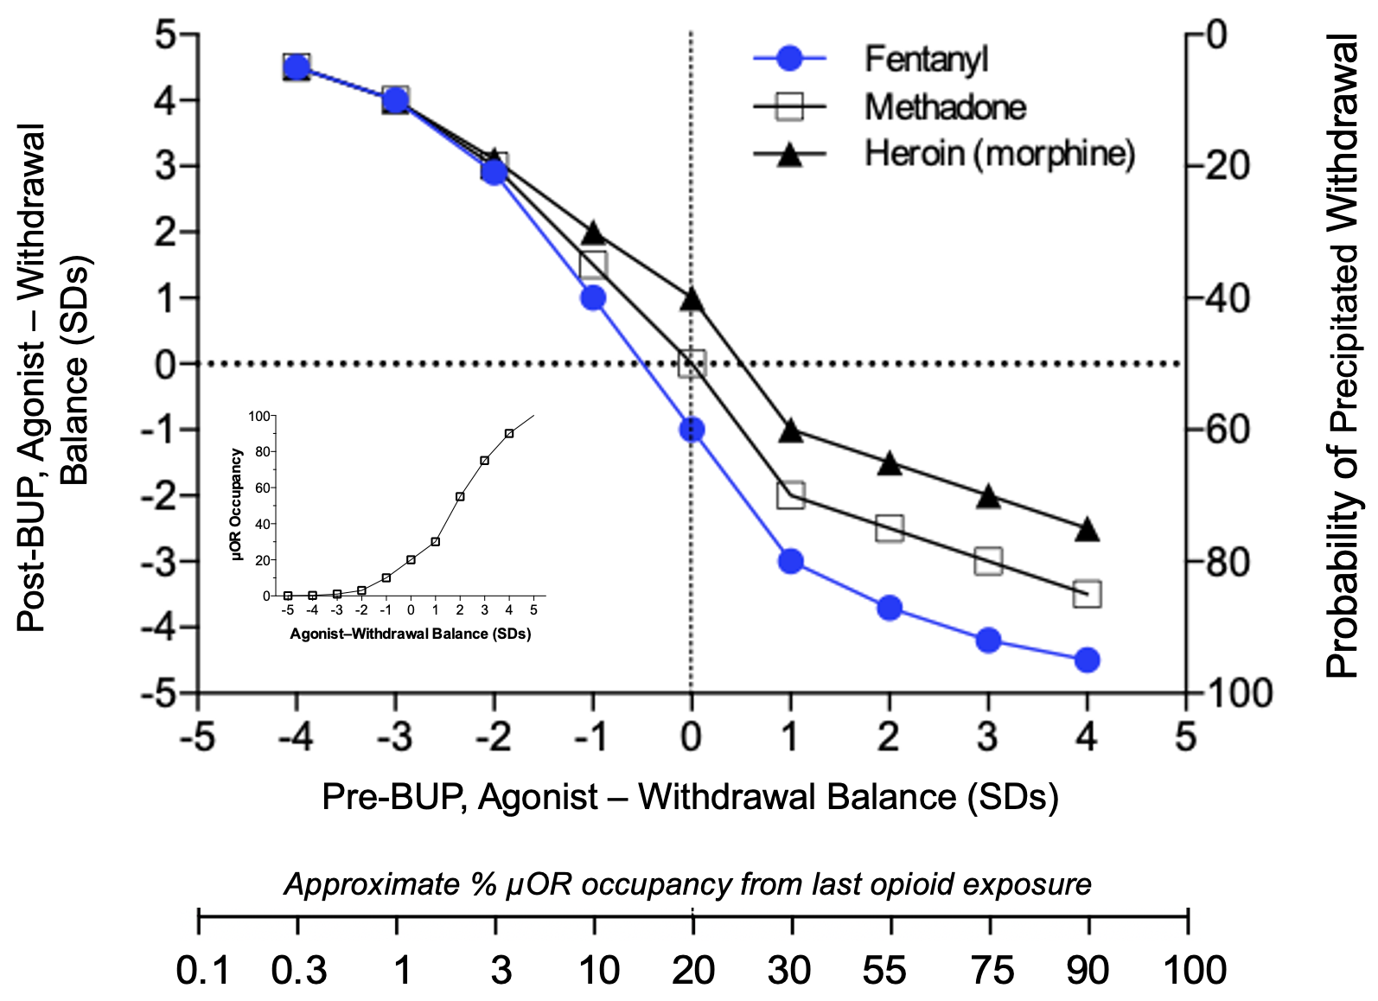
BUP induction hurdle: Premises of working model
Acute outcome of BUP induction (agonist – withdrawal balance, Y-axis) is a function of pre-initiation opioid balance, defined as symptom state or µOR occupancy (dual X-axes and inset).
  Negative balance (withdrawal and lower % µOR occupancy) before initial BUP dose is associated with greater post-BUP agonist balance (upper left quadrant).
  Positive balance (agonist effect from residual opioid and higher % µOR occupancy) is associated with greater likelihood and severity of POW by initial BUP dose (lower right quadrant).
BUP induction outcome will differ by pre-exposure to opioids with high ALE values (affinity * lipophilicity * intrinsic efficacy).
  Pre-exposure to fentanyl (higher ALE value, and longer time to re-sensitize µORs) leads to more difficult BUP induction, whereas heroin/morphine (lower ALE value) leads to easier BUP induction.
  Extended exposure to fentanyl (dependence) increases the probability and severity of POW, because underlying µOR desensitization may not be fully reversed.
Greenwald MK, et al. (2022) A neuropharmacological model to explain buprenorphine induction challenges. Annal Emerg Med. 80(6): 509-524.

Slide 16
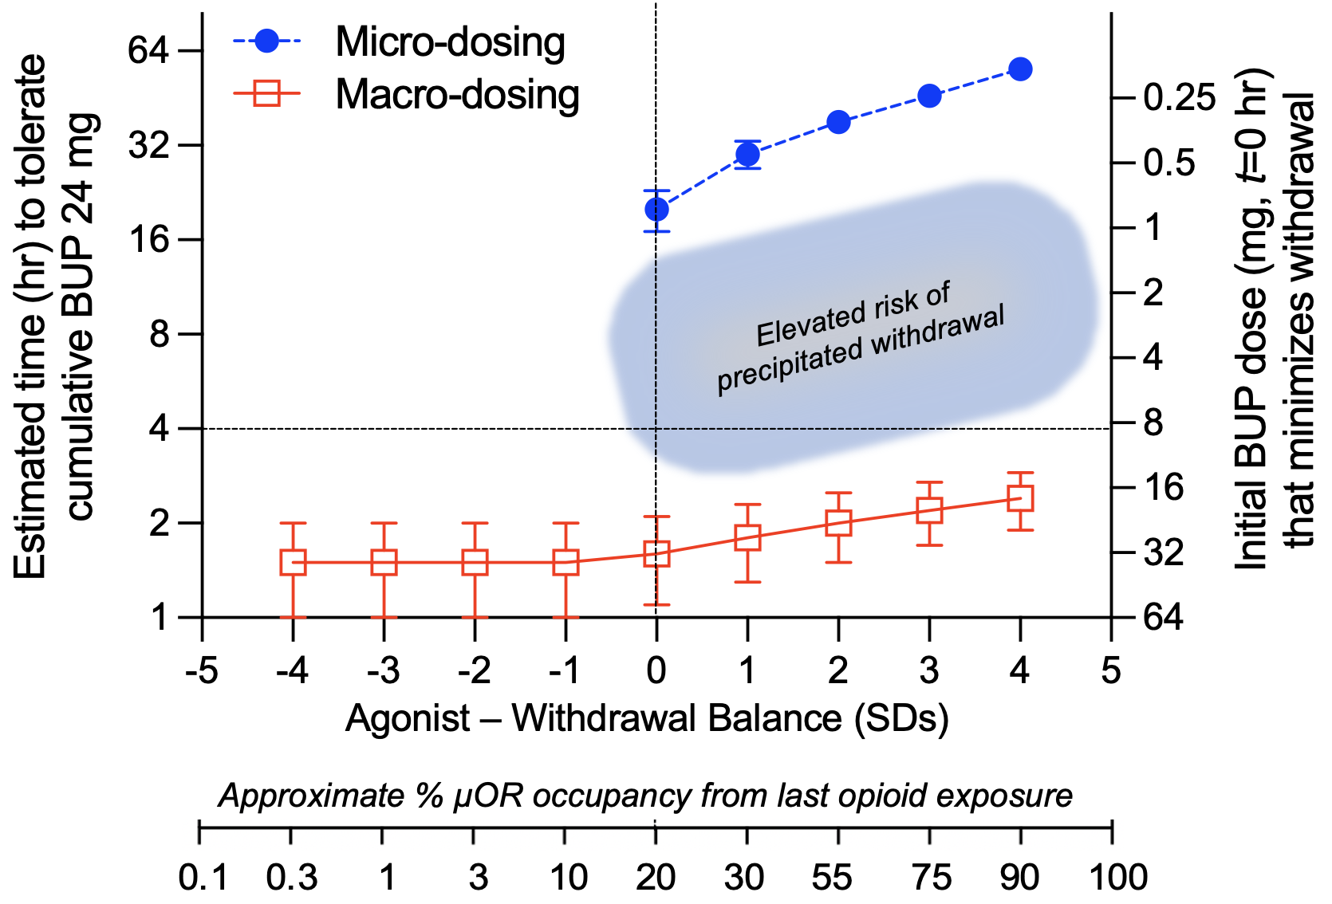
Avoiding POW and maximizing agonist effects during BUP induction
When there is residual agonist effect from prior opioid exposure, intermediate BUP starting doses (approx. 1-12 mg) increase risk of POW (shaded area, informally termed “the donut hole”)
Why? Intermediate BUP doses displace enough residual agonist to POW, but insufficient to maximally stimulate spare functional µORs.
In contrast, “macro-dosing” (i.e. starting doses >16 mg SL) or “micro-dosing (i.e. starting doses of <0.5 mg SL) will be better tolerated with less chance of POW.
When baseline withdrawal is present (low µOR occupancy),
• Macro-dosing should result in a positive agonist balance, whereas
• Micro-dosing is unlikely to sufficiently replace the residual agonist and abstinence withdrawal will persist (i.e. micro-dosing is counter-productive when there is baseline withdrawal).
These curves may shift depending on the ALE value of the last opioid used.
Greenwald MK, et al. (2022) A neuropharmacological model to explain buprenorphine induction challenges. Annal Emerg Med. 80(6): 509-524.

Slide 17
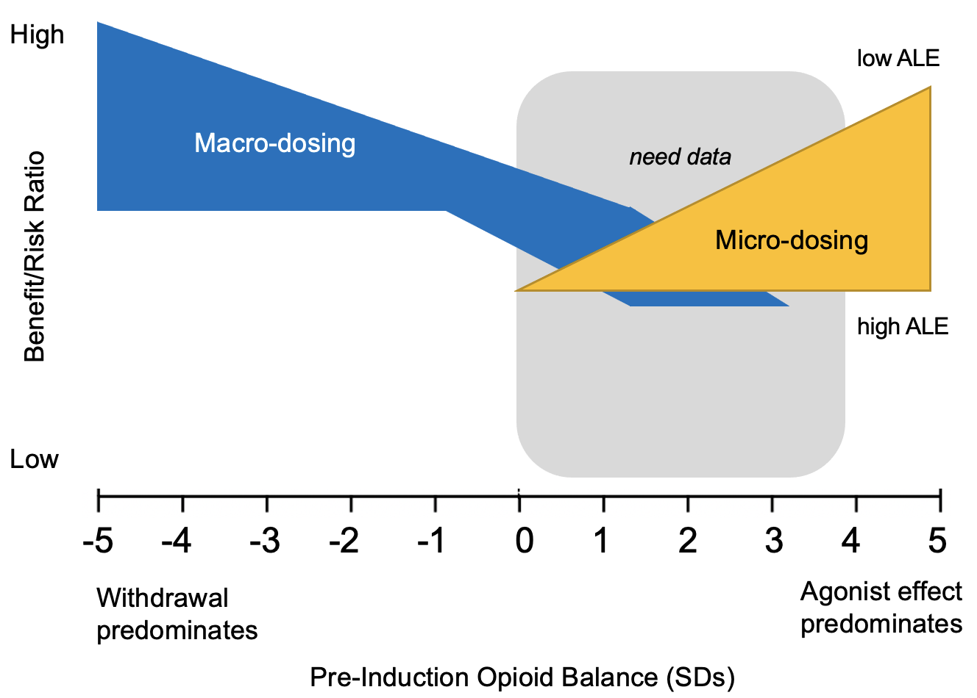
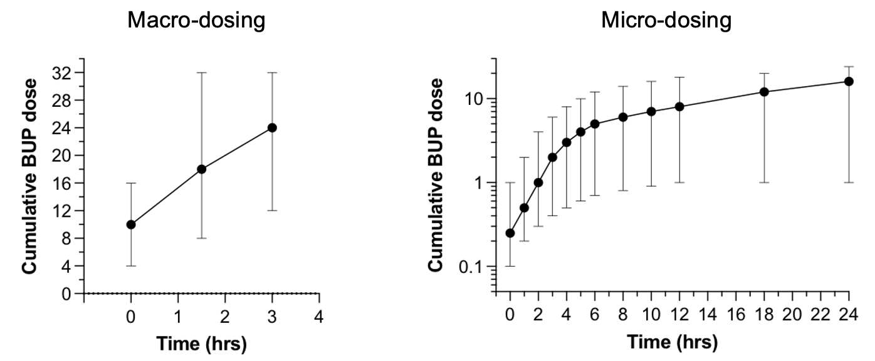
Working model of BUP induction: Clinical application
Macro-dosing (high/fast approach) is most effective and safe under conditions of baseline withdrawal (minimal µOR occupancy from prior opioid exposure
Reason: µORs are likely to have undergone restorative processes (e.g. de-phosphorylation, re-sensitization) from the prior opioid, such that BUP can occupy functional µORs and produce its agonist effects
Micro-dosing (low/slow approach) can be effective and safe under conditions of baseline agonist activity (higher % µOR occupancy from prior opioid exposure)
Reason: µORs remain partly occupied and desensitized from prior opioid exposure, so lower BUP doses can gradually re-occupy and re-sensitize µORs without POW
More empirical data are needed in situations where agonist baseline conditions prevail, to better understand tradeoffs between macro- and micro-dosing.
Greenwald MK, et al. (2022) A neuropharmacological model to explain buprenorphine induction challenges. Annal Emerg Med. 80(6): 509-524.

Slide 18
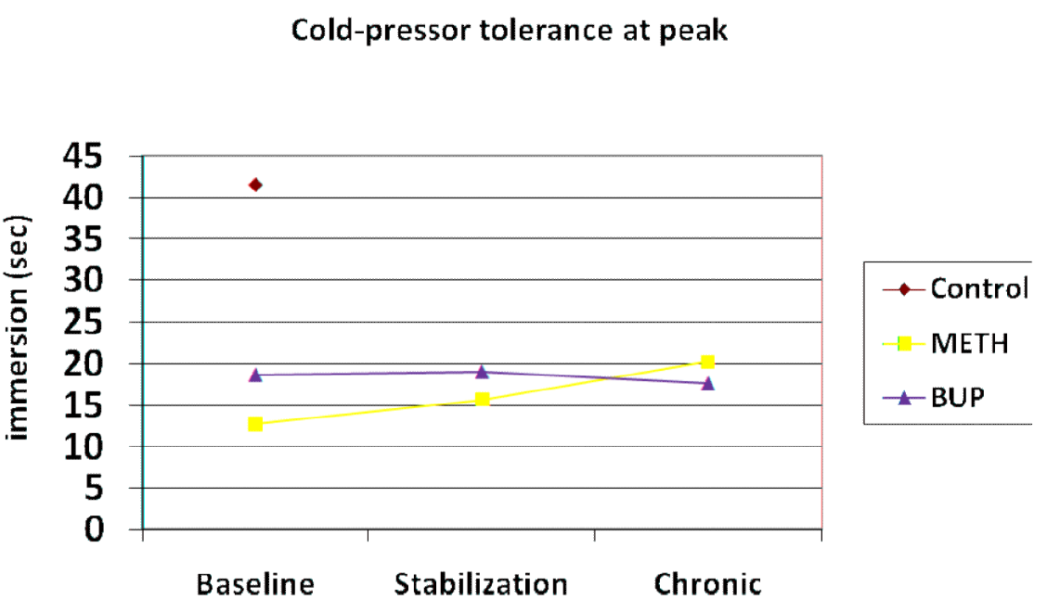
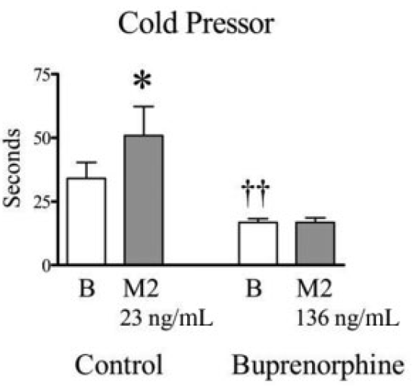
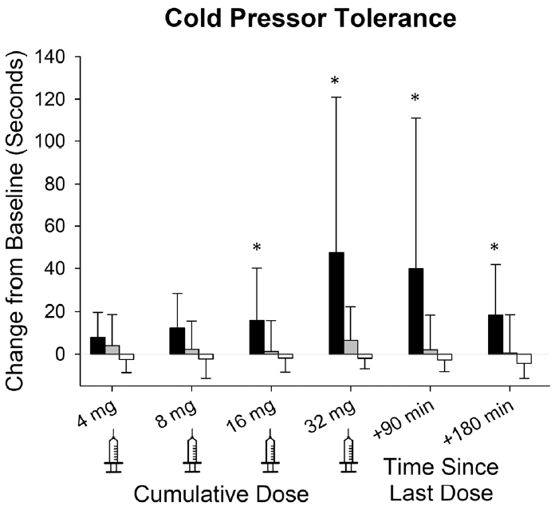

What is the role of BUP maintenance in hyperalgesia?
Overall, few controlled clinical studies
Experimental acute pain studies (Compton et al. 2012; Athanasos et al. 2019; Huhn et al. 2019) have found greatest sensitivity with cold pressor tolerance (time [sec] to remove arm from ice water):
  Chronic opioid users are hyperalgesic (remove arm from cold water quicker than healthy controls )
  BUP or MTD maintenance does not worsen or reverse this hyperalgesia
  During BUP maintenance (12-16 mg/day SL), high-dose IV hydromorphone (16-32 mg) produced time-dependent reversal of hyperalgesia whereas high IV doses of BUP and morphine did not
Compton P, et al. (2012) Hyper-algesia in heroin dependent patients and the effects of opioid substitution therapy. J Pain 13: 401-409.
Compton et al 2012
Huhn AS, et al (2019) Analgesic effects of hydromorphone versus buprenorphine in buprenorphine-maintained individuals. Anesthesiology 130: 131-141.
Athanasos et al 2019
Huhn et al 2019
Athanasos P, et al. (2019) Buprenorphine maintenance subjects are hyperalgesic and have no antinociceptive response to a very high morphine dose. Pain Med 20: 119-128.

Slide 19
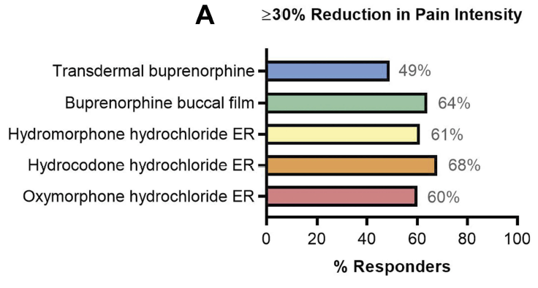
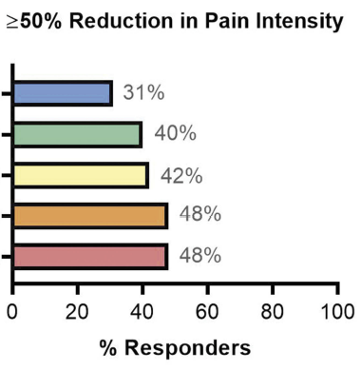
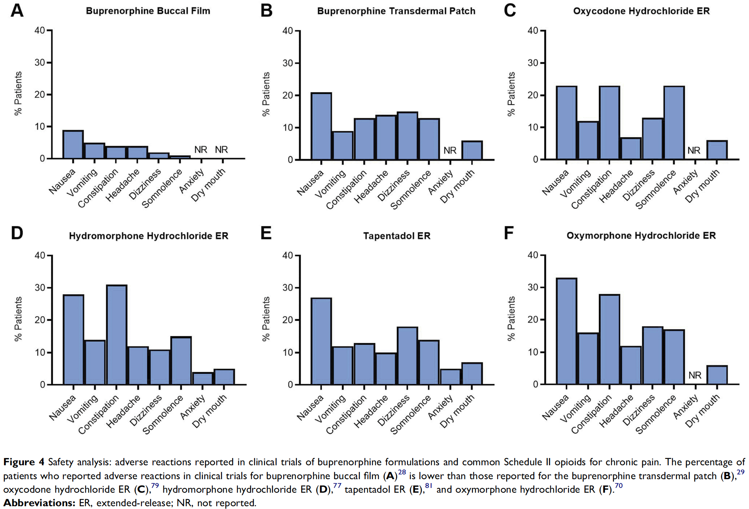
Benefit-risk of BUP vs. other ER-opioid formulations for analgesia
Review: Compared BUP vs. other opioid formulations for treating chronic pain patients
Relative to BUP TD system, buccal film showed greater analgesic benefit and led to statistically similar pain relief compared to other ER-opioid formulations.
BUP TD system, followed by BUP buccal film, had fewer safety concerns than other ER-opioid formulations
Thus, overall benefit-risk ratio favors BUP formulations for analgesia, although this will depend on pain severity
Pergolizzi JV, Raffa RB (2019) Safety and efficacy of the unique opioid buprenorphine for the treatment of chronic pain. J Pain Res 12: 3299-3317.

Slide 20
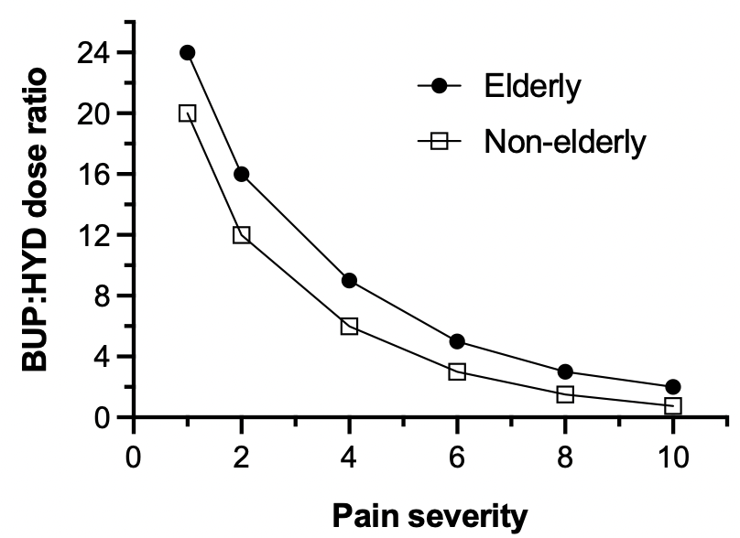
Pain intensity and BUP vs. ‘on-top’ agonist dosing: a proposal
Misconception and debate (esp. among anesthesiologists and surgeons) re: use of BUP and/or ‘on-top’ opioid agonist (or adjunctive analgesic) dosing for chronic pain and perioperative pain.
Algorithm is partly a function of the severity of ongoing pain (chronic) or anticipated pain (perioperative).
To balance BUP agonist effects with the need to treat breakthrough pain, a potentially useful concept is to consider the ratio of BUP (total daily dose) to ‘on-top’ agonist dosing (hydromorphone [HYD] units, reflecting use of more potent opioids than morphine in this context).
Figure shows proposed form of the function. BUP:HYD ratios need to be empirically determined, and may differ due to individual differences such as age (e.g. BUP more favorable analgesic for the elderly)
  At low pain severity, higher BUP:HYD ratio is feasible, i.e. continue BUP dosing, minimal need for additional agonist.
  At higher pain severities, BUP:HYD ratio would decrease, e.g. increase on-top dosing to overcome cross-tolerance, and/or reduce BUP, based on clinical judgment.
  Usually, not necessary to discontinue BUP for acute pain (Veazie et al. 2020). As pain severity decreases, BUP dose (if tapered) can be restored as needed for OUD.
MK Greenwald, unpublished simulation
(do not cite)

Slide 21
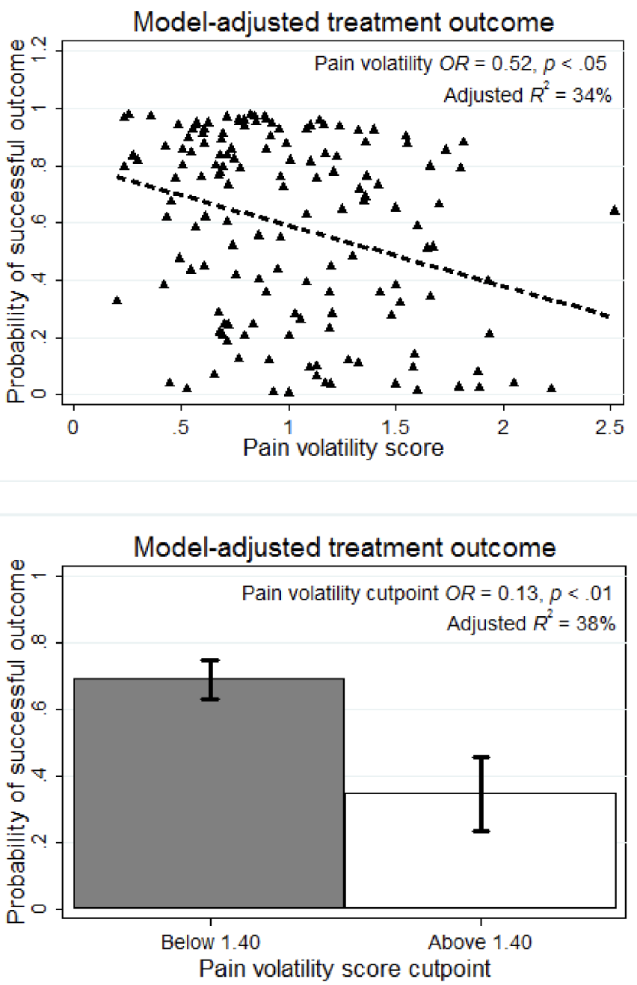
Pain volatility predicts worse treatment (BUP + counseling or medical management) outcome
Most studies have focused on pain severity, whereas pain volatility (within-subject variability across time) could be more informative or predictive of clinical outcomes
Worley et al. (2015) conducted secondary analysis of POATS study, which had not demonstrated different opioid abstinence outcomes by chronic pain status (Weiss et al. 2011)
Pain volatility = deviation of each patient’s pain scores around their own pain trajectory across 12 study weeks, controlling for intercept, slope and covariates (mean absolute residual)
Higher pain volatility – expressed as a continuous score (upper panel) or group (lower panel) – was associated with significantly less opioid abstinence
Worley et al. (2017) extended this finding to the 4-week BUP dose taper period
Worley MJ, et al. (2015) Pain volatility and prescription opioid addiction treatment outcomes in patients with chronic pain. Exp Clin Psychopharmacol 23: 428-435.
Worley MJ, et al. (2017) Volatility and change in chronic pain severity predict outcomes of treatment for prescription opioid addiction. Addiction 112: 1202-1209.

Slide 22

Final Takeaways
Numerous misconceptions and questions
  Partial agonism at µORs (not other receptors), ceiling effects, POW, opioid blockade, on-top analgesia, hyperalgesia, C_{min} vs. C_{max}, divided daily dosing
  Although not covered in this talk … When/for whom to start XR formulations and duration of BUP treatment should be determined by patient benefit
Induction
  Opioid-preexposure (including ALE value) critical in avoiding POW and maximizing agonist effects during transition (slow vs. rapid BUP induction dosing)
Maintenance
  While acknowledging that doses should be titrated using clinical judgment, higher doses (higher C_{min}) offer more certain benefit for a higher proportion of patients for treating OUD (e.g. withdrawal suppression, opioid blockade, preventing respiratory depression)
  But for patients with chronic pain (esp. volatile pain) or perioperative pain, high BUP doses should be balanced against benefits of potent full agonists for on-top analgesia (BUP:HYD ratio)
Tapering
  Untreated pain volatility seems to predict relapse risk
Notes:
Take this time at the end of your presentation to review key takeaways and information that audiences should remember in the future. If practical, apply this to clinical practice.

Slide 23


Slide 24
References. 1
Albayaty M, et al. (2017) Pharmacokinetic evaluation of once-weekly and once-monthly buprenorphine subcutaneous injection depots (CAM2038) versus intravenous and sublingual buprenorphine in healthy volunteers under naltrexone blockade: an open-label phase 1 study. Adv Ther 34: 560-575.
Andresen T, et al. (2011) Pharmacokinetic/pharmacodynamic relationships of transdermal buprenorphine and fentanyl in experimental human pain models. Basic Clin Pharmacol Toxicol 108: 274-284.
Athanasos P, et al. (2019) Buprenorphine maintenance subjects are hyperalgesic and have no antinociceptive response to a very high morphine dose. Pain Med 20: 119-128.
Berg KA, Clarke WP (2018) Making sense of pharmacology: inverse agonism and functional selectivity. Int J Neuropsychopharmacology 21: 962-977.
Buresh M, et al. (2020) Treating perioperative and acute pain in patients on buprenorphine: narrative literature review and practice recommendations. J Gen Intern Med 35: 3635-3643.
Caritis SN, et al. (2017) An evidence-based recommendation to increase the dosing frequency of buprenorphine during pregnancy. Am J Obstet Gynecol. 217: 459.e1-459.e6
Coe MA, et al. (2019) Buprenorphine pharmacology review: update on transmucosal and long-acting formulations. J Addict Med 13: 93-103.
Compton P, et al. (2012) Hyperalgesia in heroin dependent patients and the effects of opioid substitution therapy. J Pain 13: 401-409.
Goel A, et al. (2019) Perioperative pain and addiction interdisciplinary network (PAIN) clinical practice advisory for perioperative management of buprenorphine: results of a modified Delphi process. Br J Anaesth 123: e333-e342.
Greenwald MK et al. (2003) Effects of buprenorphine maintenance dose on mu-opioid receptor binding potential, plasma concentration, and antagonist blockade in heroin-dependent volunteers. Neuropsychopharmacology 28: 2000-2009.
Greenwald MK, Johanson CE, Bueller J, Chang Y, Moody DE, Kilbourn MR, Koeppe RA, Zubieta JK (2007) Buprenorphine duration of action: Mu-opioid receptor availability, pharmacokinetic and behavioral indices. Biol Psychiatry 61: 101-110.
Notes:
ASAM requests the APA citation format
Link: https://owl.purdue.edu/owl/research_and_citation/apa_style/apa_formatting_and_style_guide/general_format.html

Slide 25
References. 2
Greenwald MK, Comer SD, Fiellin DA (2014) Buprenorphine maintenance and mu-opioid receptor availability in the treatment of opioid use disorder: implications for clinical use and policy. Drug Alcohol Depend 144: 1-11.
Greenwald MK, et al. (2022) A neuropharmacological model to explain buprenorphine induction challenges. Annal Emerg Med. 80: 509-524.
Huhn AS, et al (2019) Analgesic effects of hydromorphone versus buprenorphine in buprenorphine-maintained individuals. Anesthesiology 130: 131-141.
Huang P, et al. (2001) Comparison of pharmacological activities of buprenorphine and norbuprenorphine: norbuprenorphine is a potent opioid agonist. JPET 297: 688-695.
Kuhlman JJ, et al. (1996) Human pharmacokinetics of intravenous, sublingual, and buccal buprenorphine. J Anal Toxicol 20: 369-378.
Laffont CM, et al. (2016) Population pharmacokinetic modeling after repeated administrations of RBP-6000, a new, subcutaneously injectable, long-acting, sustained-release formulation of buprenorphine, for the treatment of opioid use disorder. J Clin Pharmacol 56: 806-815.
McAleer SD, et al. (2003) Pharmacokinetics of high-dose buprenorphine following single administration of sublingual tablet formulations in opioid naïve healthy male volunteers under a naltrexone block. Drug Alcohol Depend 72: 75-83 .
Nasser AF, Greenwald MK, et al. (2016) Sustained-release buprenorphine (RBP-6000) blocks the effects of opioid challenge with hydromorphone in subjects with opioid use disorder. J Clin Psychopharmacol 36: 18-26.
Reimer J, et al. (2020) Impact of buprenorphine dosage on the occurrence of relapses in patients with opioid dependence. Eur Addict Res 26: 77-84.
Veazie S, et al. (2020) Managing acute pain in patients taking medication for opioid use disorder: a rapid review. J Gen Intern Med 35(Suppl 3): S945-S953.
White J, et al. (2009) Open-label dose-finding trial of buprenorphine implants (Probuphine®) for treatment of heroin dependence. Drug Alcohol Depend 103: 37-43.
Worley MJ, et al. (2015) Pain volatility and prescription opioid addiction treatment outcomes in patients with chronic pain. Exp Clin Psychopharmacol 23: 428-435.
Worley MJ, et al. (2017) Volatility and change in chronic pain severity predict outcomes of treatment for prescription opioid addiction. Addiction 112: 1202-1209.
Notes:
ASAM requests the APA citation format
Link: https://owl.purdue.edu/owl/research_and_citation/apa_style/apa_formatting_and_style_guide/general_format.html

Slide 26
MOUD treatment = Harm reduction
Fentanyl has high lipophilicity, and high affinity and intrinsic efficacy at µORs
  ALE = (1÷K_{d}) * lipophilicity * intrinsic efficacy
  High-ALE opioids also tend to cause more µOR phosphorylation, internalization, and desensitization than lower-ALE opioids
  Will return to “ALE” concept later, in the context of BUP induction
Fentanyl doses that are misused may surmount low-to-moderate daily doses of MOUDs (e.g. <6 mg BUP), especially if fentanyl is taken long after peak medication effect.
Supra-analgesic fentanyl doses (>0.4 mg IV) might even surmount higher daily MOUD doses (approx. >16 mg BUP); however, there are almost no empirical data regarding this issue.
Figure: This simulation based on extrapolations from hydromorphone (24 mg IM) + BUP dose (2, 16 and 32 mg) interaction for VAS “good drug effect” (Greenwald et al. 2003), accounting for relative potency of HYD and FEN.
Higher-dose BUP should be able to decrease fentanyl’s positive subjective effect approx. 10-fold. Goal = shift the fentanyl dose-response curve to the right (reduce fentanyl potency, abuse potential, and toxicity)
Greenwald MK (unpublished simulation), based on Greenwald et al.
Neuropsychopharmacology 2003;28:2000-2009

Slide 27
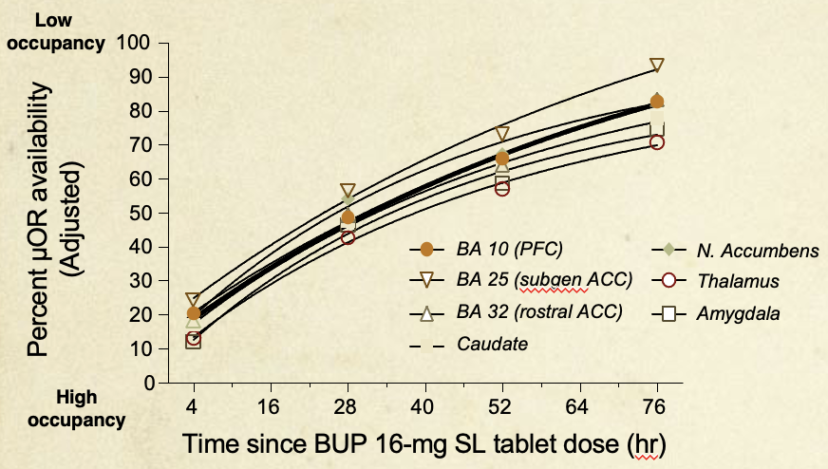
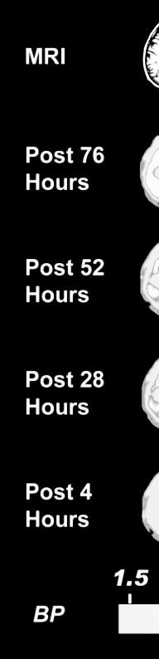
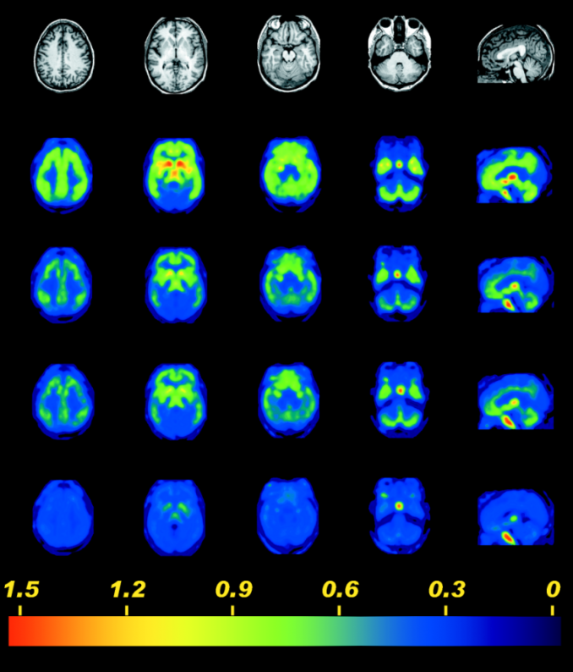
µOR availability across post-BUP time and brain regions
Greenwald MK, Comer SD, Fiellin DA (2014) Buprenorphine maintenance and mu-opioid receptor availability in the treatment of opioid use disorder: implications for clinical use and policy. Drug and Alcohol Dependence 144: 1-11.
Greenwald MK, Johanson CE, Bueller J, Chang Y, Moody DE, Kilbourn MR, Koeppe RA, Zubieta JK (2007) Buprenorphine duration of action: Mu-opioid receptor availability, pharmacokinetic and behavioral indices. Biological Psychiatry 61: 101-110.

Slide 28
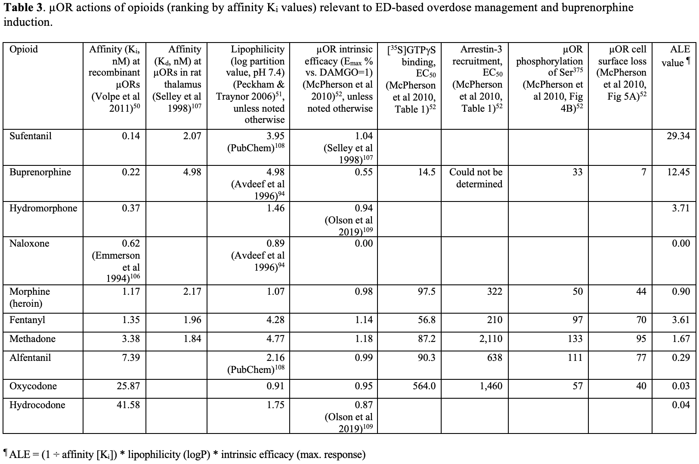
ALE values of different opioids
Greenwald MK, et al. (2022) A neuropharmacological model to explain buprenorphine induction challenges. Annal Emerg Med. 80(6): 509-524.

Slide 29
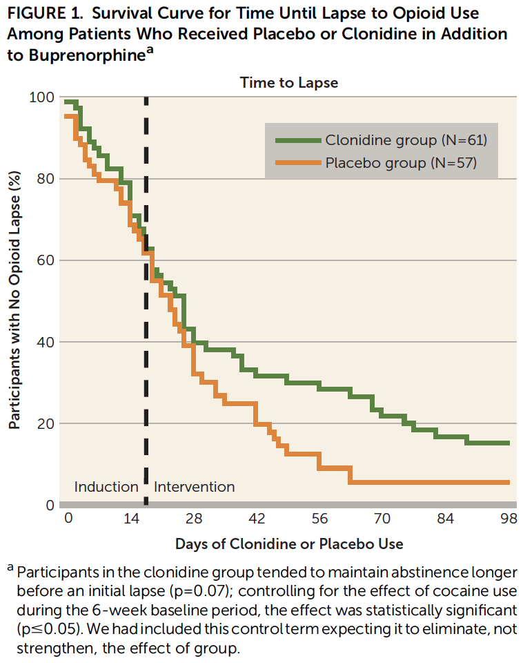
Can adjunctive treatments with BUP potentially increase abstinence?
Few controlled studies have tackled this issue and, to be clear, no such options are yet FDA approved for this purpose
One RCT found that, after controlling for cocaine use, adjunctive clonidine maintenance (target = 0.3 mg/day) during BUP treatment prolonged opioid abstinence relative to placebo clonidine
  Clonidine also helped to decouple stress from craving
While promising, further RCTs needed to determine whether this effect is robust, and to what extent adjunctive or non-pharmacological approaches (e.g. neuromodulation, CBT, CM, medication management) offer incremental efficacy improvement, especially in mitigating the role of stress-induced relapse
Kowalczyk WJ, et al. (2015) Clonidine maintenance prolongs opioid abstinence and decouples stress from craving in daily life: a randomized controlled trial with ecological momentary assessment. Am J Psychiatry 172: 760-767.

