Slide 1
Update on Guidelines for Prescribing Opioids for Chronic Pain
Joanna L. Starrels, MD, MS
Professor of Medicine and Psychiatry & Behavioral Health
Albert Einstein College of Medicine & Montefiore Medical Center
Bronx, NY
Notes:
I’m a general internist focused on pain and also an addiction medicine physician
Subheading: Where are we because if you’ve been a clinician over the past 10-20 years, the changes can be a little disorienting

Slide 2
Disclosures
Research support from NIH and FDA-mandated Opioid Post-marketing Requirement Consortium
Consulting fees from Venebio Group LLC and public health departments (NYC, DC)
Royalties from UpToDate.com
Presenter fees from SCOPE of Pain
Contributed to guidelines including CDC Guideline on Opioid Prescribing (2016), NYC guidance on opioid prescribing

Slide 3
Outline
Historical view
Take-home points
Evolving guidelines
Notes:
I grew up as a physician with this epidemic. Med school late 1990s taught that opioids don’t’ cause addiction in people with pain. My first research project as a fellow found that opioid overdose death was spreading to more rural and suburban areas because of POs. How leading opinions, guidance, and practice has evolved since then it the topic of this talk.

Slide 4
Epidemiology of opioid prescribing
Modified FSMB Model Policy (2013)
CDC Guideline (2016)
Federation of State Medical Boards (FSMB) Model Policy (1998)
CDC Guideline (2022)
VA/DoD Guideline (2022)
Source: IQVA Xponent, Mar 2020; IQVIA National Prescription Audi; IQVIA Institute, Nov 2020).
Notes:
These events are not necessarily drivers of prescribing; they exemplify the context of thought at the time; lots of expert opinion and not enough evidence to guide practice
In this talk, I’ll focus on the CDC’s Guidelines
Note: Universal Precautions (2005), APS/AAPM guidelines (2008), Washington state 120 dose limit (2012)

Slide 5
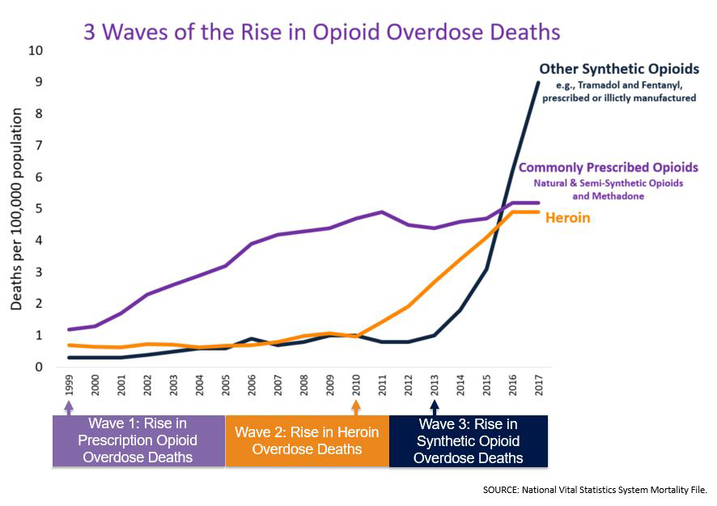
Opioid overdose death
Source: National Center for Health Statistics, National Vital Statistics System, Mortality
Notes:
We know that the high PO prescribing we saw in the previous slide was associated with the first wave of opioid overdose deaths, and continues to contribute. Thus, there certainly was and still is need to address how we prescribe – to reduce the harms associated w/ prescribing. However, at this point, we are not going to stop the overdose crisis by focusing on POs.
*We are not out of the woods yet. We still have to worry about opioid prescribing-reated deaths, and we also have to worry about opioid deprescribing related death”

Slide 6
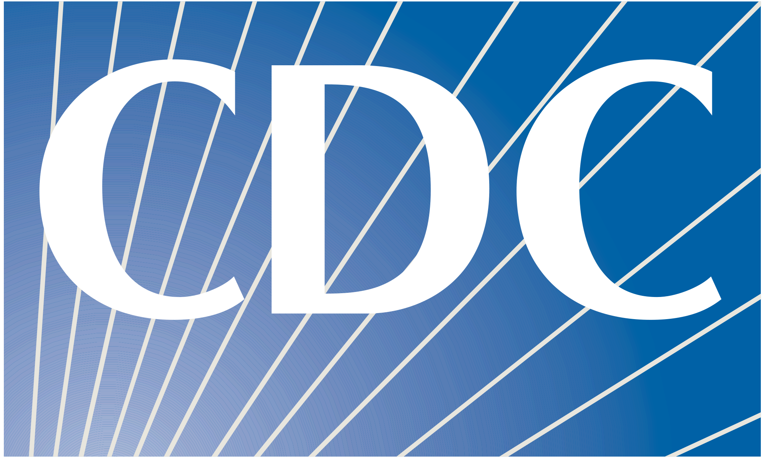
Clinical guidelines for opioid prescribing (2016)
When to prescribe opioids for chronic pain
  Non-pharmacologic and non-opioid therapies are preferred
  Establish functional treatment goals
  Discuss risks/benefits of opioids, and patient/provider responsibilities
How to prescribe opioids for chronic pain
  Start with immediate release (not long-acting) formulations
  Prescribe lowest effective opioid dose (avoid and justify >90 MME)
  For acute pain, not more than 3 to 7 days’ supply
  Regularly reassess; taper if pain and functional benefits do not outweigh risks
Assessing and mitigating harms
  Use the prescription drug monitoring program, urine drug testing, give naloxone
  Avoid concurrent benzodiazepine use when possible
  If OUD, provide or refer for OUD treatment
Notes:
In the early 2010s, there were a LOT of initatives to reduce over-prescribing – state policies, PDMPs, and the 2016 CDC guideline.
Not going to go through all of these, but highlight (non-opioids preferred, prescribed lowest effective dose, avoid and justify >90), acute pain 3-7days, taper if pain/benefits don’t exceed risks, avoid rx with benzos
Evidence strongest for the last one (OUD treatment,as we heard).

Slide 7
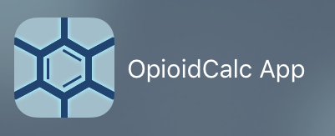
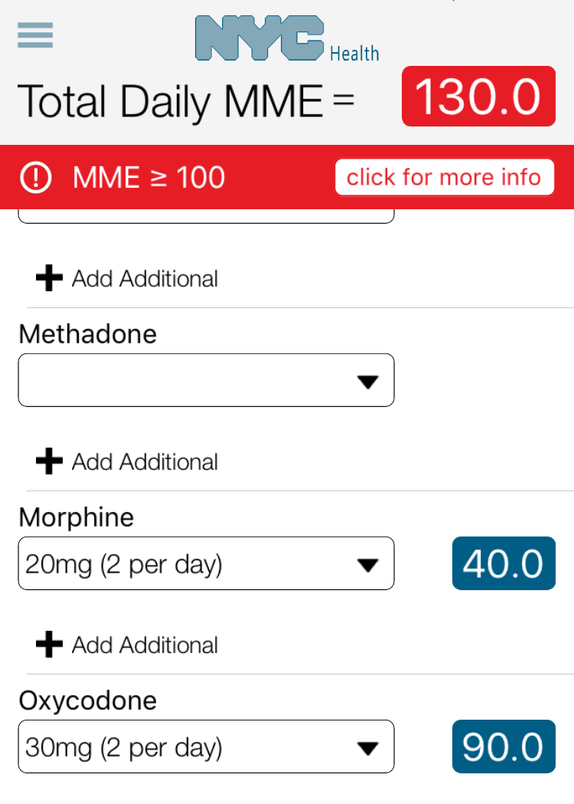
90 MME
MME = morphine milligram equivalents
  90 MME is ~65 mg oxycodone
CDC (2016): “Avoid” or “carefully justify” increasing to ≥90 MME/day
  Arbitrary threshold
  Did not say to taper all patients
to below 90 MME

Slide 8
No clear benefit to escalating opioid dose
No difference in chronic pain or function with increasing opioid dose
  RCT of stable dose (mean 40 MME) vs. liberal dose escalation¹
No improvement in chronic pain or function with opioids for chronic pain
  RCT of opioids vs. non-opioids for chronic back or OA pain²
¹Naliboff BD et al., J Pain (2011); ²Krebs EE et al., JAMA (2018)
Notes:
In Krebs’ SPACE trial, *pain” was actually worse in the opioid group vs. the nonopioid group over 12m
*add image of steps

Slide 9
Overdose death increases with opioid dose
Daily prescribed opioid dose (MME per day)
Bohnert AS et al., JAMA 2011
Notes:
Correlation is not causation – there were no RCTs

Slide 10
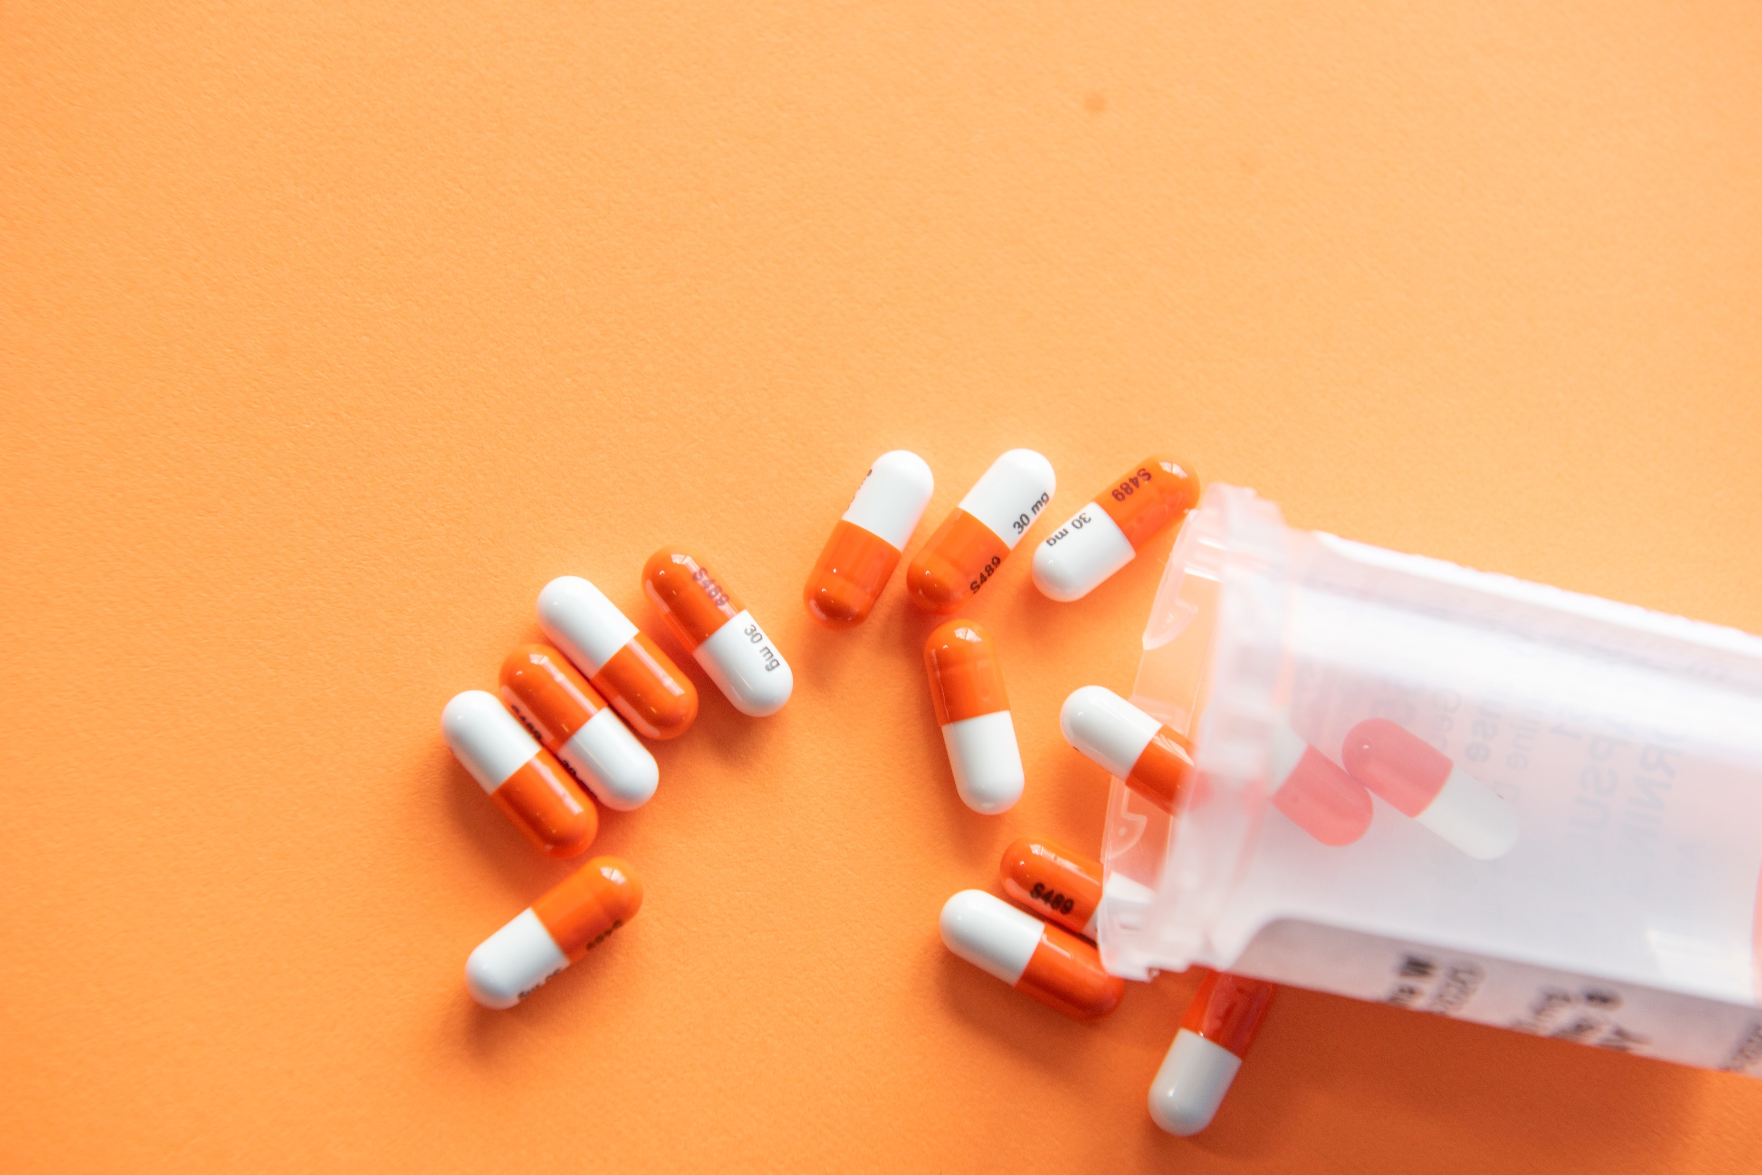
Benefits of tapering
67 studies, very low-quality evidence overall
Fair-quality evidence suggesting:
  Improvement in pain severity
  Improvement in function
  Improvement in quality of life
Limited ability to conclude effects on:
  Opioid withdrawal symptoms
  Substance use
  Adverse events
Most studies were in multimodal pain care programs
Frank J, 2017
Notes:
A more direct reason why opioid tapering cab be appropriate is…
In this atmosphere spurred on by increased interest in opioid tapering, the first systematic review of opioid tapering outcomes was produced in 2017. They concluded that the evidence base on opioid tapering outcomes was very low quality. They found fair quality evidence that suggested improvements in pain, function, and quality of life in patients who had tapered. One major limitation is most of the studies were in specific multimodal pain care programs, not in primary care offices.

Slide 11
What happened?
CDC Guideline (2016)
Source: IQVA Xponent, Mar 2020; IQVIA National Prescription Audi; IQVIA Institute, Nov 2020).
Notes:
These events are not necessarily drivers of prescribing; they exemplify the context of thought at the time; lots of expert opinion and not enough evidence to guide practice
In this talk, I’ll focus on the CDC’s Guidelines
Note: Universal Precautions (2005), APS/AAPM guidelines (2008), Washington state 120 dose limit (2012)

Slide 12

Providers turning patients away
43% of PCP clinics surveyed unwilling to prescribe to a new patient on long-term opioids
Why?
  Stigma of chronic pain or opioid use
  Fear of liability and regulatory burden
  Payor and pharmacy barriers
Lagisetty P et al. Assessing reasons for decreased primary care access. Pain (2021)
Notes:
Lagisetty “secret shopper” study conducted in 2019: called >450 PCP clinics in 9 states. This 43% was turning away all patients, regardless of situation (including prior provider retired).

Slide 13
Inequities in opioid prescribing and de-prescribing
Compared with white patients, Black patients are:
  Less likely to be prescribed opioids, and prescribed fewer or lower dose³
  More likely to have prescription opioids tapered¹
  More closely monitored, including more urine drug testing²
Similar and less pronounced trends for Latinx vs. white non-Hispanic
Compared with men, women are:
  Less likely to be prescribed opioids, and prescribed lower dose⁶
  More likely to have prescription opioids tapered⁵
Notably, Black and female patients have lower risk for prescription opioid death than white and male patients
¹Buonora M et al., Pain Medicine (2019); ²Becker WC et al., Ann Family Med (2011), Hausmann LR et al. Pain (2013); ³Pletcher MJ et al., JAMA (2008), Joynt M et al, JGIM (2013), Todd KH Ann Emerg Med (2000), Wisniewski AM et al., J Addict Med (2008), Morasco BJ et al., Pain (2010); ⁴ Hoffman KM et al., PNAS (2016); ⁵Buonora M et al., Pain Medicine (2019); ⁶Kaplovitch E, et al. PLoS One (2015), Wisniewski AM et al, J Addict Med (2008)

Slide 14
Harms of rapid taper or discontinuation
Opioid withdrawal
Exacerbation of pain
Psychological distress, suicidality, and death¹
Termination of chronic medical care²
Illicit opioid use³
Opioid-related hospitalization and ED visits⁴
Overdose and overdose death⁵
  Possible explanations: Decreased tolerance after tapering, non-prescribed opioids, suicidality, confusion about change in prescription
¹Demidenko MI et al., Genl Hosp Psych (2017), Oliva EM et al., BMJ (2020); ² Perez HE et al., JGIM (2019); ³ Binswanger IA et al., DAD (2020), Coffin PO et al., Plos One (2020); ⁴Mark TL et al., JSAT (2019); ⁵James JR et al., JGIM (2019), Glanz JM et al., JAMA Network Open (2019)
Notes:
Note these are real world, observational studies
Acute or protracted opioid withdrawal

Slide 15
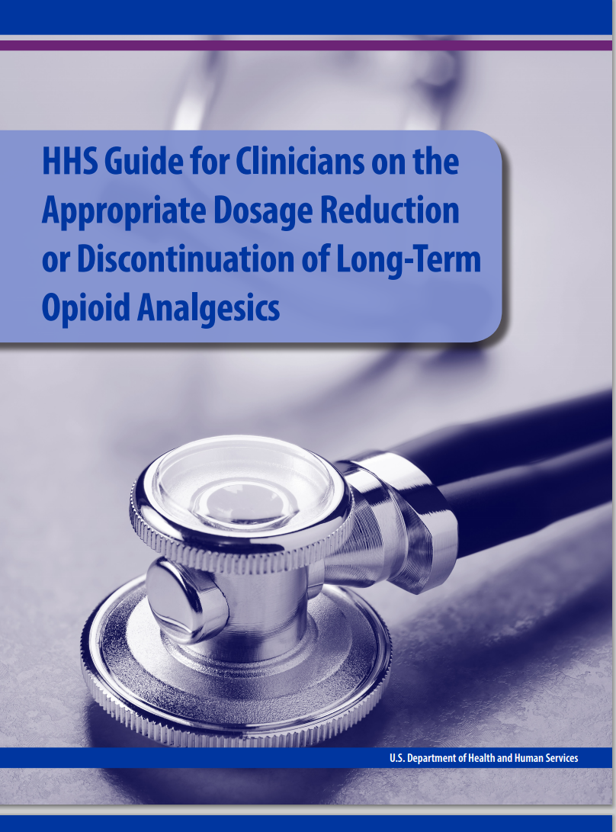
Reaction to overzealous opioid de-prescribing
U.S. Department of Health and Human Services Guideline (2019)
Opioids should not be tapered rapidly or discontinued suddenly
  Except if there is a life-threatening issue, such as impending overdose
CDC (2022)
“Misapplication [of the 2016 guideline] including inflexible application of recommended dosage and duration thresholds, contributed to patient harms…These experiences underlined the need for an updated guideline reinforcing the importance of flexible, individualized, patient-centered care.”
Dowell D et al. NEJM (2022), CDC website

Slide 16
Updated 2022 CDC guideline
My summary of key changes:
Less paternalistic, more collaborative
More room for individualized care rather than algorithmic (removed 90 MME threshold, 3-7 days for acute pain, less “avoid” language)
Emphasized provider responsibility to provide care
Loads of new guidance in “implementation considerations”
Clarified that the guideline is not for payors, health systems, or regulators to set rigid standards and they “should ensure that policies do not result in rapid tapers or abrupt discontinuation”
Dowell D et al. NEJM (2022), CDC website
Notes:
Overall, more nuanced. A lot of the headline content and reccs are concretely the same, but the language and tone is less prescriptive.
I suggest reading it, it’s actually quite comprehensive and helpful for non-opioid treatments

Slide 17
Some highlights of the revised CDC recommendations
New guidance on non-opioid treatments for acute, chronic, and sub-acute pain
  Acute: ice, heat, NSAIDS, triptans, etc. Chronic: PT, CBT, SNRIs, etc.
  Be intentional if transition from acute event to long-term treatment
Still, prescribe the lowest effective dose of opioids for chronic pain
  Avoid increasing dosage above levels likely to yield diminishing returns in benefits:risks
Regarding tapering: “If benefits do not exceed risks, work closely with patients to gradually taper or lower doses…”
  Follow up at least monthly, 10% per month or slower is likely to be better tolerated
  Need for taper if opioid treatment > a few days
Notes:
A LOT in there – strongly recommend reading it.
Acute pain -- new reccs for different painful conditions and special populations including pregnancy
Re doses that yield diminishing returns – 50MME mentioned – but clarified individualized

Slide 18


Operationalizing tapering “if benefits do not outweigh risks”
High risk
Adverse effects
Overdose
Risky use or misuse
High dose opioids or concurrent sedatives (e.g., benzodiazepines)
OUD -> switch to OUD treatment
Low benefit
Persistent or worsening pain
Poor function
Also consider:
Risks/benefits of tapering too
Patient (not only provider) perspectives
Benefit
Risk
New CDC Guideline: In situations where benefits and risks of continuing opioids are considering to be close or unclear, shared decision-making with patients is particularly important.”
Notes:
One aspect that is VERY prevalent in the new guideline that requires some thought to operationalize is B vs. R.
Possible explanations for overdose: Decreased tolerance after tapering, non-prescribed opioids, suicidality, confusion about change in prescription
At times, clinicians and patients might not be able to agree on whether or not tapering is necessary. When patients and clinicians are unable to arrive at a consensus on the assessment of benets and risks, clinicians should acknowledge this discordance, express empathy, and seek to implement treatment changes in a patient-centered manner while avoiding patient abandonment.
My favorite sentence in the new guideline:

Slide 19

Applying harm reduction principles to opioid prescribing and de-prescribing
Respecting the rights of people prescribed opioids
Acknowledging a spectrum of use and problems
Providing non-judgmental, low-threshold services
Meeting people where they are
Individualized care
No forced withdrawal
Shared decision-making
Slow taper
Sometimes benefits exceed risks
People may not be able to taper off
Do not refuse care
Patients have told us this is what they need.
Matthias M et al., J of Pain (2017); Ritchie CS et al., The Gerentologist (2020); Goesling J et al., Pain (2019); Dassieu L et al., Canadian J of Pain (2021); Perez HE et al., AMERSA abstract (2019); Henry S et al., J of Pain (2019).
Notes:
[[could remove if needed]]

Slide 20
Diagnosing OUD when opioids are prescribed
Diagnostic criteria
    1. Taking more or for longer than intended
    2. Unsuccessful efforts to stop or cut down
    3. Spending a great deal of time obtaining/using/recovering
    4. Craving
    5. Failure to fulfill major role obligations due to use
    6. Continued use despite resulting social or interpersonal problems
    7. Important activities reduced because of use
    8. Recurrent use in hazardous situations
    9. Continued use despite resulting physical or psychological problems
    10.Tolerance*
    11. Withdrawal symptoms*
Mild
Moderate
Severe
2-3
4-5
≥6
*Tolerance and withdrawal don’t contribute if taken under medical supervision
Notes:
DSM is written by the American Psychiatric Association
Re tolerance and withdrawal – source of confusion even among doctors – having these does not mean a person has addiction – need the negative consequences
[]JLS add something about CPOD/grey zone – more nuanced re diagnosing OUD. Sometimes it takes time

Slide 21
If your patient meets criteria for OUD
If moderate or severe OUD
  Connect them with evidence-based treatment with methadone or buprenorphine
If mild OUD
  Offer transition to buprenorphine (particularly if prior unsuccessful taper)
  Less evidence to guide treatment; may be reasonable to attempt taper
It is not always clear
  Ongoing assessment, additional criteria may emerge
  Even if no OUD but risks>benefits and unable to taper, may benefit from buprenorphine per CDC
Notes:
Mention proposed term of “complex persistent opioid dependence”

Slide 22
Veterans Affairs/Department of Defense Guideline (2022)
“Paradigm shift” in pain care towards more patient-centered, whole health approaches
Largely consistent with updated CDC recommendations with notable exceptions:
  Assess and address mental health in patients with chronic pain
    Depression, PTSD, traumatic brain injury
    Increased risk of suicidality after opioid tapering¹
  New recommendation #5: “For patients receiving daily opioids for the treatment of chronic pain, we suggest the use of buprenorphine instead of full agonist opioids due to lower risk of overdose and misuse.” [weak evidence for]
    Evidence is limited, but strong safety profile over other long-acting opioids
    Note that sublingual buprenorphine/naloxone is FDA-approved for OUD and is used off-label for pain management
¹Demidenko MI et al. Gen Hosp Psychiatry 2017.
Notes:
Reviewer: consider emphasizing the "weak for" = "suggest" rather than "We recommend"

Slide 23

Questions and considerations in expanding buprenorphine for chronic pain without OUD
Are we going too fast again?
  Will use of opioids for chronic pain expand because safer option?
  Not enough evidence to guide implementation
For opioid-naïve patients:
  Low-dose dose buccal or transdermal probably best
  In conflict with recommendation not to start with long-acting opioid
For opioid-tolerant patients:
  Remaining lack of clarity about when to switch, e.g. only if high risk/unsuccessful taper?
  More likely to need higher doses, such as sublingual bupe/naloxone, but this is off-label
  Many providers will need help with induction and dosing
Public health perspective: We still need to identify and track OUD
Cunningham C and Starrels JL. Guideline Promoting Buprenorphine for Treatment of Chronic Pain: Transformative Yet Underdeveloped. Annals of Int Med; 2023.
Notes:
Likely to expand beyond VA
Reviwer: Rec 5 is in the context of bup being an opioid and therefore is not recommended to start for chronic pain (rec 1)
Also Modules A has an algorithm for "determination of appropriateness for opioids for chronic pain"

Slide 24

Take-home points
The prescription opioid landscape and guidance continue to evolve
Apply harm reduction principles for opioid prescribing and deprescribing and consider each individual’s whole health
Be mindful of biases and equity in pain and opioid management
Buprenorphine is a safer alternative to full agonists and seems like the future, but questions remain
Stay tuned!

